Slide 1
With the forthcoming introduction of deemed consent in Wales in December 2015, is presumed (deemed) consent the future for organ donation in England?
Claudia Carr – University of Hertfordshire

Slide 2
The all important questions….
Will the introduction of presumed consent increase the number of organ donors, if so, it should be adopted in England.
If presumed consent is to be adopted in England, then can it be ethically justified?

Slide 3
Why change the status quo?
The demand for organs outweighs the supply.
21 million registered on the Organ Donor register.
Only 1% will die in circumstances that their organs can be used for transplantation.
Since 1.04.15, 171 people donated their organs on death, 432 patients have received transplants but 6890 patients remain on the transplant list.
3 patients die every day waiting for available organs.
The Human Transplantation (Wales) Act 2013 introduces soft oft out system of organ donation or deemed (presumed) consent from December 2015 with a view to increasing organ donation in Wales by 25-30%.

Slide 4
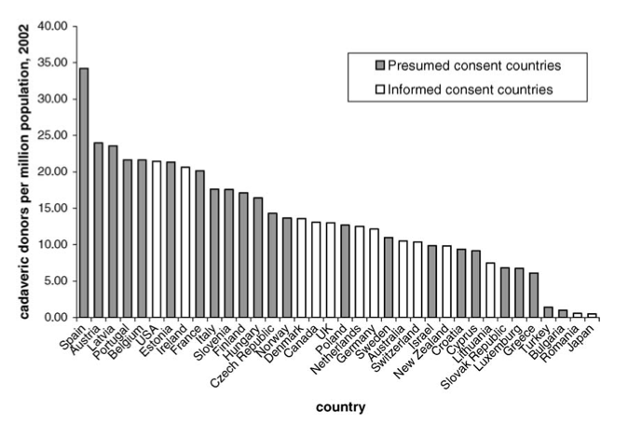
Source – Abadie and Gay
The impact of presumed consent on cadaveric organ donation: A cross country study, Journal of Health Economics 25 (2006)

Slide 5
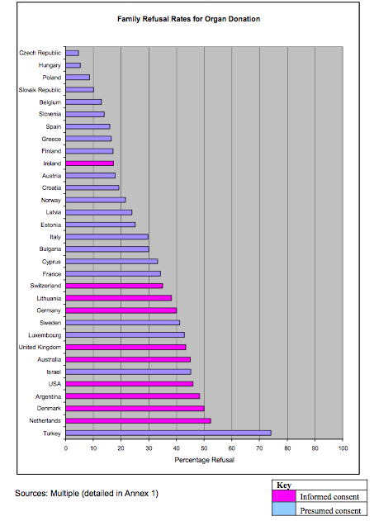
Source: The role of families in organ donation: International evidence review 2012

Slide 6
Ethical issues
Altruism is not lost by presumed or deemed consent.
Presumed consent may encourage altruism.
Argued that presumed consent is no consent.
Argued contrary to the principle of a patient’s autonomy.
Is it ethically acceptable to remove organs from a patient who has neither consented nor opted out but whose organs may save the lives of others?
Utilitarian and communitarian approach.
No legal interest in our bodies once we die although our bodies till define who we are.
Presumption that the majority of people wish to do the ‘right thing’.

