Slide 1
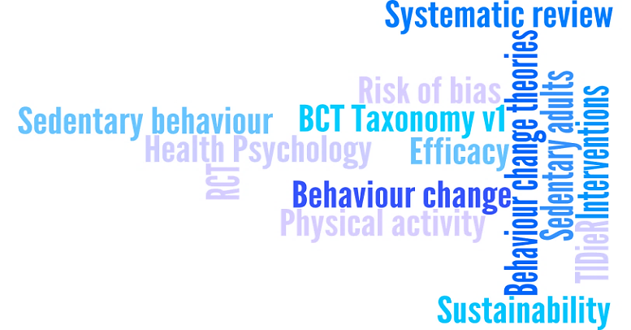
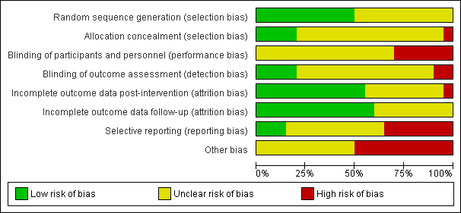
What are the most effective behaviour change techniques to promote physical activity and/or reduce sedentary behaviour
in inactive adults? A systematic review
¹Howlett, N., ²Trivedi, D., ¹Troop, N., & ³Chater A.
¹Department of Psychology and Sport Sciences, School of Life and Medical Sciences, University of Hertfordshire, UK; ²Centre for Research in Primary and Community Care, School of Health and Social Work, University of Hertfordshire, UK; ³School of Pharmacy, Centre for Behavioural Medicine, Department of Practice and Policy, University College London, UK
Introduction
Physical activity (PA) has a beneficial effect on the risk factors associated with cardiovascular disease (CVD), type 2 diabetes, and cancer (Baumann, 2004). However, only 67% of men and 55% of women in England report participating in the recommended levels (HSCIC, 2014). Sedentary behaviour (SB) is an independent risk factor related to all-cause mortality (Chau et al., 2013). Despite this, sedentary activities comprise 52-67% of daily behaviour in US adults (CDC, 2015).
There have been a range of systematic reviews in this area but they have included non-randomised designs (Wilcox, Parra-Medina, Thompson-Robinson, & Will, 2001), both inactive and active populations (Martin et al., 2015), or did not analyse behaviour change techniques (BCTs) (Pavey et al., 2011). Even those that have included randomised controlled trials (RCT) have not analysed BCTs (Orrow, Kinmonth, Sanderson, & Sutton, 2012) or included non-RCTs (Greaves et al., 2011). Reviews have also included heterogeneous samples (e.g. diabetes and cancer patients). Therefore, only inactive participants not suffering from serious conditions are included in this review.
Another problem is imprecise BCT descriptions and vague descriptions of key intervention details such as materials, providers, or fidelity. Two methodological aids have made this a more robust process. Firstly, the BCT taxonomy v1 is a 93 item list which allows interventions to be systematically described, reviewed, and replicated (Michie et al., 2013). Secondly, the ‘Template for Intervention Description and Replication’ (TIDieR; Hoffman et al., 2014) - a 12 item checklist detailing how to report the why, what, who, and where of intervention delivery. This review will code interventions using the BCT taxonomy v1 and the TIDieR checklist. The aim of this systematic review is to answer:
What are the most effective BCTs in RCTs to increase PA or reduce SB in inactive adults?
Which intervention features are associated with intervention effectiveness?
Risk of bias: Two reviewers independently assessed the methodological quality of the studies using the Cochrane tool for assessing risk of bias (Higgins et al., 2011).
Data Synthesis: We are in the process of conducting a meta-analysis to calculate pooled effect sizes across studies for physical activity and sedentary behaviour. Meta-regression will also investigate differences in effectiveness according to number and type of BCTs (Martin, Chater, & Lorencatto, 2013).
Subgroups and Sensitivity Analysis: Analysis by subgroups will include the following: type of PA measurement (objective vs subjective); theoretical basis; targeting single versus multiple health behaviours. Sensitivity analysis will determine the effects of studies with a high risk of bias on the overall results.
Confidence in Cumulative Evidence: The quality of evidence for primary outcomes is being assessed using the Grading of Recommendations Assessment, Development and Evaluation guidelines which includes the following domains: design; study limitations; consistency; directness; precision and publication bias.
Figure 1 presents the PRISMA diagram of literature search results.
Figure 1. PRISMA diagram of literature search results.
14927 records identified through database searching
4305 duplicates removed
10622 records screened
10413 records excluded by title and abstract
209 full-text articles assessed for eligibility
189 full-text articles excluded:
Active participants: n = 49
Did not have 6 month follow-up: n = 70
Ongoing studies: n = 10
Not an RCT: n = 15
Duplicate study: n = 20
Unhealthy participants: n = 13
Insufficient information: n = 13
18 studies remaining
20 studies included in the narrative synthesis
2 additional records identified through published SRs
14 of the 20 studies were included in the quantitative synthesis (meta-analysis)
Methods and Analysis
Eligibility criteria: Study characteristics: Published and unpublished interventions from January 1990 to December 2014, in English language only. Participants: Inactive adult participants without a serious/chronic condition. Intervention: RCTs of interventions that aim to increase PA and/or reduce SB, and include a BCT. Comparator or control: Any passive or active control group. Outcome measures: A primary outcome must be PA or SB assessed at baseline, post intervention, and six month follow-up.
Information Sources: PubMed; Scopus; CINAHL; Applied Social Sciences Index (ASSIA); PsycINFO; Web of Science; SPORTDiscus; EMBASE; Cochrane Central Register of Controlled Trials (CENTRAL); British Nursing Index (BNI); Health Technology Assessment (HTA) database; the Database of Abstracts of Reviews of Effects (DARE); the Cochrane systematic review database; National Institute of Health Research (NIHR) portfolio; the current controlled trials register; the System for Information on Grey Literature (SIGLE); published SRs. Experts (e.g. CHAIN, EHPS, DHP) were also asked for relevant studies.
Search Strategy: Searches included a combination of terms from medical subject headings (MeSH) and keywords in the title, abstract or text. Howlett, Trivedi, Troop, and Chater (2015) contains full terms.
Selection Process: One reviewer screened records by title and abstract for all eligibility criteria. A second reviewer then screened a random 10%. Full text versions of all potentially relevant studies were then reviewed independently by two reviewers.
Data Extraction: Data from the final 20 studies was extracted into a data extraction form independently by two authors using the following categories: General (e.g. type of publication); Study characteristics (e.g. inclusion criteria); Participants (e.g. baseline characteristics); Intervention features (e.g. intervention setting); Measurement description (e.g. unit of measurement, follow-up length).
Outcomes: The primary outcomes were PA and SB. PA outcomes included pedometer steps, accelerometer data, cardiorespiratory fitness, self-report walking, moderate and/or vigorous activity. SB outcomes included sedentary time using accelerometers and self-reported sitting.
Preliminary Results
Data was extracted and risk of bias was coded for all 20 studies – a brief summary is provided below:
Mean age of participants: 50.39 for intervention participants and 50.49 for control participants
Sex of participants: 78% female in the intervention and 77% control conditions.
Sample sizes: 126 participants for intervention (2526 total) and 144 for control conditions (2884 total)
Mean BMI of participants: 28.65 for the intervention conditions and 28.49 for the control conditions.
Mean duration of intervention: 21 weeks, with a range from 7 to 52 weeks.
Mean duration of follow-up: 43 weeks, with a range from 24 to 121 weeks post-intervention.
Mean attrition rates at follow-up: 30.73% in the intervention and 28.58% in the control conditions.
Behaviours targeted: PA only (16), PA and SB (2), PA and diet (1), PA, diet and smoking (1).
The risk of bias coding showed that many of the
studies did not provide sufficient information
represented by yellow bars. Random sequence
generation and incomplete outcome data (post and follow-up) showed the lowest risk of bias. Blinding of participants, selective reporting, and ‘other’ showed the highest risk of bias.
Figure 2. Risk of bias summary
Discussion
Inactive populations are a key intervention target as they are at risk of a host of negative health outcomes. To date, no review of PA or SB interventions has focused exclusively on inactive populations in RCTs, coded BCTs using the most recent BCT taxonomy v1 or TIDieR guidelines. It is important to assess the effectiveness of previous interventions, and to inform future interventions for people with inactive lifestyles before they develop chronic conditions that place such a large burden on individuals and society in terms of personal, social, and economic costs. This review also represents preliminary work for the development and evaluation of a future complex intervention, consistent with the guidelines from the Medical Research Council (Craig, Dieppe, Macintyre, Michie, Nazareth, & Petticrew, 2008).

Slide 2
What are the most effective behaviour change techniques to promote physical activity and/or reduce sedentary behaviour
in inactive adults? A systematic review
¹Howlett, N., ²Trivedi, D., ¹Troop, N., & ³Chater A.
¹Department of Psychology and Sport Sciences, School of Life and Medical Sciences, University of Hertfordshire, UK; ²Centre for Research in Primary and Community Care, School of Health and Social Work, University of Hertfordshire, UK; ³School of Pharmacy, Centre for Behavioural Medicine, Department of Practice and Policy, University College London, UK
For more information about this review please download the full published protocol from BMJ Open:
Howlett, N., Trivedi, D., Troop, N., & Chater, A. (2015). What are the most effective behaviour change techniques to promote physical activity and/or reduce sedentary behaviour in active adults? A systematic review protocol. BMJ Open, 5, e008573. doi:10.1136/bmjopen-2015-008573
Or contact the first author:
Neil Howlett
Research Fellow
Department of Psychology and Sport Sciences
School of Life and Medical Sciences
University of Hertfordshire
Email: n.howlett@herts.ac.uk
Tel: 01707 28 5971
Twitter: @neil_howlett
References
Baumann, A. E. (2004). Updating the evidence that physical activity is good for health: an epidemiological review 2000-2003. Journal of Science and Medicine in Sport, 7, 6-19. doi:10.1016/S1440-2440(04)80273-1.
Chau J. Y., Grunseit, A. C., Chey, T., Stamatakis, E., Brown, W. J., Matthews, C. E., . . . van der Ploeg, H. P. (2013). Daily sitting time and all-cause mortality: a meta-analysis. PLoS One, 8, e80000. doi:10.1371/journal.pone.0080000
Centre for Disease Control and Prevention. Retrieved from http://www.cdc.gov/physicalactivity/data/facts.html.
Craig, P., Dieppe, P., Macintyre S, Michie, S., Nazareth, I., & Petticrew, M. (2008). Developing and evaluating complex interventions: the new Medical Research Council guidance. BMJ, 337, a1655. doi: http://dx.doi.org/10.1136/bmj.a1655
Greaves, C., Sheppard, K. E., Abraham, C., Hardeman, W., Roden, M., Evan, P. H., Schwarz, P. (2011). The Image Study Group. Systematic review of reviews of intervention components associated with increased effectiveness in dietary and physical activity interventions. BMC Public Health, 11(1), 119. doi:10.1186/1471-2458-11-119
Health and Social Care Information Centre. Statistics on Obesity, Physical Activity and Diet: England 2014.
Higgins, J. P. T., Altman, D. G., Gøtzsche, P. C., Jüni, P., Moher, D., Oxman, A. D., . . . Sterne, J. A. C. (2011). The Cochrane Collaboration’s tool for assessing risk of bias in randomised trials. BMJ, 343, d5928. doi: http://dx.doi.org/10.1136/bmj.d5928
Hoffman, T. C., Glasziou P. P., Boutron, I., Milne, R., Perera, R., Moher, D., . . . Chan, A. (2014). Better reporting of interventions: template for intervention description and replication (TIDieR) checklist and guide. BMJ, 348, g1687. doi: 10.1136/bmj.g1687
Howlett, N., Trivedi, D., Troop, N., & Chater, A. (2015). What are the most effective behaviour change techniques to promote physical activity and/or reduce sedentary behaviour in active adults? A systematic review protocol. BMJ Open, 5, e008573. doi:10.1136/bmjopen-2015-008573
Martin, J., Chater, A., & Lorencatto, F. (2013). Effective behaviour change techniques in the prevention and management of childhood obesity. International Journal of Obesity, 37, 1287-1294. doi:10.1038/ijo.2013.107
Martin, A., Fitzsimmons, C., Jepson, R., Saunders, D. H., van der Ploeg, H. P., Teixeira, P. J., . . . Mutrie, N. (2015). Interventions with potentiial to reduce sedentary time in adults: systematic review and meta-analysis. British Journal of Sports Medicine, 0, 1-10. doi:10.1136/bjsports-2014-094524
Michie, S., Richardson, M., Johnston, M., Abraham, C., Francis, J., Hardeman, W., . . . Wood, C. E. (2013). The behavior change technique taxonomy (v1) of 93 hierarchically clustered techniques: building an international consensus for the reporting of behavior change interventions. Annuals of Behavioral Medicine, 46, 81-95. DOI 10.1007/s12160-013-9486-6
Orrow, G., Kinmonth, A. L., Sanderson, S., & Sutton, S. (2012). Effectiveness of physical activity promotion based in primary care: systematic review and meta-analysis of randomised controlled trials. BMJ, 344, e1389. doi: 10.1136/bmj.e1389
Pavey, T. G., Taylor, A. H., Fox, K. R., Hillsdon, M., Anokye, N., Campbell, J. L., . . . Taylor, R. S. (2011). Effect of exercise referral schemes in primary care on physical activity and improving health outcomes: systematic review and meta-analysis. BMJ, 343, d6462. doi: 10.1136/bmj.d6462
Wilcox, S., Parra-Medina, D., Thompson-Robinson, M., & Will, J. (2001). Nutrition and physical activity interventions to reduce cardiovascular disease risk in health care settings: a quantitative review with a focus on women. Nutrition Reviews, 59, 197–214. DOI: http://dx.doi.org/10.1111/j.1753-4887.2001.tb07012.x

