Slide 1


Biosensors for healthy oceans
EnviGuard - Biosensor technology for environmental monitoring and disease prevention in aquaculture.
Dr Ian Johnston
University of Hertfordshire, UK

Slide 2

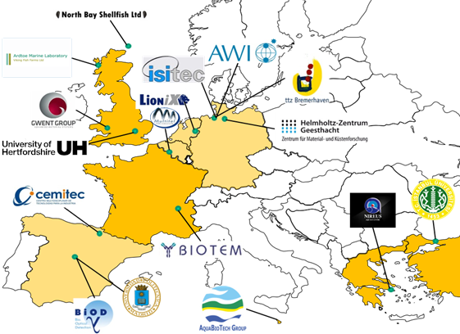
Development of a biosensor technology for environmental monitoring and disease prevention in aquaculture, ensuring food safety.
EnviGuard’s main outcome will be an early warning system for aquaculture enterprises and an environmental monitoring tool to assess the status of the sea.
EnviGuard technology will significantly contribute to a sustainable thriving maritime economy, one of the EU’s integrated maritime policy’s objectives, and thus, maximize the impact of research and innovation on European society and economy.
18 partners
9 countries
11 SMEs
7 RTDs
5 Years
7.2 M€

Slide 3
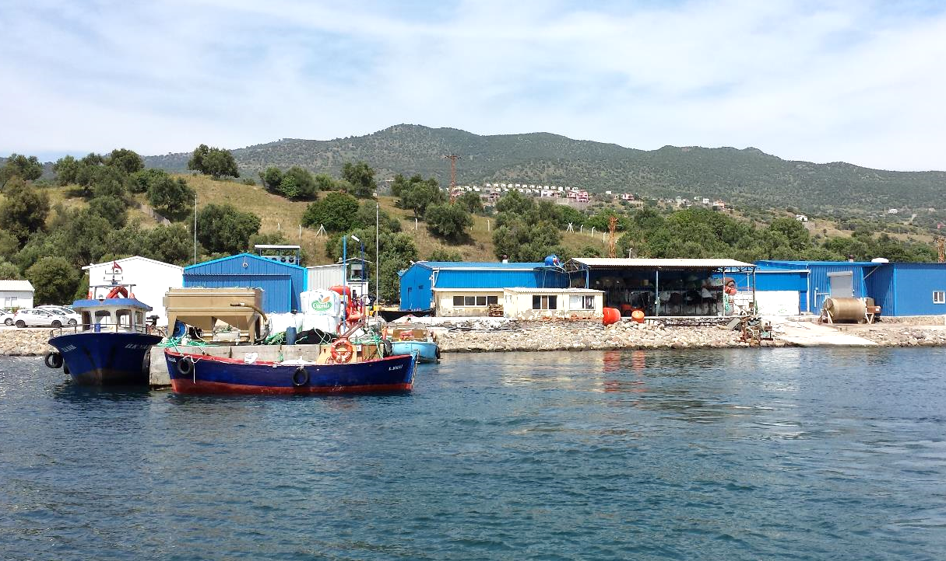
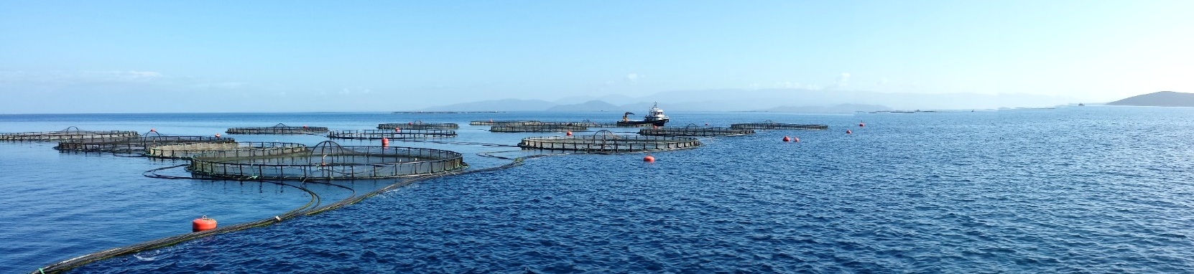
Main objectives:
Highly specific, precise and reliable measurements of biohazards and chemical contaminants in seawater with real-time results.
Multi-class, multi-analytic method for simultaneous determination.
A modular system integrated into a single, durable device.
Automatic sampling under multi-stressor conditions in the marine environment.
Easy access to data through internet
database.
Easy, fast and cheap way to measure
harmful substances in-situ.
Shellfish Farms & Hatcheries
Offshore fish farms

Slide 4




EnviGuard’s integrated modular approach utilises 3 independent bio-sensing technologies in a single, durable device. Providing an easier, faster and cheaper way to measure harmful substances in-situ in real-time.
By combining innovations in nanotechnology and molecular science EnviGuard is developing the future state-of-the art in terms of accuracy, reliability and simplicity in operation. Putting European research and highly innovative SMEs at the forefront of rapidly developing markets.
  3 independent biosensors:
  Algal - A quantitative nucleic acid based detection sensor for relevant toxic algae in EU waters.
  Chemical - An anti-body based optical nano-biosensing unit for the detection of chemicals & toxins.
  Bacterial and Viral – An microfluidic aptamer-based fluorescence detection system to specifically detect pathogens.
Connected to one common interface; the EnviGuard Port, which provides the samples, pre-treatment, power, data processing and distribution.

Slide 5
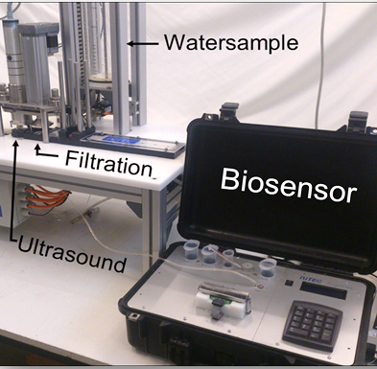
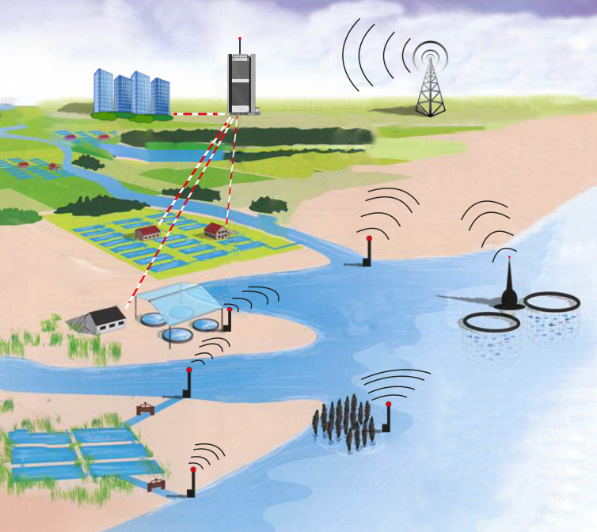
Typical sensing locations and remote data management.
Working prototype of the Algal bio-sensing system.
Working prototype of the Bacterial and Viral bio-sensor system.
Source: Fischerei und Aquakultur in Europa, Nr. 56 Juni 2012, European Union 2012 / modified.

Slide 6

Thank you.
This project has received funding from the European Union’s Seventh Framework Programme for research, technological development and demonstration under grant agreement no 614057.

