Slide 1
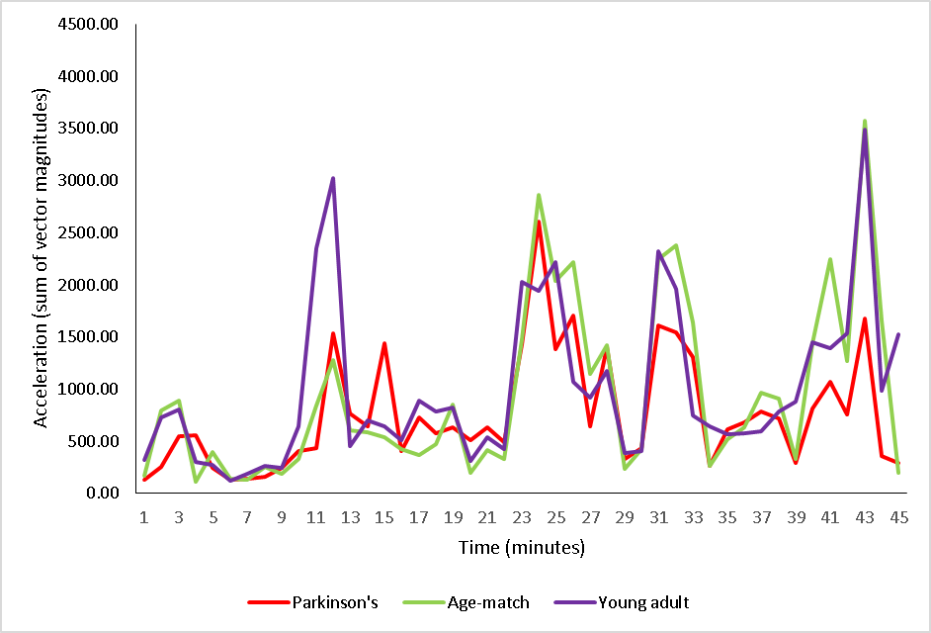
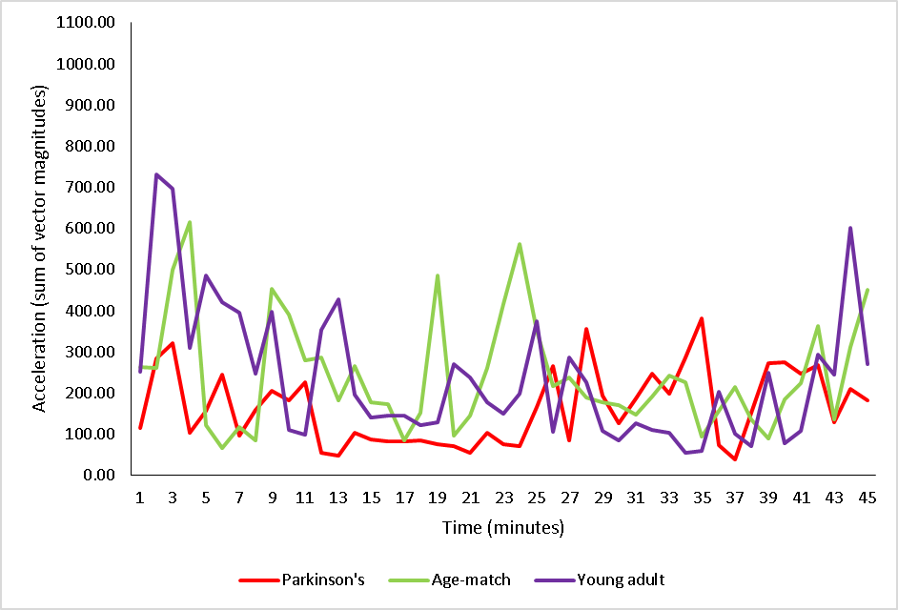
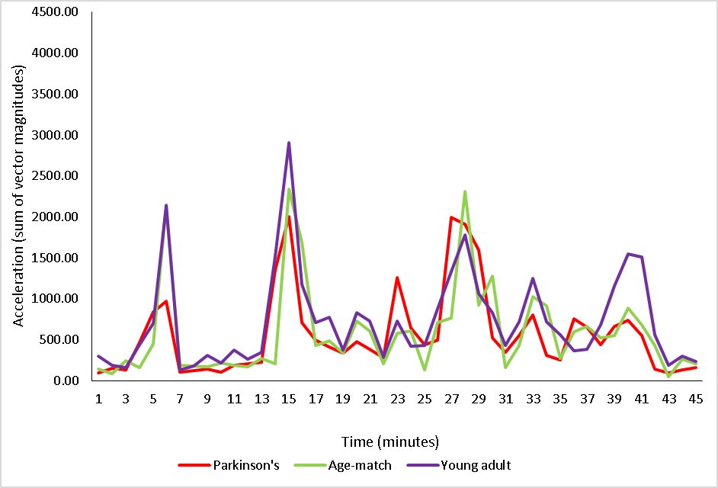
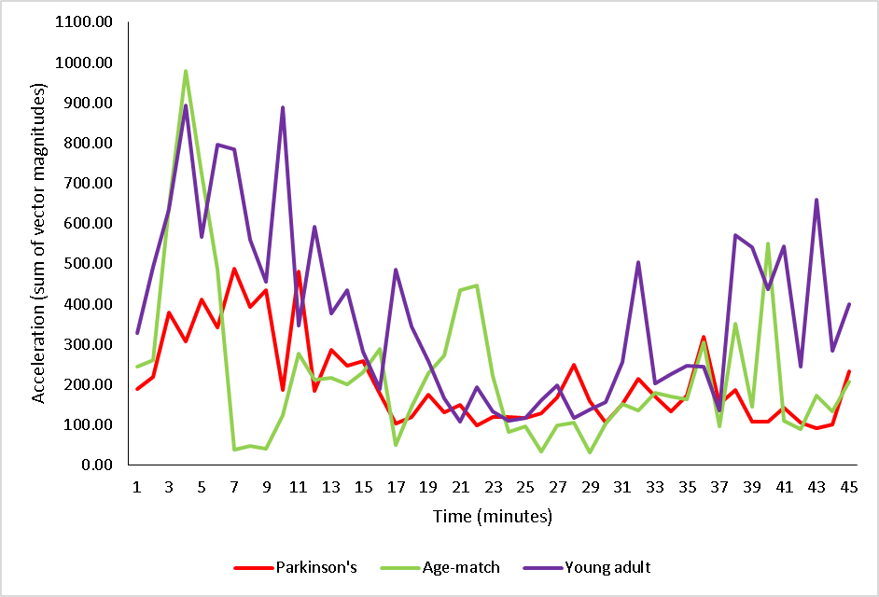
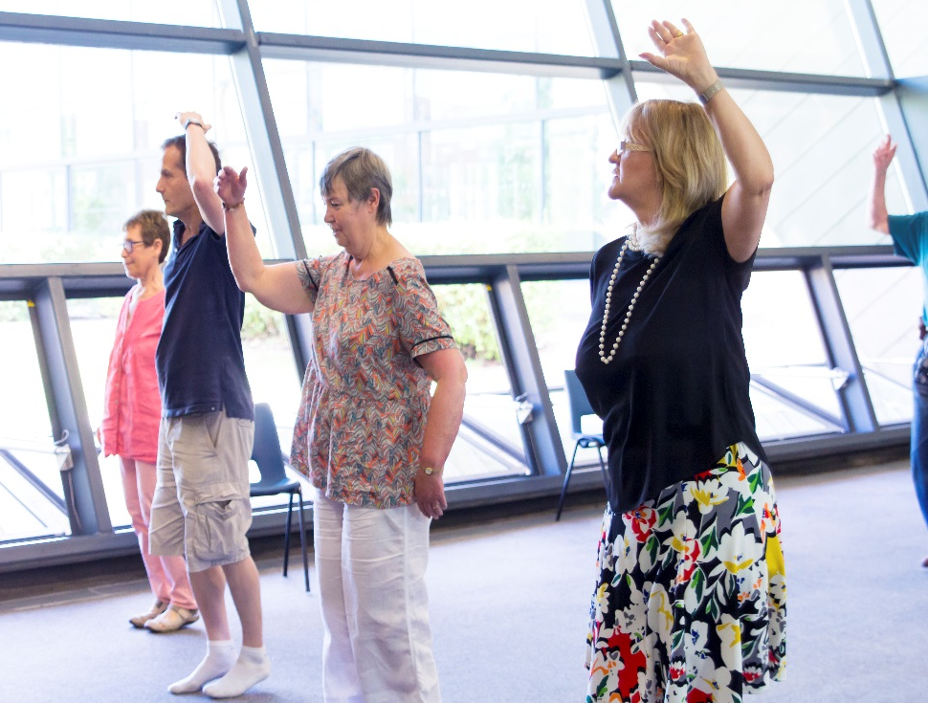
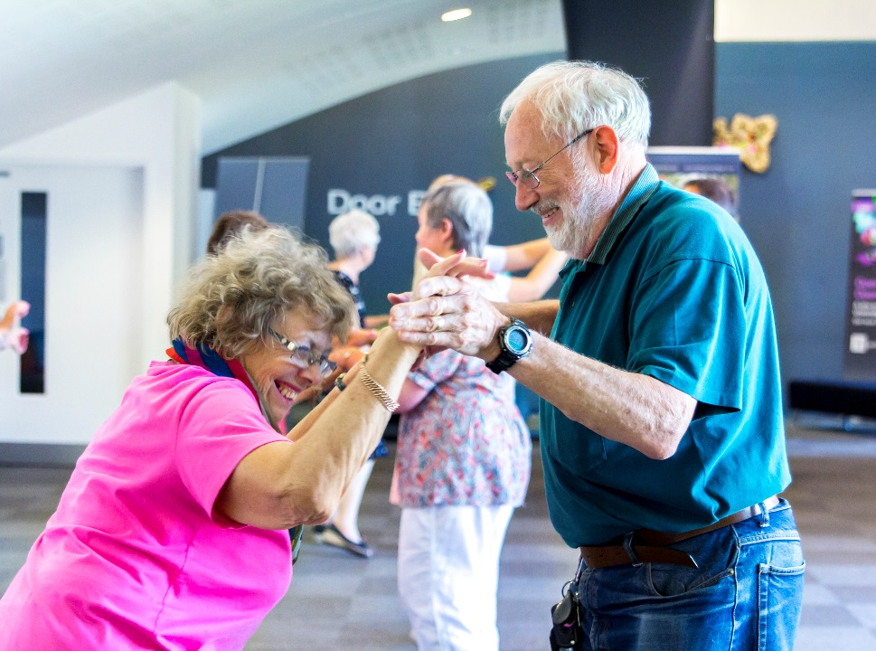
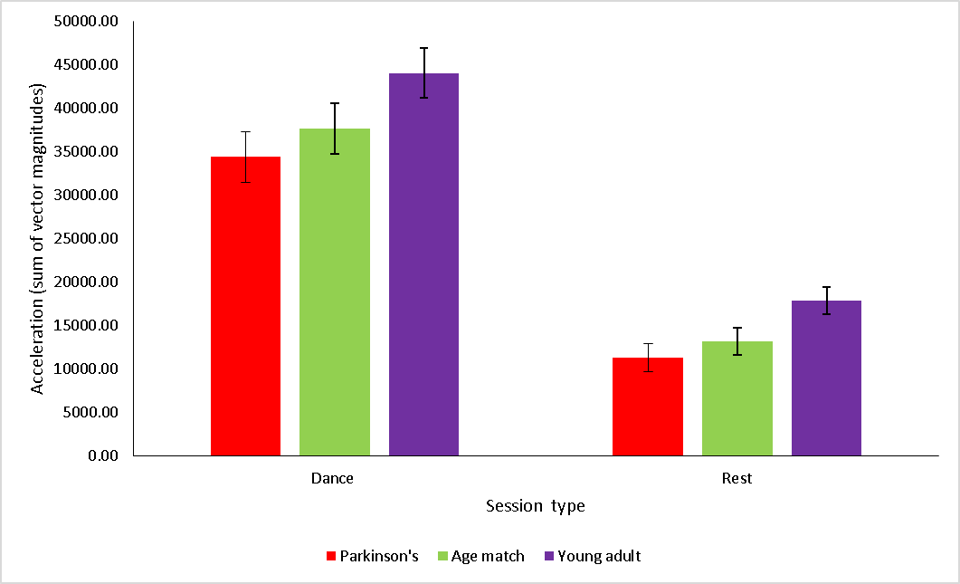
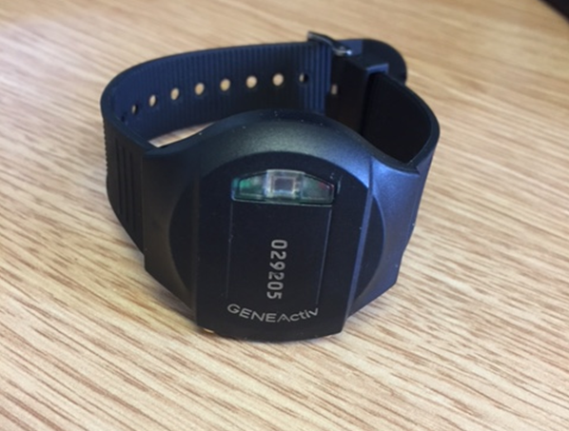
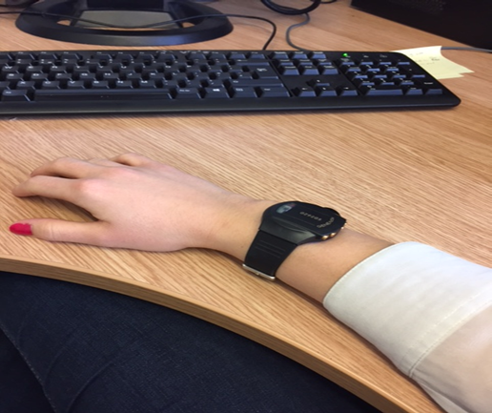
Wrist-worn accelerometer measures of movement by people with Parkinson’s attending dance classes at the University of Hertfordshire.
Rebecca Hadley, Dr Lucy Annett, Dr Peter Lovatt.
Department of Psychology and Sport Sciences, School of Life and Medical Sciences, University of Hertfordshire, UK.
Introduction
Evidence suggests that various forms of physical activity can be beneficial, both physically and psychologically, for people with Parkinson’s disease (PD).
Dance classes are useful way for people with PD to incorporate exercise in to their weekly routine and has been found to lead to improvements in quality of life and functional mobility and reductions in mood disturbance (Lewis, Annett, Davenport, Hall & Lovatt, 2014; Shanahan, Morris, Ni Bhriain, Saunders, Clifford, 2015).
However, it is unclear what level of intensity is required for dance to be beneficial, or indeed whether the amount of activity is crucial as opposed to psychological and social aspects of attending dance classes.
The use of a wrist worn accelerometer can provide an objective, yet non-invasive, way of quantifying physical exercise (Eslinger, Rowlands, Hurst, Catt, Murray & Eston, 2011).
Research to date has focused on using accelerometers to measure/classify specific movements , such as tremor, over a short period of time.
There is little research using accelerometers to quantify movement by people with PD in the longer term as they dance and in the following hours and days.
The present study aims to use wrist-worn accelerometers to quantify activity by people with PD as they dance and for the following rest hour, compared with age-matched controls and younger persons without PD attending the same dance class.
Results
Feedback from participants was positive about wearing the accelerometers, indicating the feasibility of using this device to measure activity during dance classes. Data across the time bins showed the accelerometers accurately tracked movements given the close correspondence between the vector magnitudes for the 3 individuals attending the same dance class. An example of the data from one triad is shown in fig. 3A and from a different triad (attending a different dance class) in fig. 3B. Similarly the acceleration data from two different triads for the rest period is displayed in fig. 4A and 4B.
Fig. 3A Dance
Fig. 4A Rest period
Fig. 3B Dance
Fig.4B Rest period
Fig. 1
Fig. 3A and 3B: Acceleration during a dance class made by a participant triad (one participant with PD, one age-match control and one younger adult without PD), displayed separately for two different triads (A and B) participating in different dance classes.
Figure 4A and 4B: Acceleration during a rest session made by a participant triad (PD, age-match and young adult without PD), displayed separately for two different triads (A and B) participating in different rest sessions.
Method
People with PD who regularly attend a dance class at the University of Hertfordshire wore an accelerometer on their wrist as they took part in the hour class and the following hour whilst relaxing with refreshments (see fig.1).
Participants were not asked to do anything specific other than take part in the dance class as usual.
In addition to people with PD, their carer/partner and a younger volunteer attending the same dance class also wore an accelerometer during the same two hour period, thus providing matched data from both younger and older non-PD controls. Participants were grouped in triads such that one person with PD, one age-matched control and one younger adult all attended the same dance class and rest session.
The GENEActiv accelerometers (Activinsights) are light-weight (16g), waterproof devices that measure acceleration in three different axes . The devices were set to record at 100 hertz in 60 second time bins, over a two hour time period.
In addition to the vector magnitudes displayed per 60 sec time bin (figs 3 and 4), the vector magnitudes were also summed across the 45 minutes of the dance class (excluding the warm up period), and summed separately for the 45 minute refreshment period, to give a measure of the overall activity for each participant (PD, age-match and younger adult) during the dance class and during the following rest period.
Fig. 5: Mean total acceleration made by participants (N=11 per group) during the dance and rest sessions.
A two-way mixed ANOVA was conducted on the total acceleration during both sessions (dance vs rest; within subjects) for each participant group (Parkinson’s vs age matched control vs younger adult; between subjects). The main effect of session was found to be significant showing that participants’ acceleration was greater during the dance class (mean= 38712) than during the rest session (mean= 14138; F= (1,30)= 335.86, p<.001. The main effect of participant group was found to be significant; F= (2,30)= 4.21, p<.05. Bonferroni corrected post-hoc tests showed that the acceleration of young adults (mean= 30965) was significantly higher than the acceleration of the people with Parkinson’s (mean= 22868, p<.05) but did not differ significantly from the age-matched controls (p=.19). The acceleration of people with Parkinson’s and age-matched controls did not significantly differ (p= 1.00). There was no significant interaction between session and participant group.
Fig. 2
Conclusion and Future Directions
It is feasible to measure the amount of movement made by people with PD as they take part in a dance class. This will allow future studies to compare the movement during a dance class with the movement involved in other types of activities to determine whether the amount of movement is the key factor for any benefits.
The next stage of the research, currently ongoing, investigates the feasibility of people with PD wearing the accelerometer over a week while continuing with their normal regime. Participants are asked to wear an accelerometer for 7 consecutive days following participation in a dance class. This data will provide information on the activity levels of participants in the hours and days following the dance class.
References
Esliger, D. W., Rowlands, A. V., Hurst, T. L., Catt, M., Murray, P., & Eston, R. G. (2011). Validation of the GENEA Accelerometer. Medicine & Science in Sports & Exercise. 43(6):1085-1093. doi: 10.1249/MSS.0b013e31820513be
Lewis C, Annett LE, Davenport S, Hall AA, Lovatt P.(2014). Mood changes following social dance sessions in people with Parkinson’s disease. Journal of Health Psychology. doi: 10.1177/1359105314529681.
Shanahan, J., Morris, M. E., Bhriain, O. N., Saunders, J., & Clifford, A. M. (2015). Dance for people with Parkinson disease: what is the evidence telling us? Archives of physical medicine and rehabilitation, 96(1), 141-153. doi: 10.1016/j.apmr.2014.08.017

