Slide 1
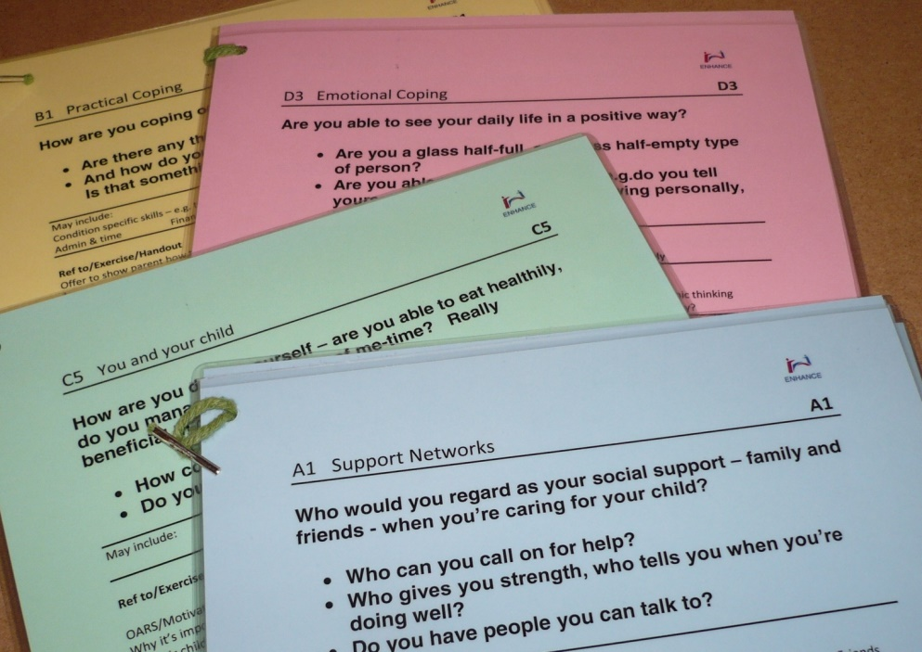
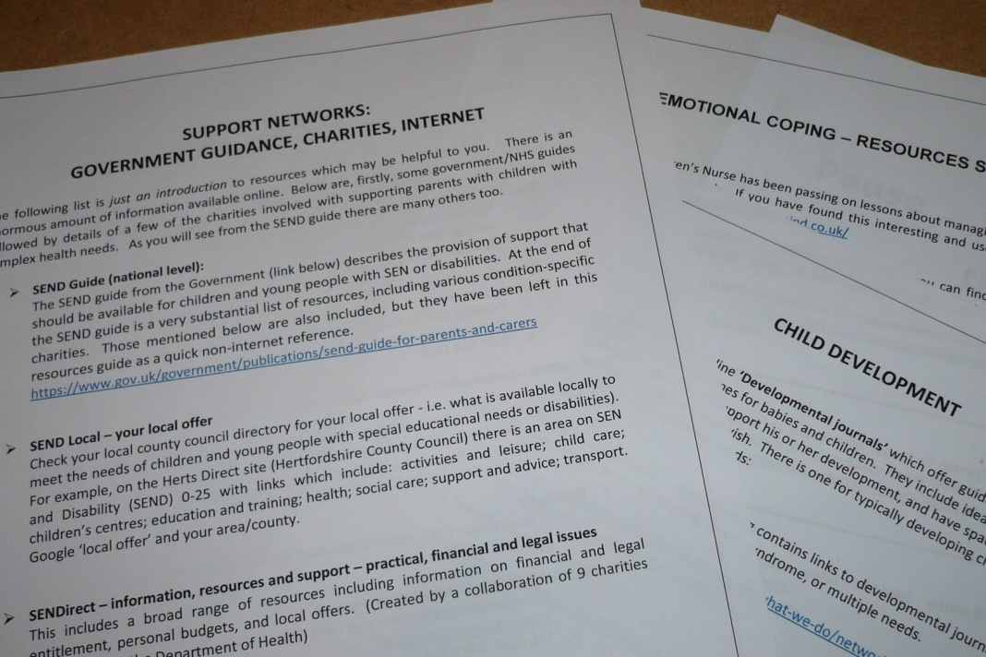
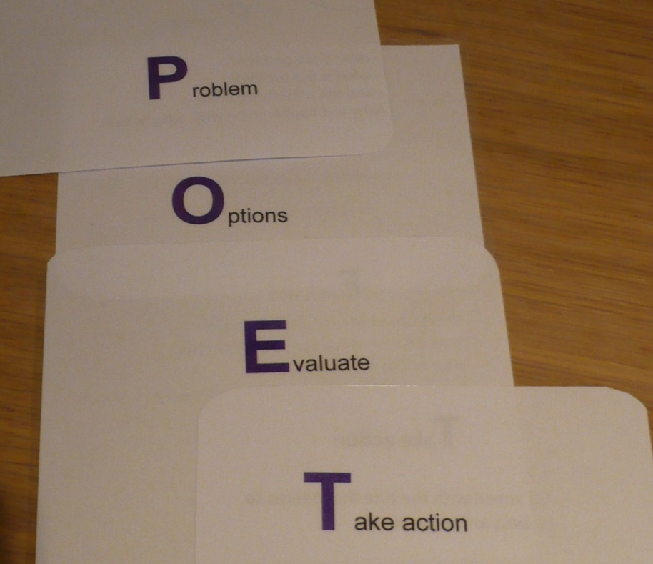
ENHANCE:
enhancing resilience and self-efficacy in the parents of children with disabilities or complex health needs
A Nash, M Whiting, S Roberts & S Kendall
Centre for Research in Primary and Community Care (CRIPACC), University of Hertfordshire
Purpose
This is a pilot study to develop and test an intervention to enhance resilience and self-efficacy in parents who have a child with a disability or complex health needs.
The ENHANCE Programme
ENHANCE is a ‘scaffolding’ intervention with its development based on the resilience and self-efficacy literature
It draws on operational features of the Family Nurse Partnership: Keyworker / Guided discussions / Supporting activities
Background
Parenting a child with a disability or complex health needs can have a significant and negative impact on a parent’s wellbeing. This can have both short-term and long-term outcomes on the health and wellbeing of the parent, the immediate family and the child concerned. This research sought to evaluate the feasibility of enhancing resilience for parents in this situation in order to help them manage any extra demands on their time, emotions and capabilities.
Method
Design: Mixed methods design
Sample: The sample comprised main caregivers, (N = 17), all of whom were the mothers of the child concerned. The children’s conditions were wide ranging, e.g. cancer, hydrocephalus (plus many other needs), heart conditions, Bartter syndrome, Hirschsprung’s disease.
Materials: The ENHANCE programme was developed with materials, discussion points, etc. – see panel (right).
The intervention is being evaluated through interviews with parents and professionals. Pre- and post-test measures include the Tool to measure Parenting Self-Efficacy (TOPSE), the Brief COPE scale and a resilience/distress thermometer. Due to the small sample size the quantitative date will only provide an indication, rather than evidence, of any effect but will inform the selection of measures for future studies.
Procedure: Four health professionals (e.g. children’s community nurses) were recruited as co-researchers and attended a 3-day workshop for training in recruitment, consent and delivery of the ENHANCE programme. The co-researchers recruited parents and delivered the ‘scaffolding’ programme, visiting parents every other week.
The research took an Action Research Cycle approach with parents taking part in a short telephone interview half-way through the programme and the co-researchers attending two interim meetings. Both parents and co-researchers have taken, or will be taking, part in longer interviews after all sessions are completed.
Working in partnership with parents
Focus on four key domains:
Emotional coping
Support networks
Practical coping
You and your child
Comprises structured sessions using guided discussions and a positive approach
Includes activities and supplementary resources
Six 30 minute sessions
Delivered by children’s community nurses, a special school nurse and a family support practitioner
Additional time over and above the usual clinical visit
Discussion
While some of the final interviews are still to take place, the initial findings are very positive with parents welcoming the intervention. The study has been informative in terms of considering the timing of the programme in relation to diagnosis, what parents are taking from the intervention, and difficulties associated with recruitment (including recruitment of the nurses) and in fitting in visits around the child’s condition and hospital visits, etc. These will be taken into consideration in the future in plans for a more substantial study.
References & Acknowledgements
Gerstein, E.D., Crnic, K.A., Blacher & Baker, B.L. (2009) Resilience and the course of daily parenting stress in families of young children with intellectual disabilities. J Intellect Disabil Res, 53(12): 981-997
Peer, J.W. & Hillman, S.B. (2014) Stress and Resilience for Parents of Children with Intellectual and Developmental Disabilities: a Review of Key Factors and Recommendations for Practitioners. Journal of Policy & Practice in Intellectual Disabilities, 11(2): 92-98
Greeff, A.P. et al. (2014) Resilience in families with a child with cancer. Pediatric Hematology & Oncology, 31(7): 670-679
We would like to thank our co-researchers who delivered the programme: Liz Hillier, Nikki Kenmore, Clare Morris and Jan Wilkins based in trusts in Hertfordshire, Bedfordshire and Cambridgeshire.
Research funded by CLAHRC East of England.
A few examples from the qualitative findings so far:
“I always do my best but you know, you don’t feel good about yourself, whereas this is, you know, my session yesterday actually felt on top of the world, I haven’t felt that good in ages.”
“I felt like I dealt with that situation much better than probably I would have done prior to this.”
“Nobody ever, ever, in all that time (ch of 11y) has ever asked her “how are you coping, how are things, never” (from ARC meeting with professionals)
“I kind of think if we hadn’t have done this I wouldn’t have had the relationship that I’ve got with my community nurse now”
Health Psychology in Public Health Network Conference, February 2016
For further information contact Avril Nash: a.s.nash@herts.ac.uk

