Slide 1

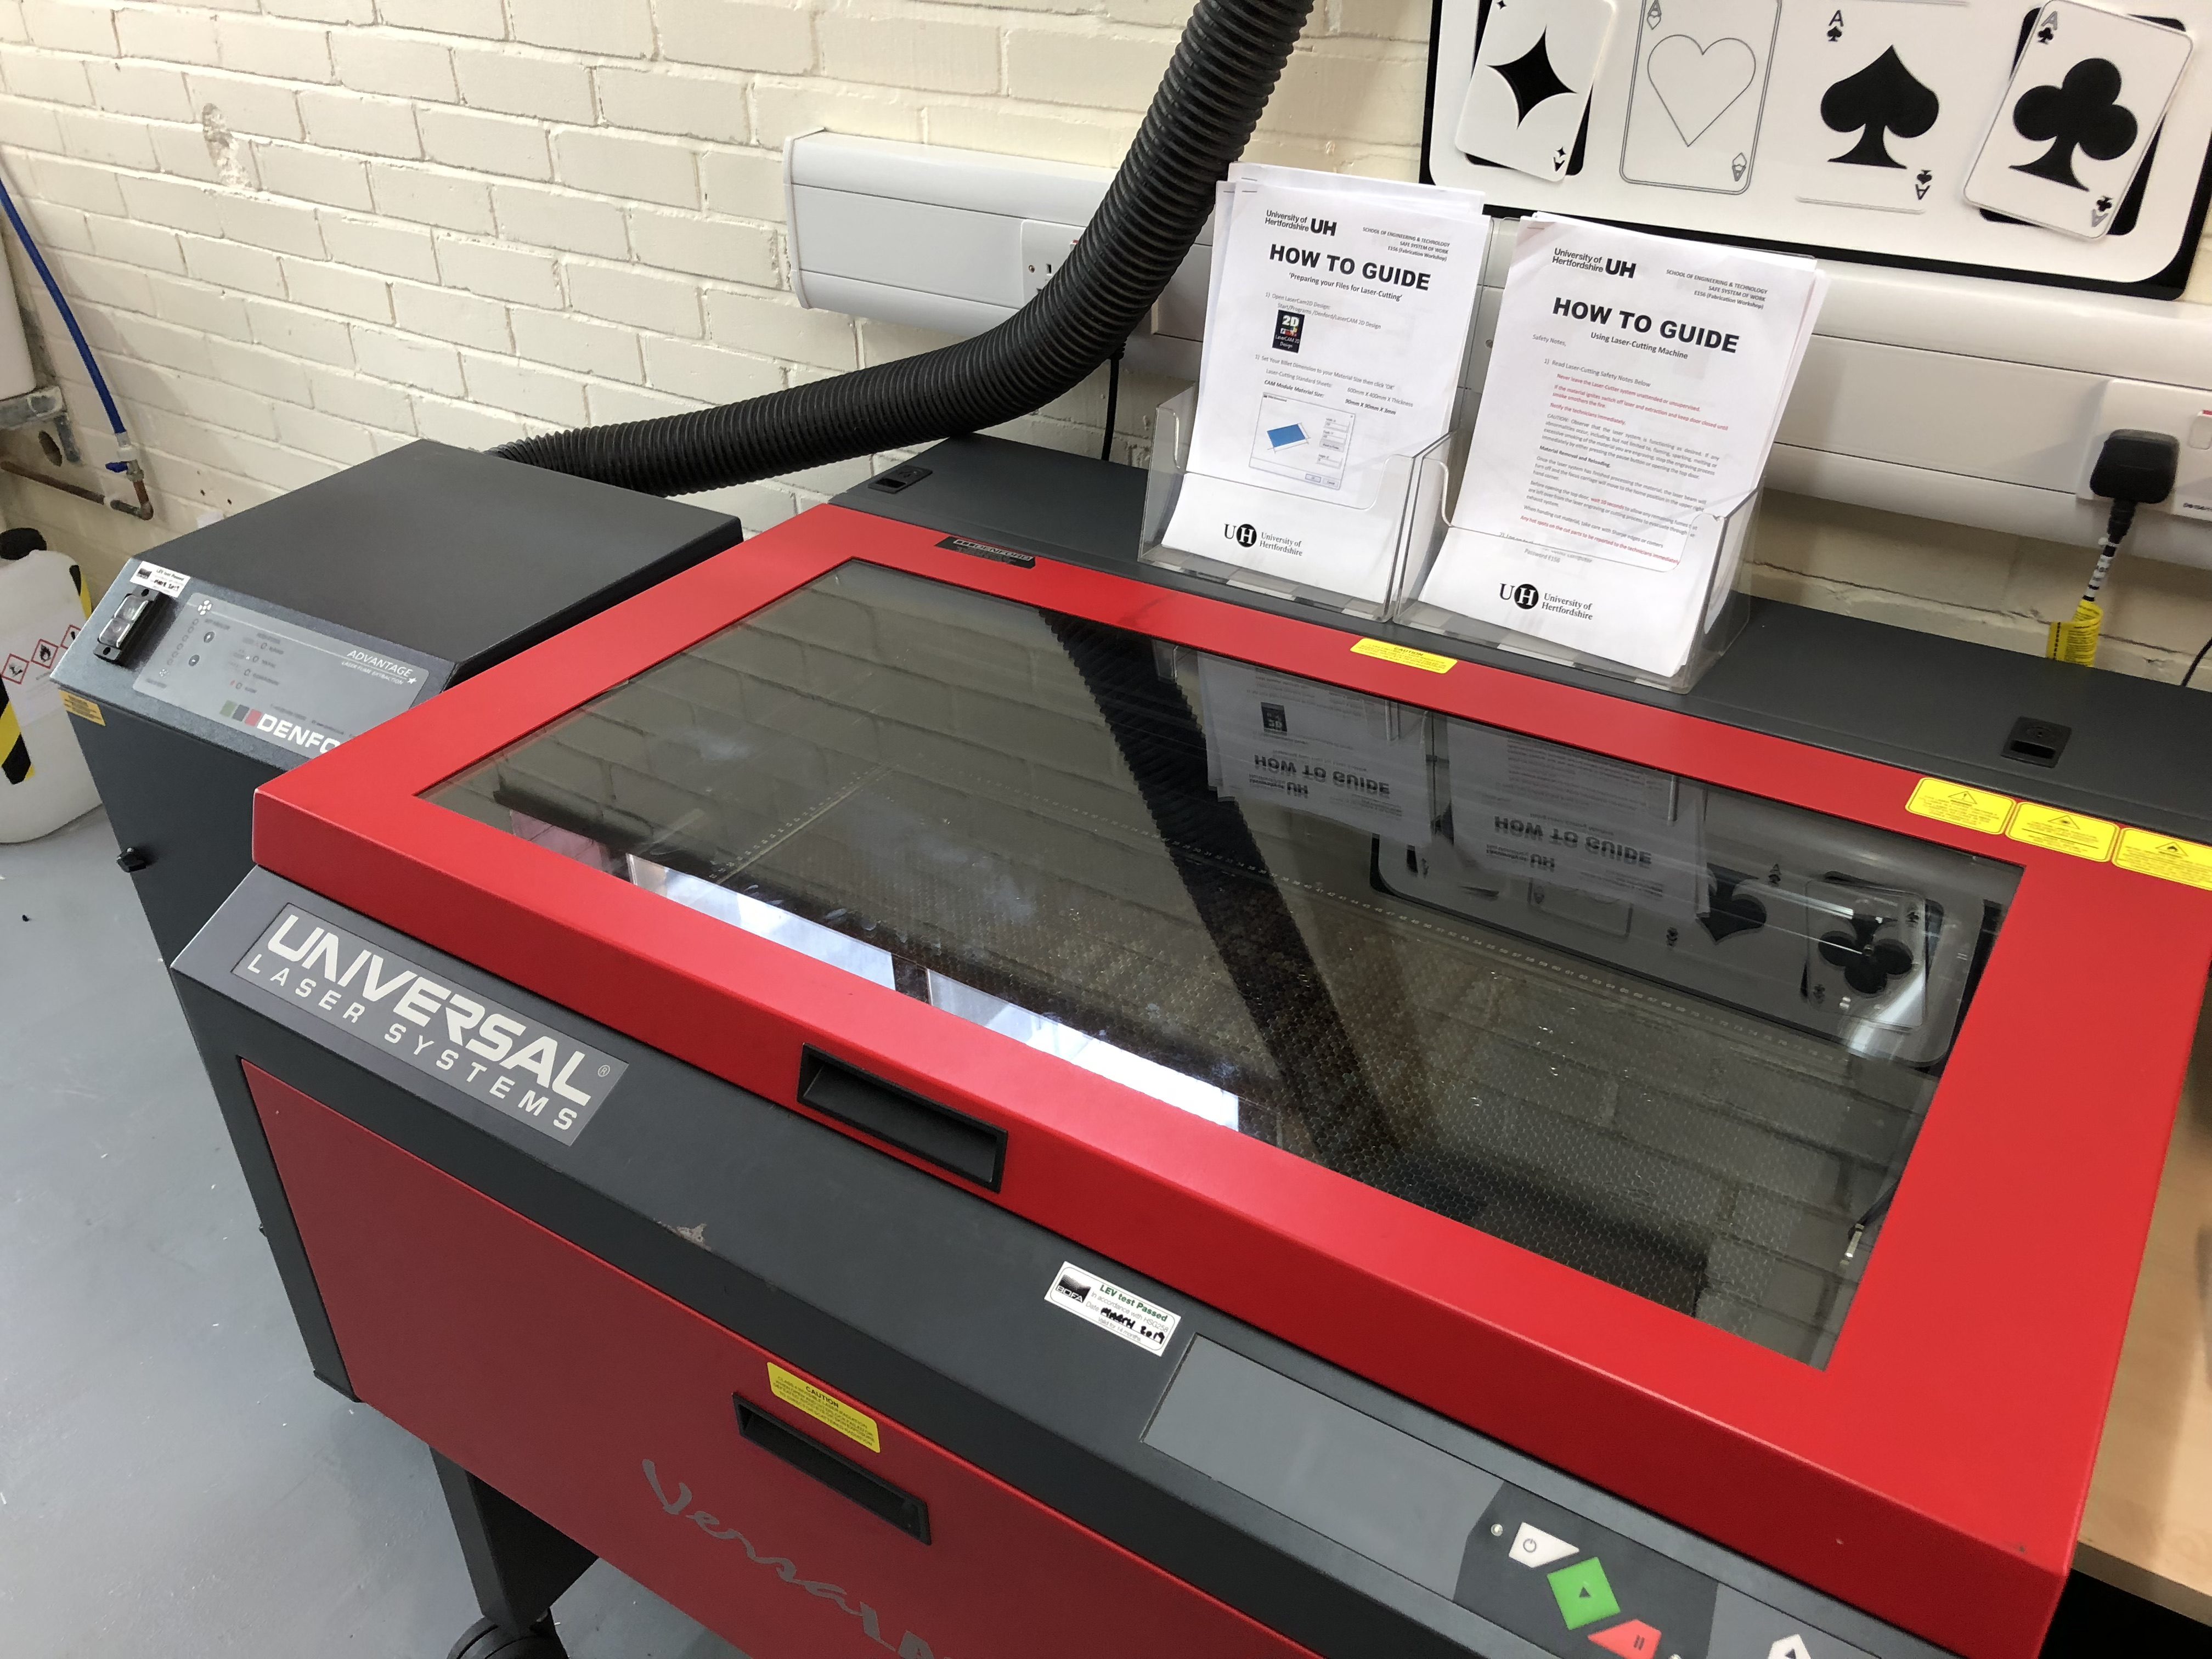
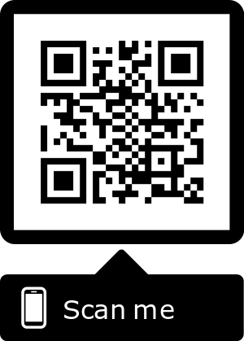
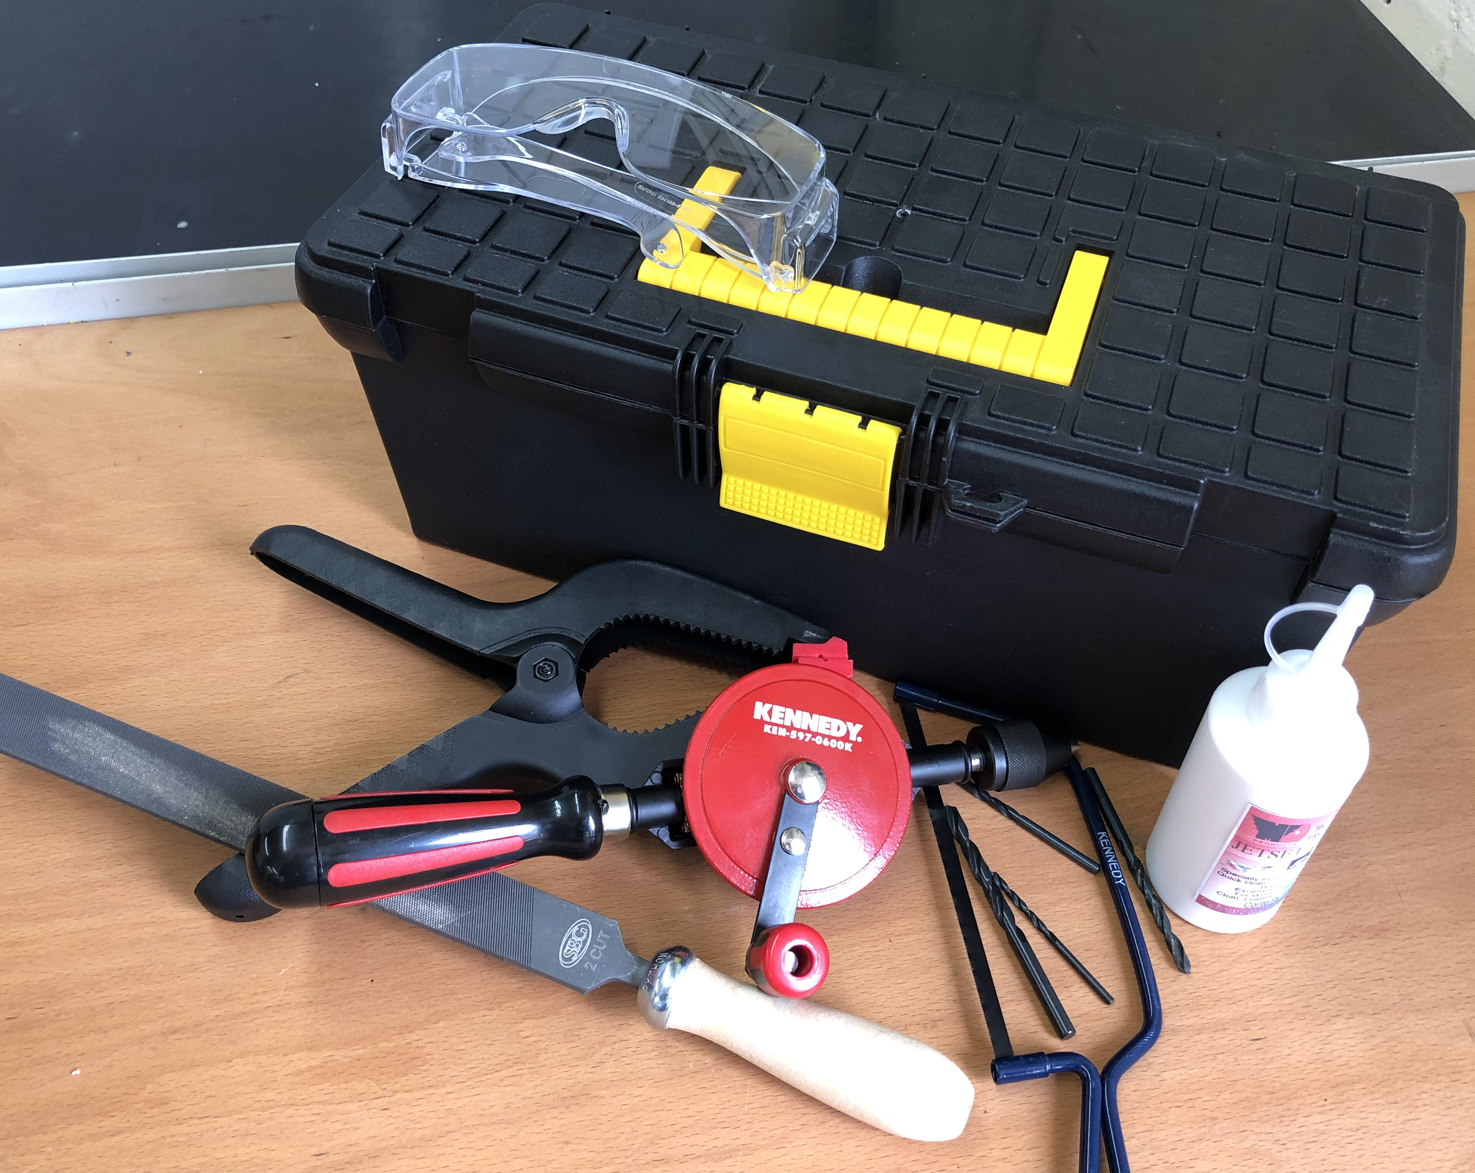
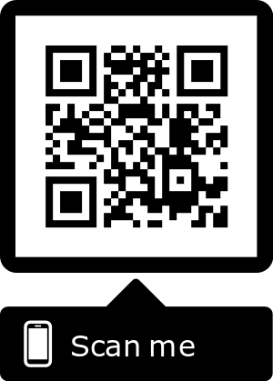
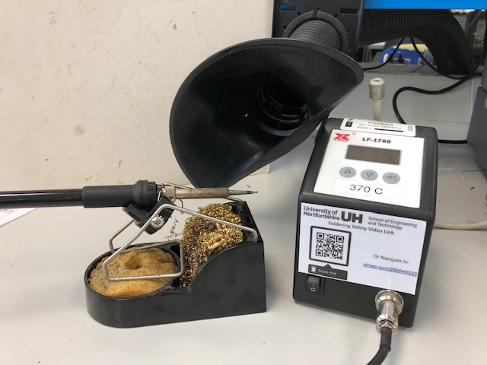
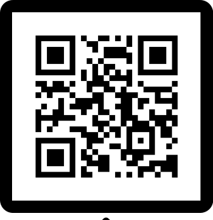
Improving the Engagement of Engineering Students in Laboratory Activities Using QR Codes
Learning and Teaching Innovation Award
Christabel Tan, Jacob Morewood, Vince De-Bellis
School of Engineering and Computer Science
Instructional Videos Accessed via Quick Response (QR) Codes
This project intents to enhance knowledge and develop confidence in practical skills and to increase satisfaction with the activities through the engagement with personal technology like smartphones and tablets.
Personal technology as an “anywhere, anytime” learning tool to support the development of self-regulated learners, encouraging independent learning through engagement (Mueller 2011)
Increase excitement, positive responses when using mobile devices and hence tend to stay focus longer (Lynch, 2015)
SCAN FOR LASER
Implementation
Aim: To equip students with knowledge and training to safely perform their lab activities using bespoke instructional materials.
Objective: To develop bespoke instructional videos and relevant training materials and to link these instructions to purposefully generated QR codes that will be available on or near each equipment and activity location
What: Instructional videos for most commonly used equipment in taught modules across all levels and cohorts within the School
How: User centred videos focussing on safe working principles captured on video. Link to video on generated QR code located on or in the vicinity of the equipment for ease of access.
SCAN FOR HANDTOOLS
SCAN FOR SOLDER
Lynch M (2015) Do mobile devices in the classroom really improve learning outcomes? Available at: http://theconversation.com/do-mobile-devices-in-the-classroom-really-improve-learning-outcomes-38740
Muller J, et al (2011) Students learning with mobile technologies in and out of the classroom. Available at: http://citeseerx.ist.psu.edu/viewdoc/download?doi=10.1.1.455.9299&rep=rep1&type=pdf

