Slide 1
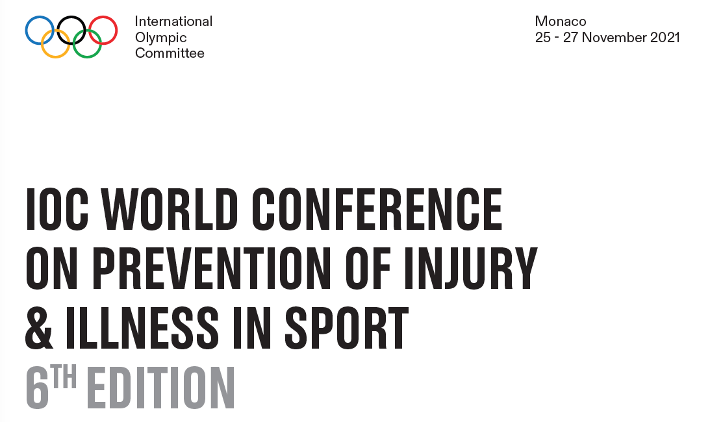


Slide 2
HEAD INJURIES PREVENTION IN JUDO; EVIDENCE AND PRACTICAL ASPECTS.
Associate Professor Mike Callan
University of Hertfordshire
Νikos Malliaropoulos MD, Msc & Dipl in SEM, PhD, ECOSEP , FFSEM(UK)
Consutant Sports &Exercise Physician Barts and The London
Senior Lecturer QMUL CSEM

Slide 3
OVERVIEW
Judo as an education and as a modern Olympic sport
The problem of head injuries in judo
Explore strategies to lead to injury reduction and prevention
Consider injuries from a Safeguarding perspective
Suggest prevention strategies

Slide 4
JUDO AS AN EDUCATION
AND AS A MODERN OLYMPIC SPORT

Slide 5
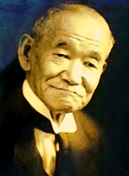
JUDO AS AN EDUCATION
AND AS A MODERN OLYMPIC SPORT
Judo is an Olympic sport, and a way, or doo.
Judo is a physical, mental and moral education
Founded by Professor Jigoro Kano
IOC member 1909, first from Asia
The purpose of judo is to benefit society.

Slide 6
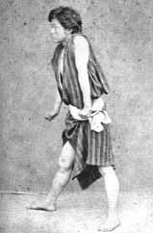
JIGORO KANO
At school, Jigoro Kano was the victim of bullying.
He became determined to study ju-jitsu.
We can say that judo was developed from a determination to deal with bullying.

Slide 7
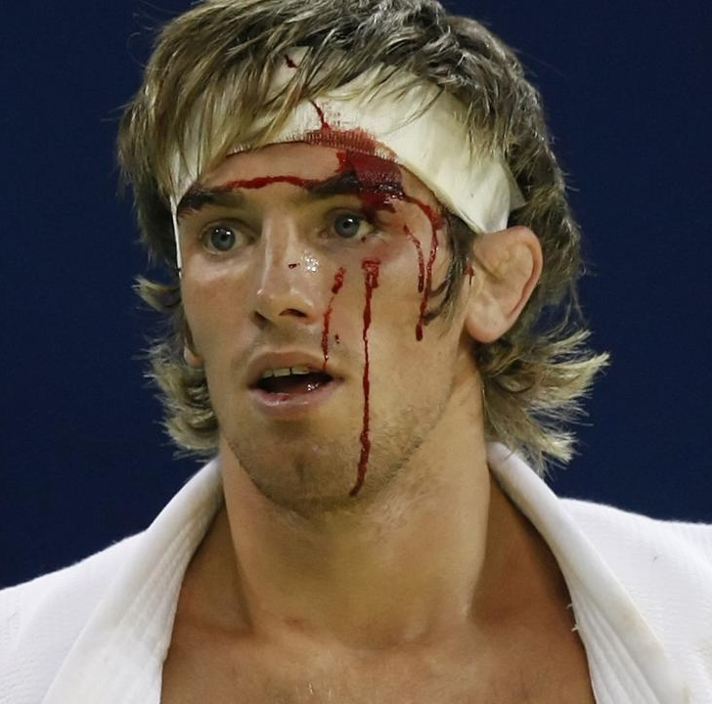
JUDO AS AN EDUCATION
AND AS A MODERN OLYMPIC SPORT
Harm can occur during competition or training
The most common types of Judo injuries are contusions, abrasions fractures, sprains and strains.

Slide 8
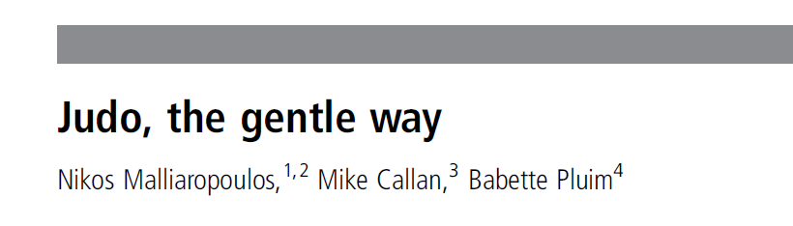
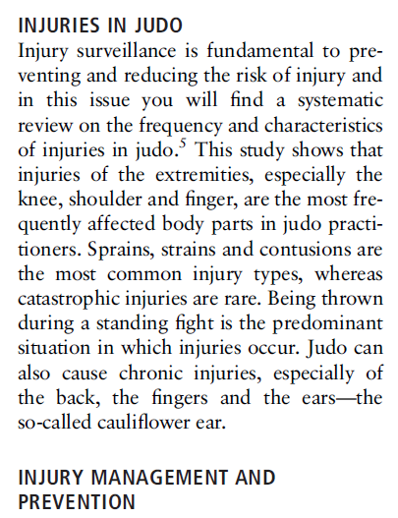
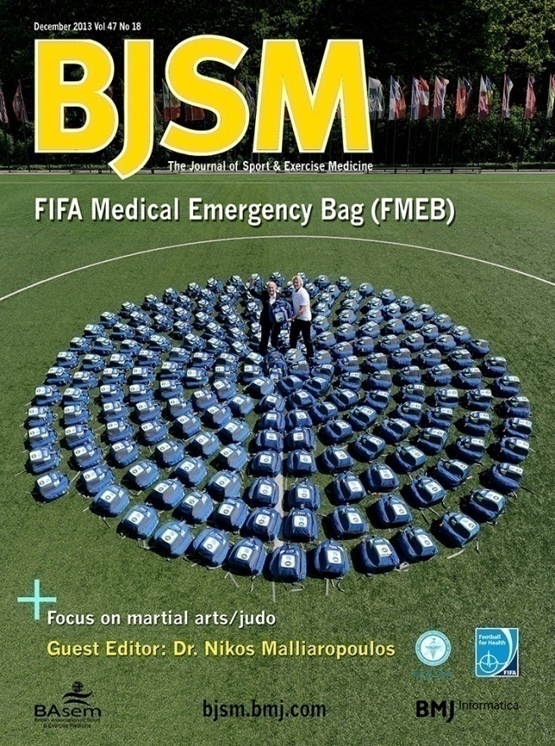


Slide 9
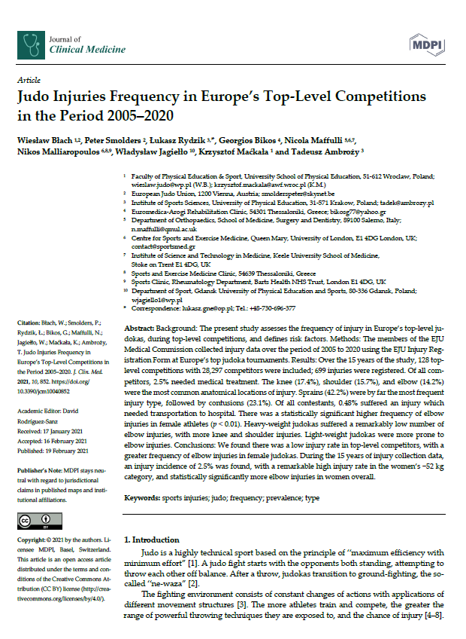
Judo injuries frequency
128 top-level competitions over 15 years
28,297 competitors
2.5% needed medical treatment
Knee 17.4%
Shoulder 15.7%
Elbow 14.2%
Sprains 42.2%
Contusions 23.1%

Slide 10
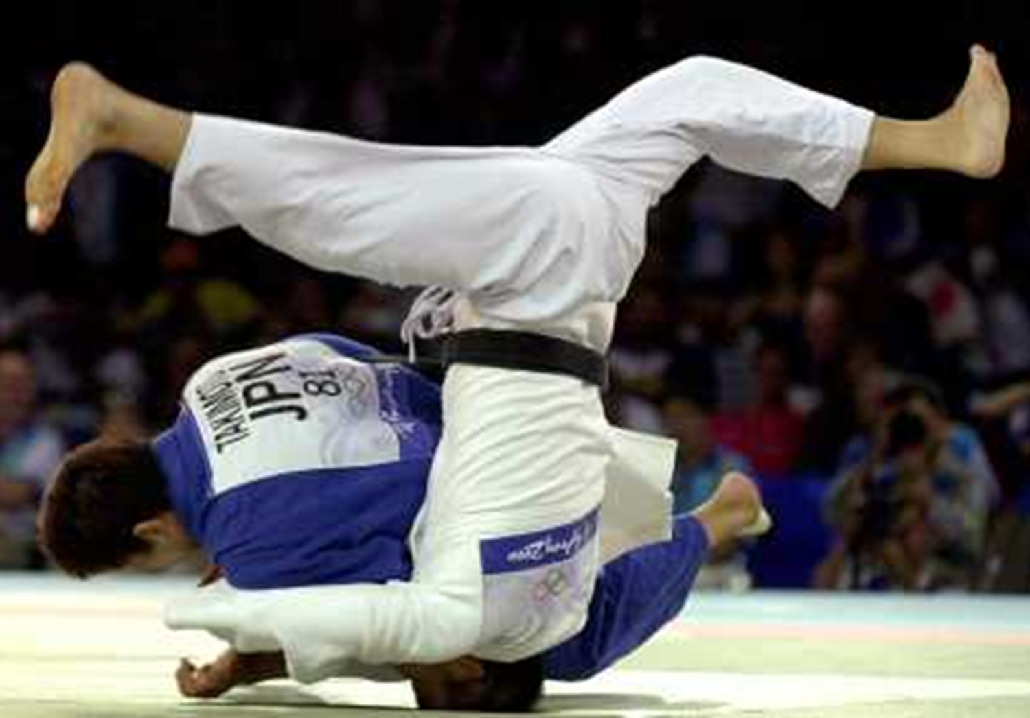
THE PROBLEM OF HEAD INJURIES IN JUDO

Slide 11
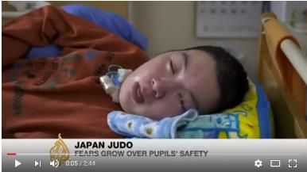
Non-accidental harm
Sport is a context in which abuse and non-accidental harm can take place
Committed by authority figures such as coaches, or peer athletes
Serious injury is defined as death, or a long-term condition such as a permanent vegetative state.

Slide 12
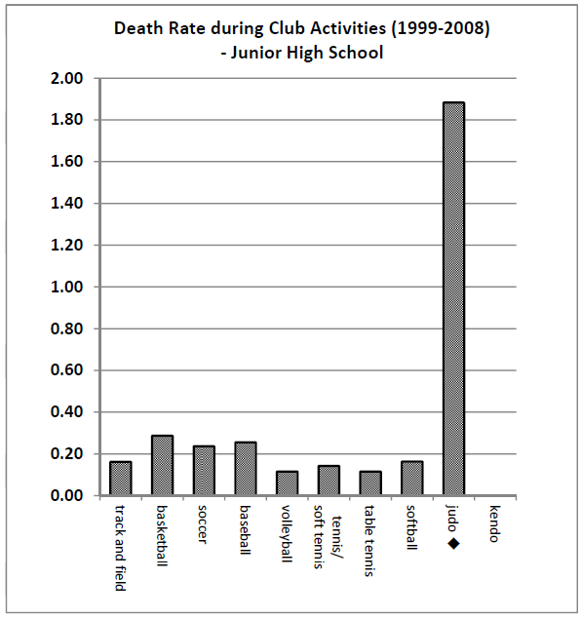
School deaths
Research into serious injury in a variety of sporting activities within Japan revealed a high number of serious cases involving Judo

Slide 13
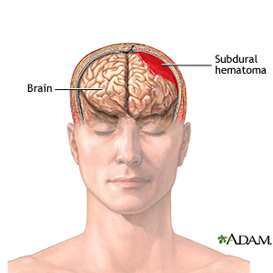
Acute Subdural Hematoma (ASDH)
120 deaths have occurred within Japanese Judo since 1983
This could be defined as neglect.
Serious injuries such as acute subdural hematoma (ASDH), that are associated to Japanese judo are not evident within UK judo

Slide 14
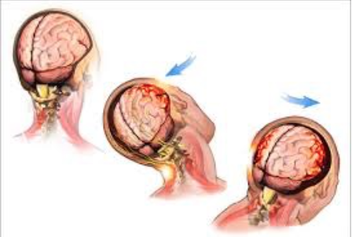
Second-impact Syndrome
A rare and dangerous result of second concussion that happens when the brain is still healing from a previous concussion.
Causes dangerous brain swelling and bleeding that can cause death or permanent disability. It can occur even days to weeks after a first concussion is diagnosed

Slide 15
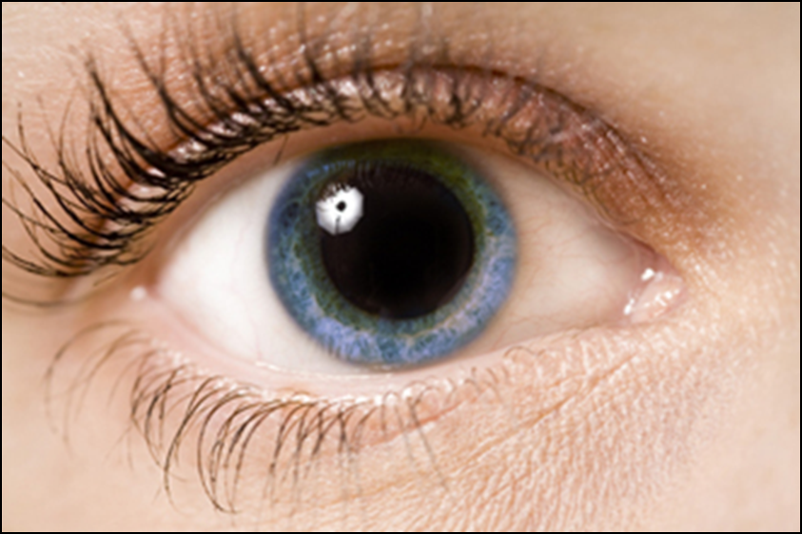
Second-impact Syndrome
Athletes under age 25 are especially vulnerable to second-impact syndrome
But there are ways to prevent a subsequent injury, including knowing the signs of concussion.

Slide 16
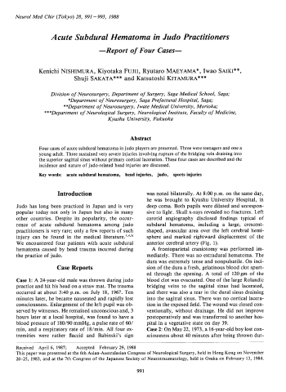
Acute Subdural Hematoma in Judo Practitioners: Report of Four Cases
Kenichi NISHIMURA et al.
1988 = 33 years ago!
Analysed 1776 cases of head injury Department of Neurosurgery, University of Tokyo Hospital
122 were sports injuries
Of these, 20 occurred during judo practice
4 of the 20 developed acute subdural hematoma

Slide 17
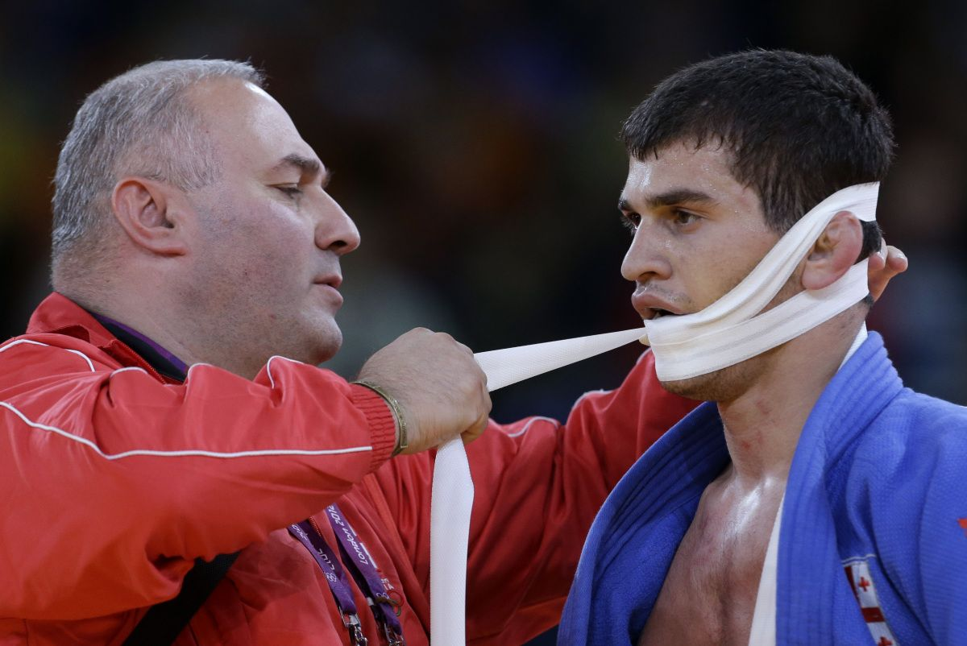
EXPLORE STRATEGIES TO LEAD TO INJURY REDUCTION AND PREVENTION

Slide 18
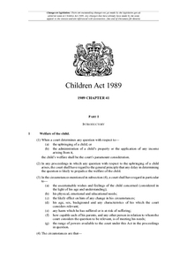
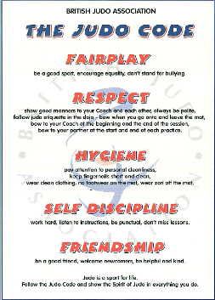
Legislation, Regulation, Policy & Guidance
Organisations can try to reduce the risk of injury and harm but if someone is determined to break the law or a code of conduct it will be difficult to guard against every inappropriate act.

Slide 19

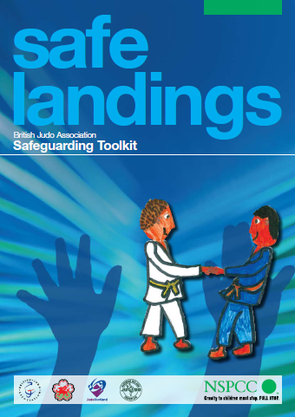
Documents & Policies
British Judo Child Protection Policy, Procedures and Guidelines
British Judo SafeguardingToolkit

Slide 20
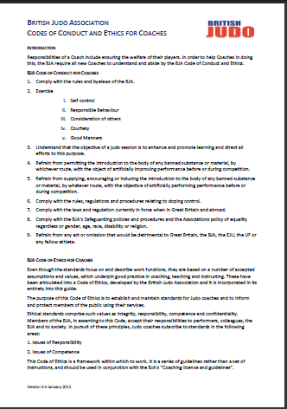
Codes of Conduct and Ethics for Coaches
Responsibilities of a Coach include ensuring the welfare of their players. In order to help Coaches in doing this, the BJA require all new Coaches to understand and abide by the BJA Code of Conduct and Ethics.

Slide 21

Return to Play policies
If young athletes have any of concussion symptoms in the hours or days immediately after a head injury, their physical activity should be restricted until they're evaluated by a doctor.

Slide 22
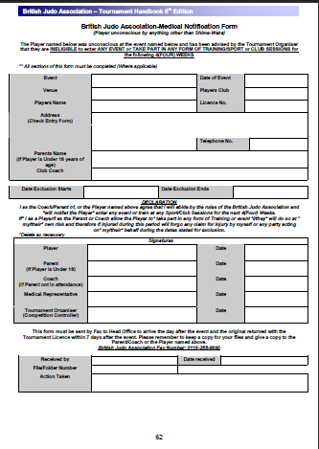
British Judo -Medical Notification Form
(Player unconscious by anything other than Shime-Waza)
The Player named below was unconscious at the event named below and has been advised by the Tournament Organiser that they are INELIGIBLE to enter ANY EVENT or TAKE PART IN ANY FORM OF TRAINING/SPORT or CLUB SESSIONS for the following 4(FOUR) WEEKS

Slide 23
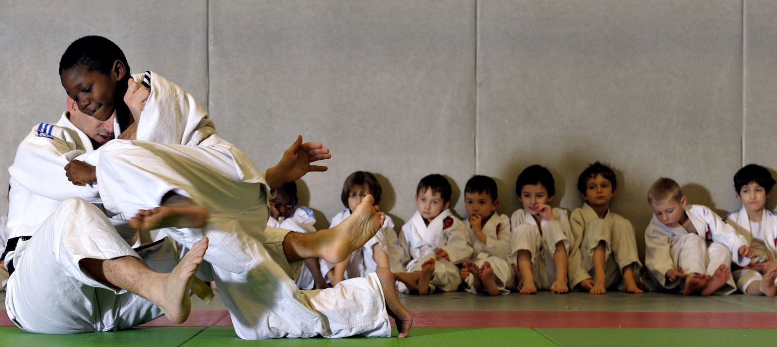
Parental Declaration
I as the Coach/Parent of, or the Player named above agree that I will abide by the rules of the British Judo Association and will not/let the Player enter any event or train at any Sport/Club Sessions for the next 4 (Four) Weeks.
If I as a Player/I as the Parent or Coach allow the Player to take part in any form of Training or event I/they will do so at my/their own risk and therefore if injured during this period will forgo any claim for injury by myself or any party acting on my/their behalf during the dates stated for exclusion.

Slide 24
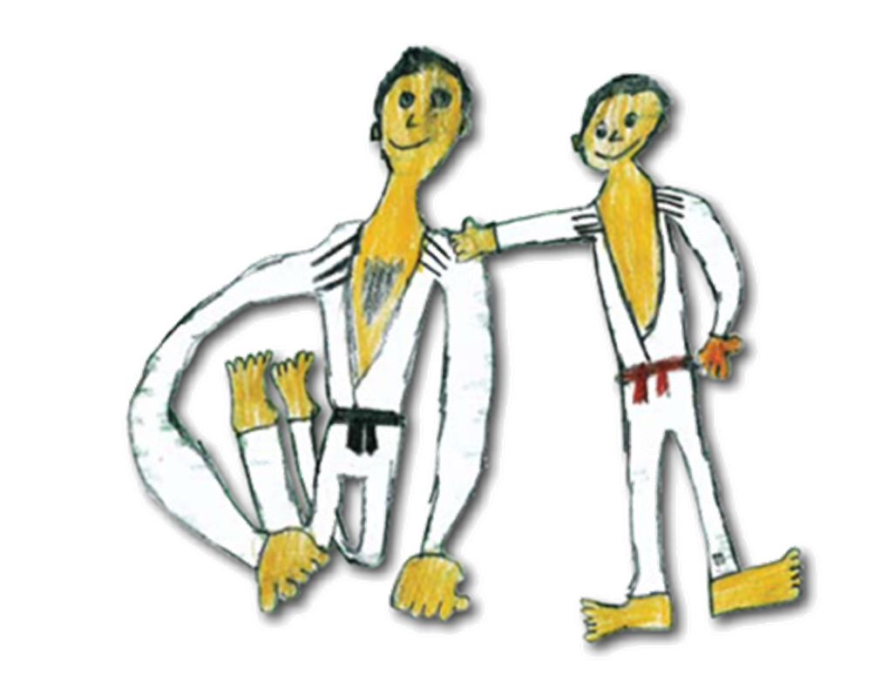
CONSIDER INJURIES FROM A SAFEGUARDING PERSPECTIVE

Slide 25
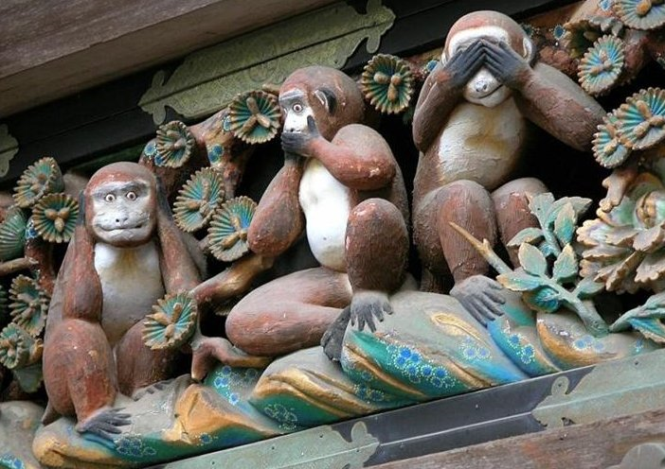

Slide 26
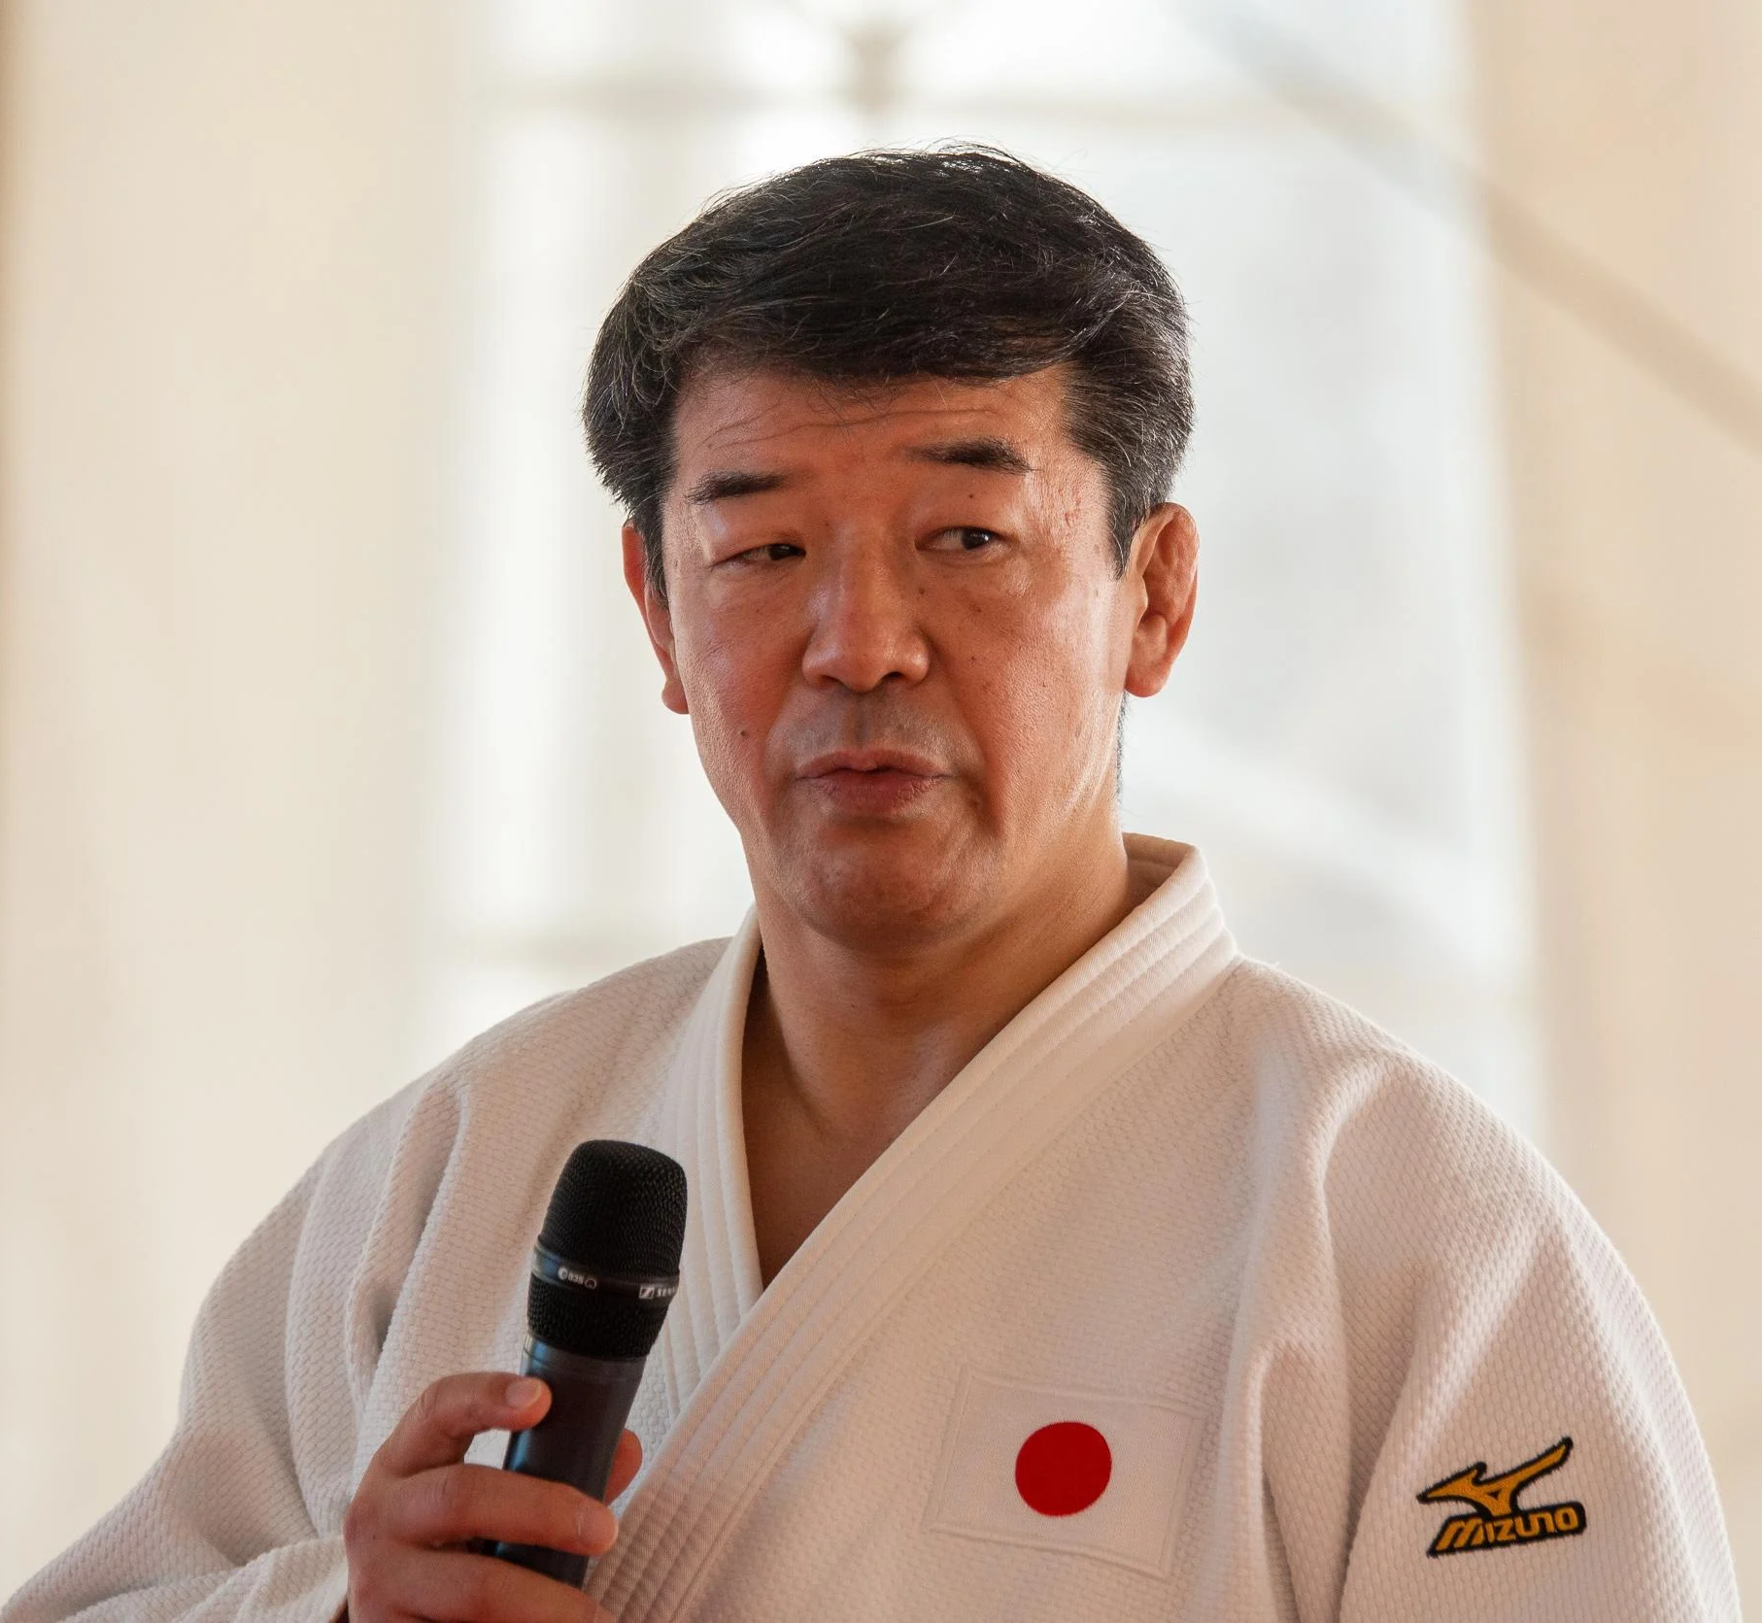
Mikihiro Mukai, Kodokan
“Until now, the judo world has tried to hide things they perceive will be disadvantageous to them…..
if there is even a single case of death or severe injury, that method is inadequate.
We as judo instructors must work to eradicate such problems,”
(Budo magazine. August 2010)

Slide 27

Why is safeguarding important for sports organisations?
Damage to reputation
Loss of athletes
Loss of fans
Loss of sponsorship
Reduced public confidence
Loss of trust
Depreciation of assets
(Mountjoy et al, 2016)

Slide 28
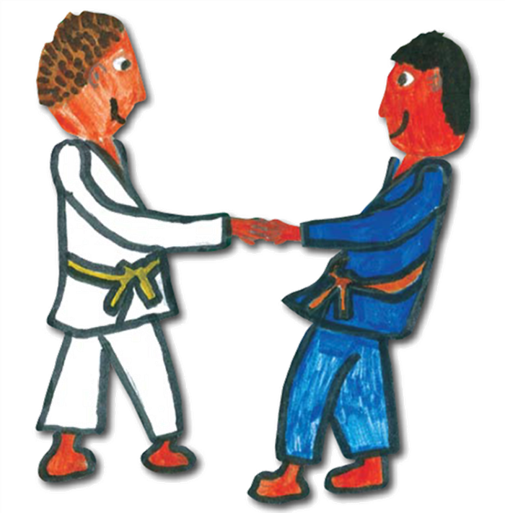
SUGGEST PREVENTION STRATEGIES

Slide 29
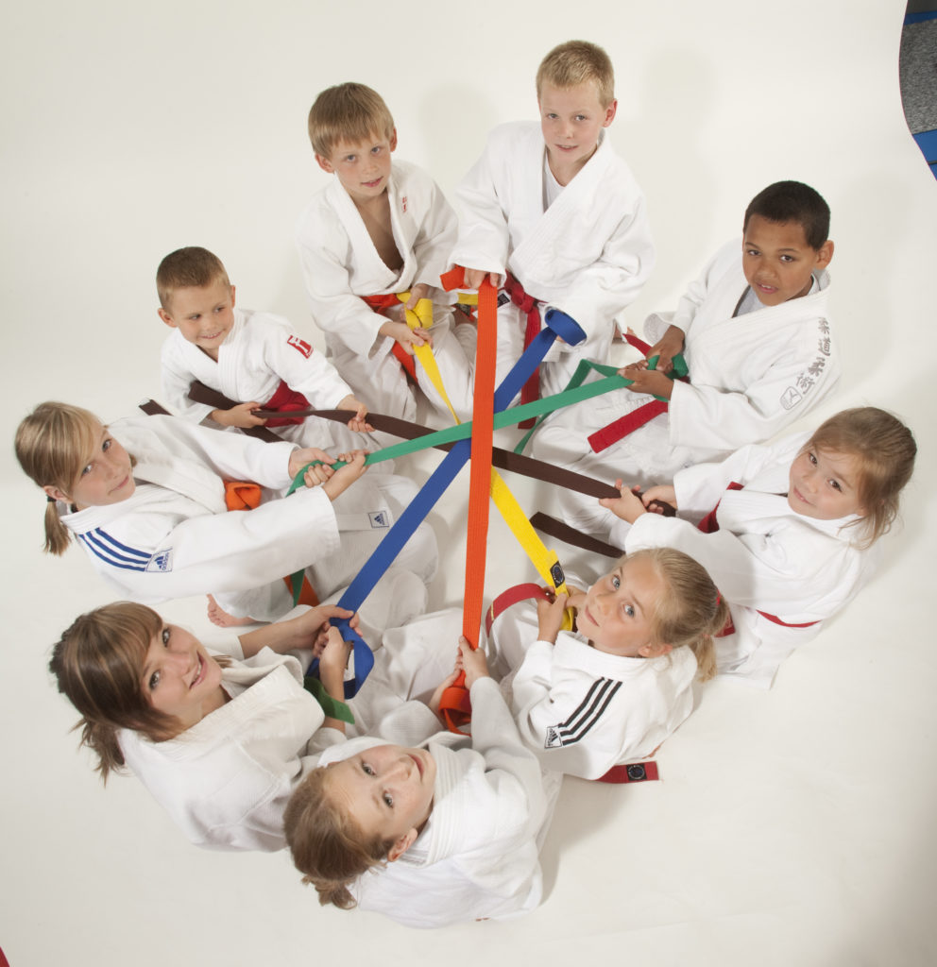
Governance and Leadership
Factors related to non-accidental violence in sport include:
Winner take all rewards
Power imbalance
Isolation
Conformity to dominant values
Role ambiguity
Organisational tolerance
(Roberts, Sojo & Grant, 2020)

Slide 30
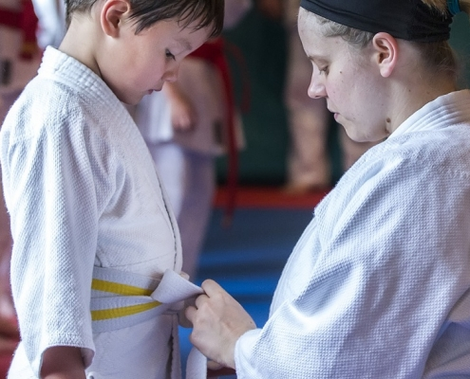
Processes to protect
Disclosure and Barring Service (DBS)
Complaints
Whistleblowing
Parent education
Welfare officers
Coach education

Slide 31
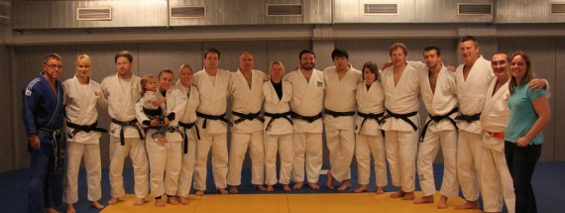
Coach Education
Requires a serious coach education structure.
Supported by Government
Academically approved
Re-validated annually
Linked to a license to coach

Slide 32
British Judo policy states:
Coaches hold a position of power in the relationship with their athlete and must not abuse this position to bully children/vulnerable young adults in their care.
In a judo situation, bullying may occur when the coach is:
  overly zealous
  resorts to aggressive, physical or verbal behaviour
  torments, humiliates or ignores an athlete in their charge/care

Slide 33
Conclusion
Judo as an education and as a modern Olympic sport
The problem of head injuries in judo, Second-impact Syndrome
Explore strategies to lead to injury reduction and prevention
Safeguarding perspective, Don’t be a Nikko Monkey
Suggest prevention strategies, Coach Education

Slide 34
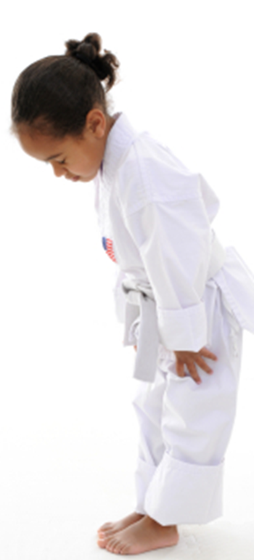
Thank you

