Slide 1
Who say’s you can’t
Kate cady
Senior lecturer sports therapy University of Hertfordshire
Clinical director back2fitness sports injuries clinic

Slide 2
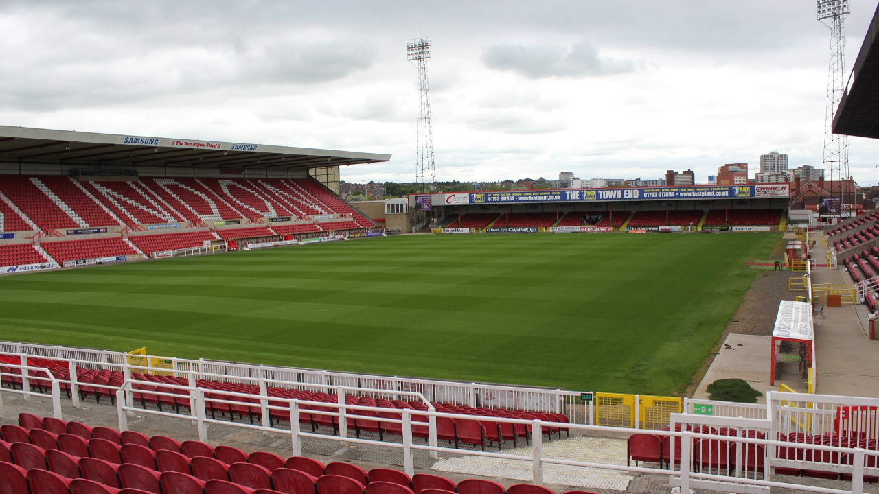
The goal

Slide 3
Graduate Sports Therapist
prevention
Recognition and evaluation
Management
Rehabilitation
Education

Slide 4
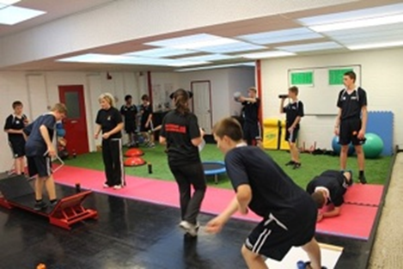
Prevention

Slide 5
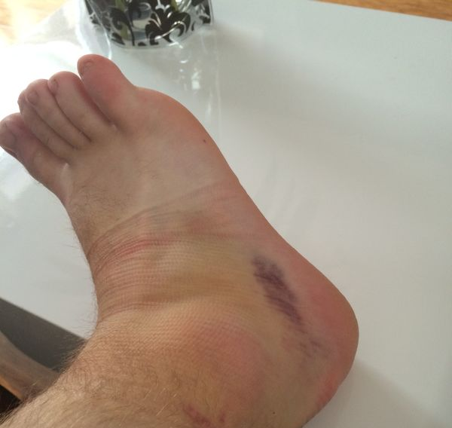
Recognition and evaluation How to assess

Slide 6
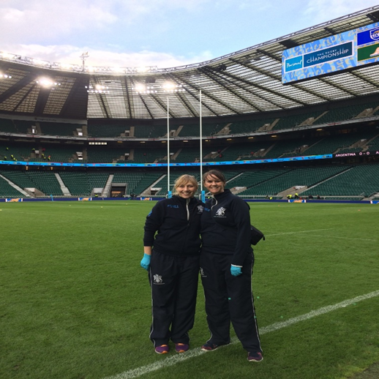
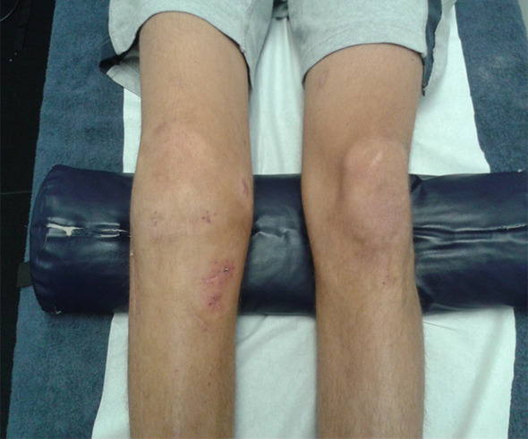
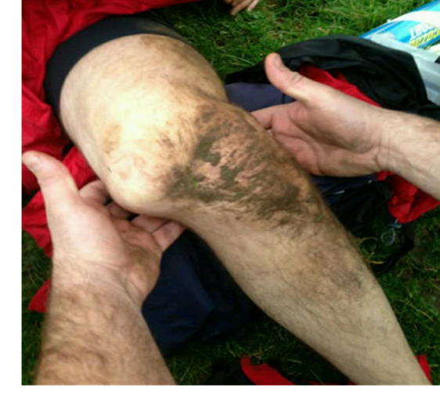
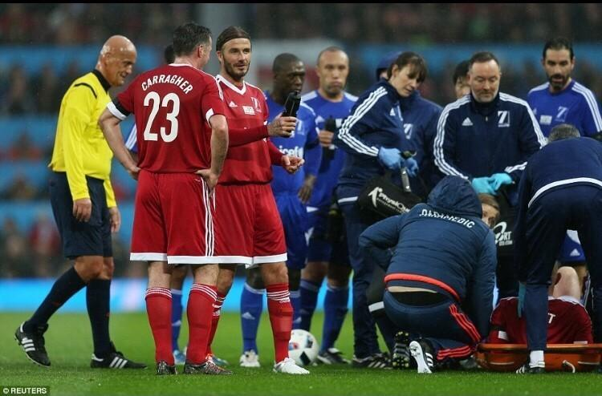
Management and treatment of injury and referral

Slide 7
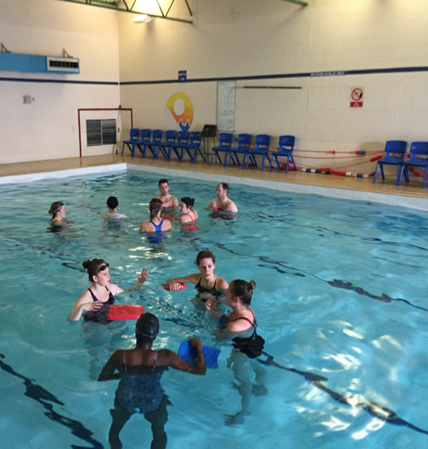
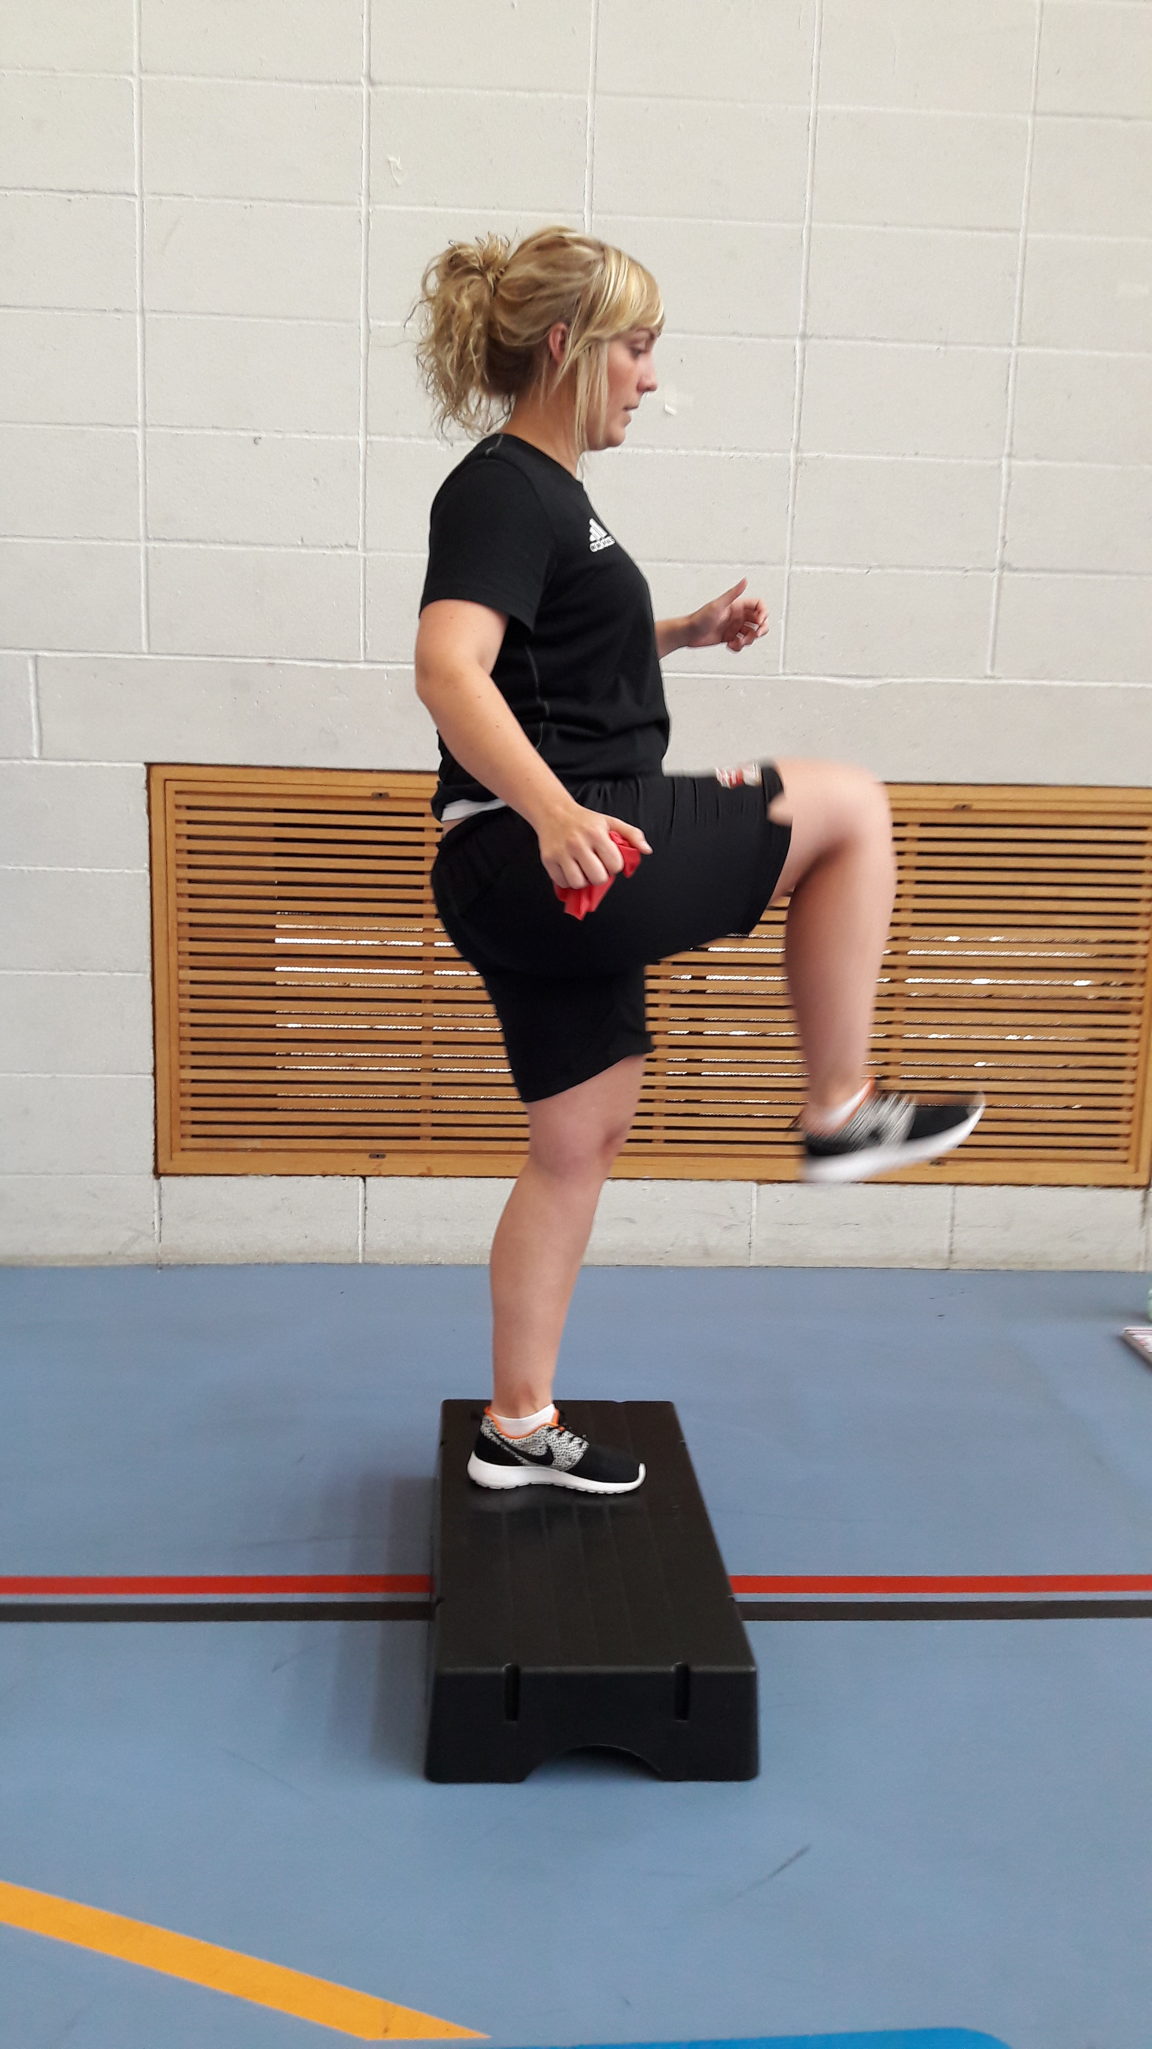
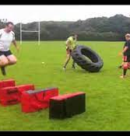
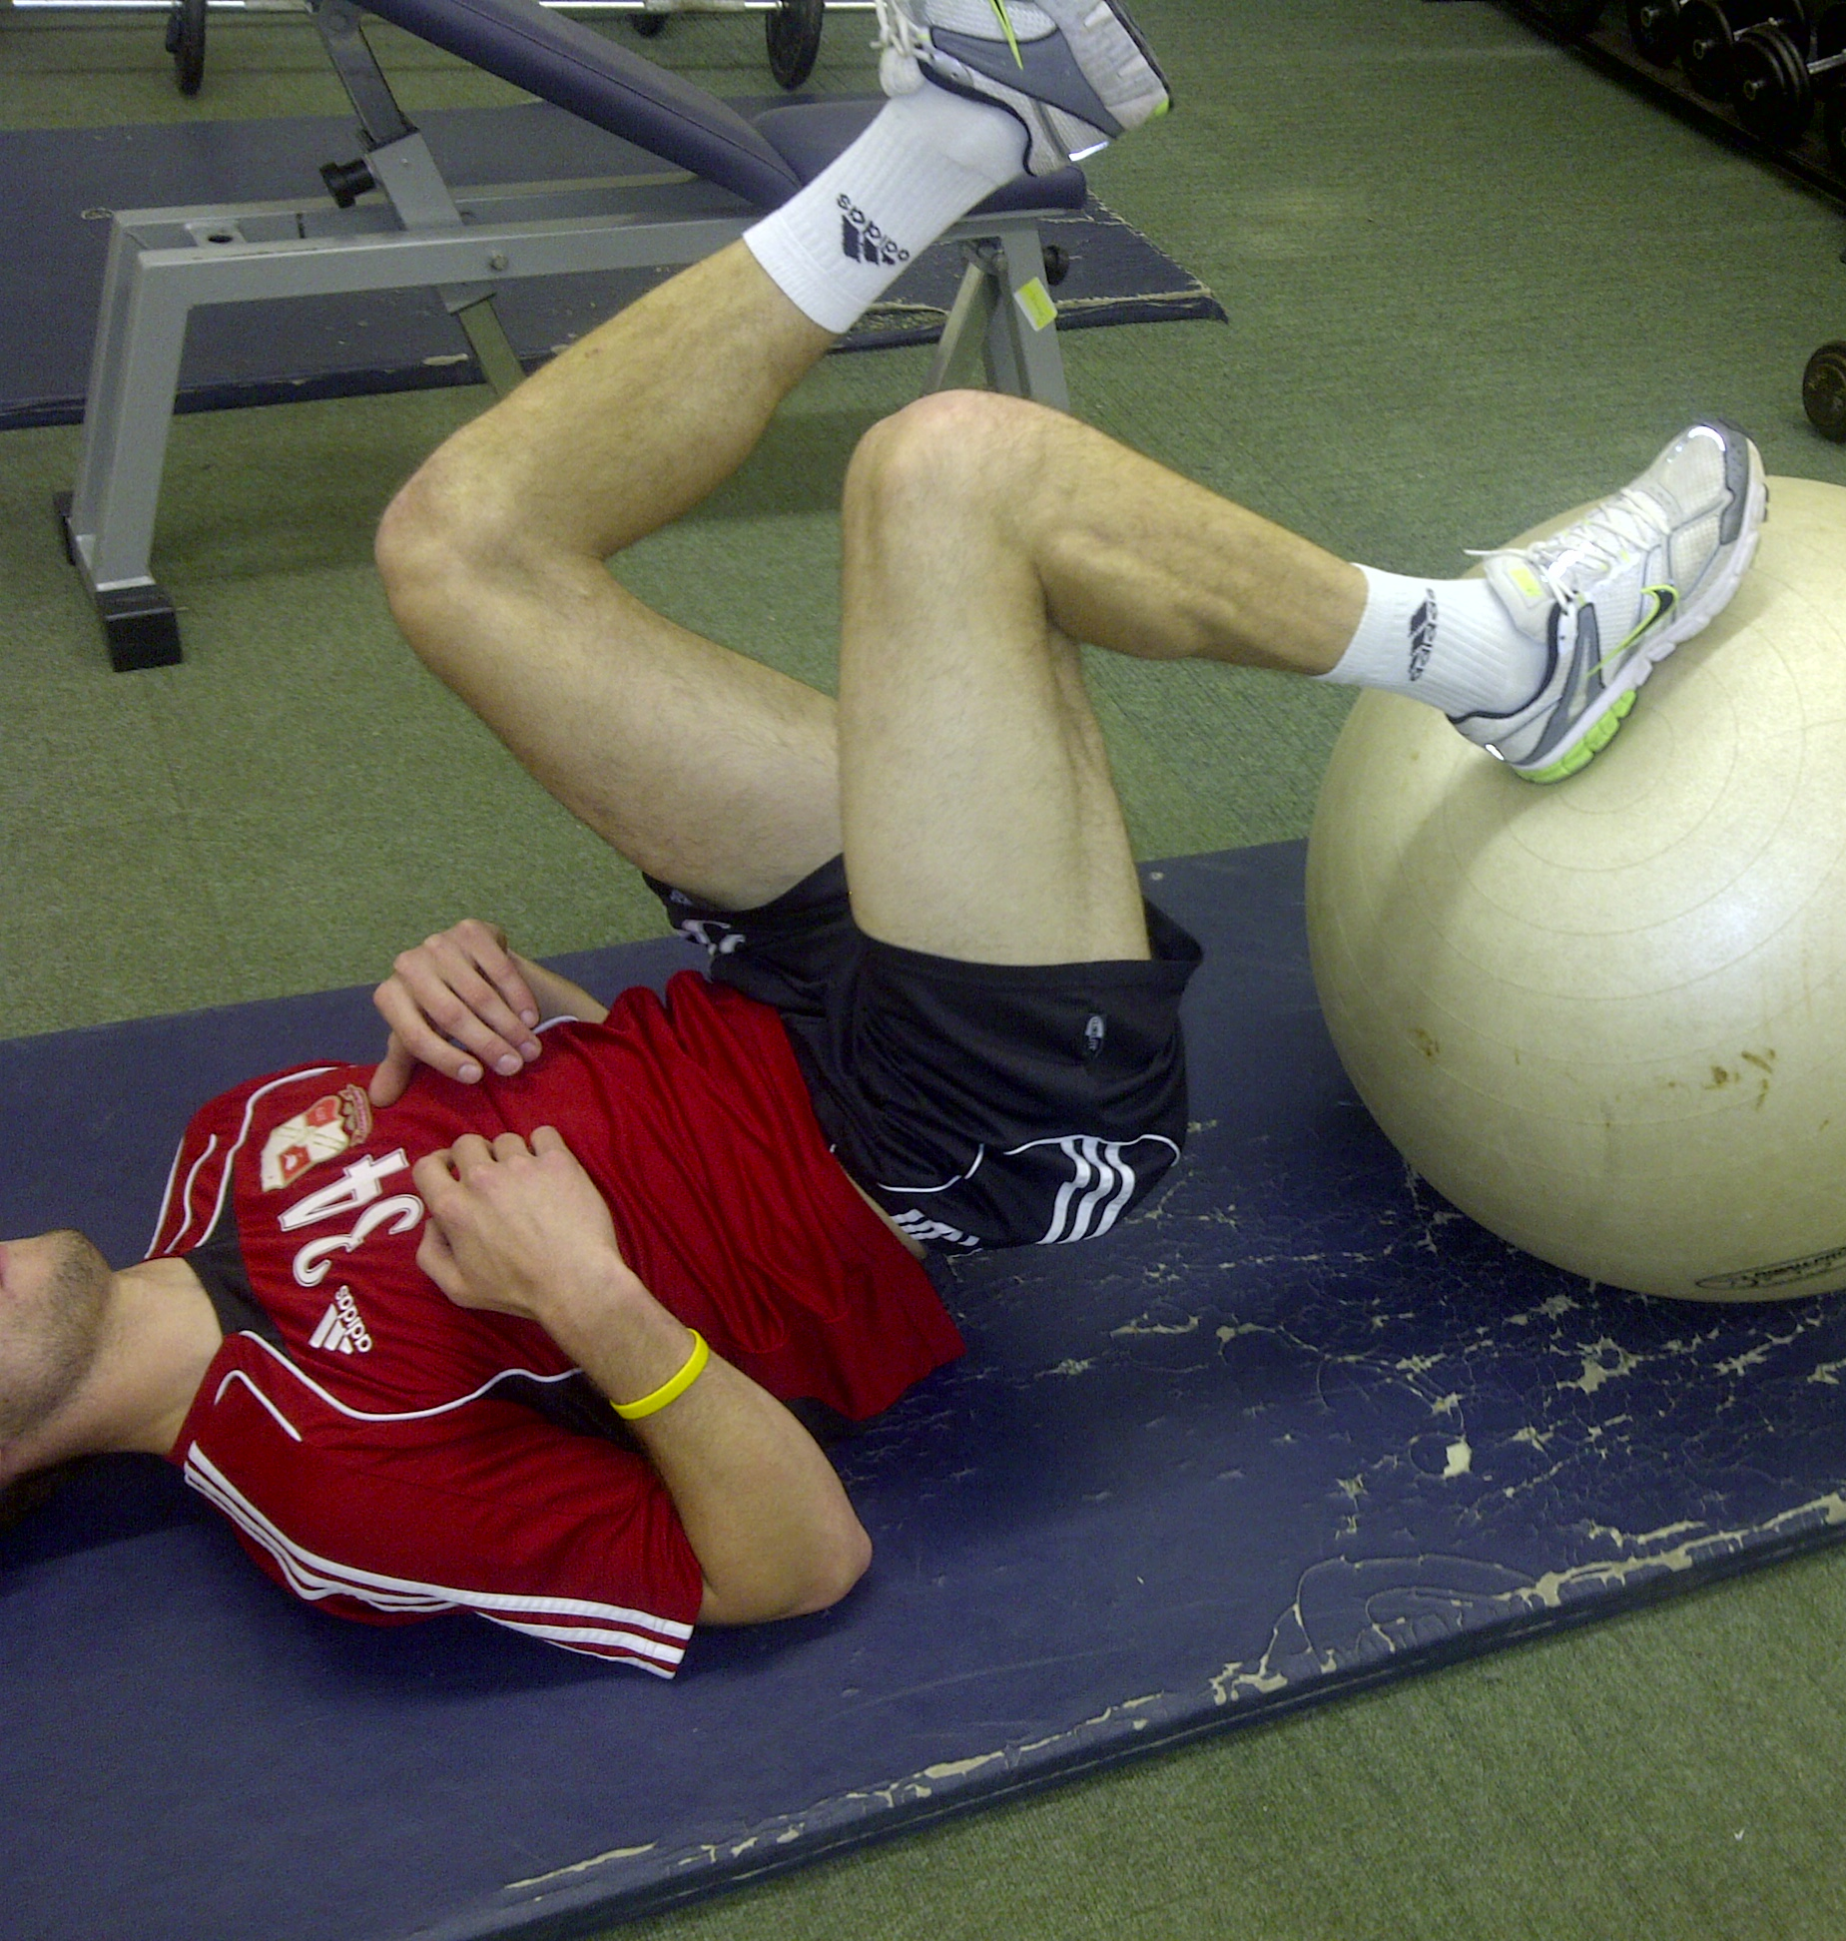
Rehabilitation
From injury to sport

Slide 8
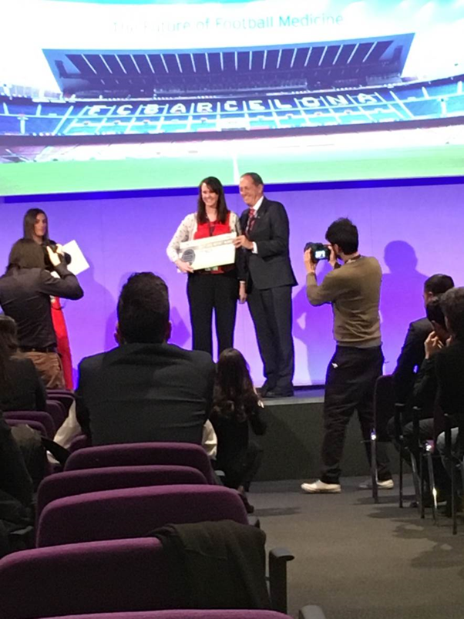
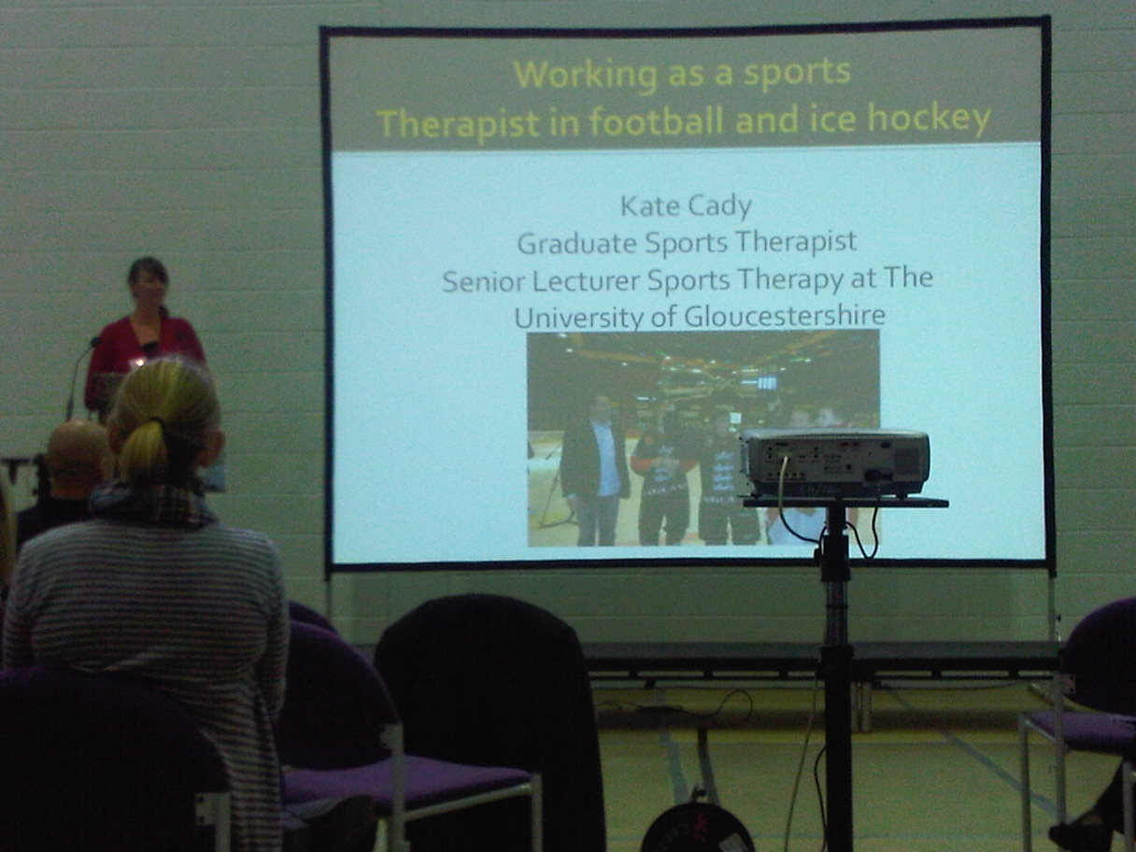
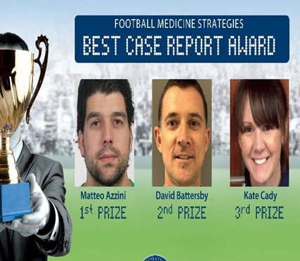
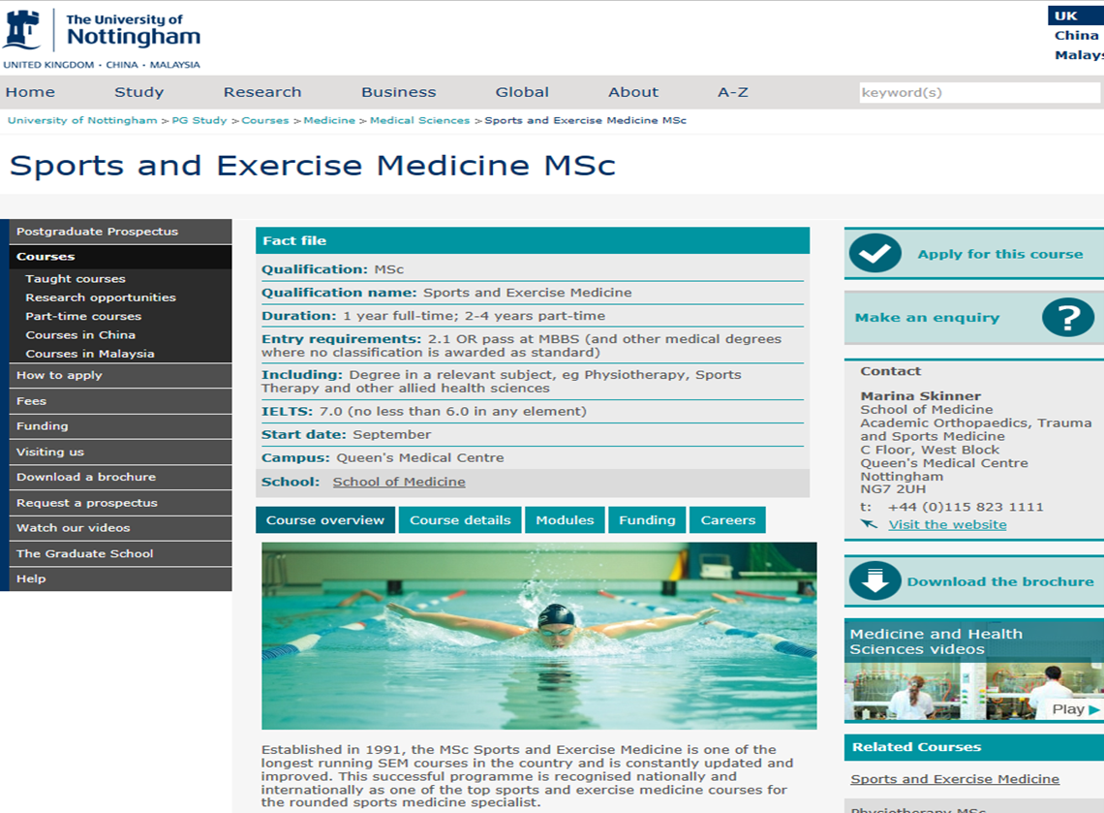
Education

Slide 9
My Journey

Slide 10
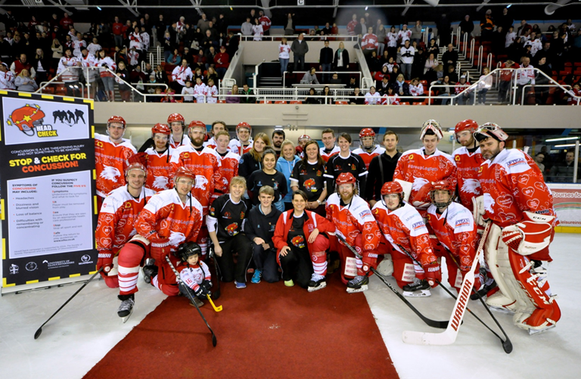
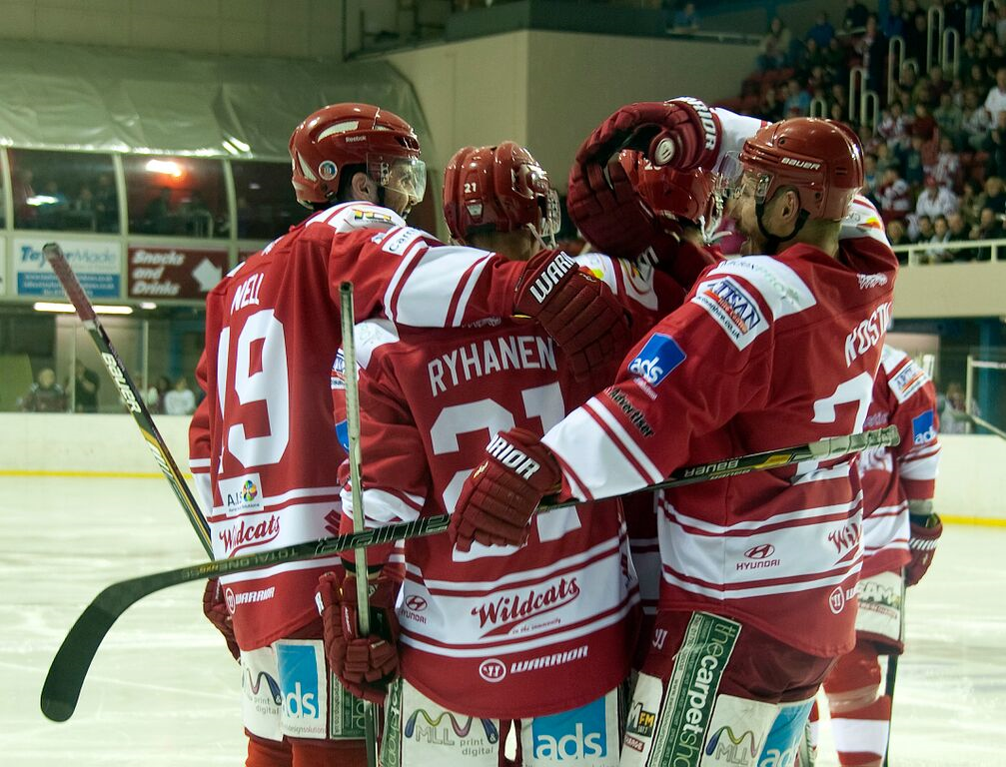
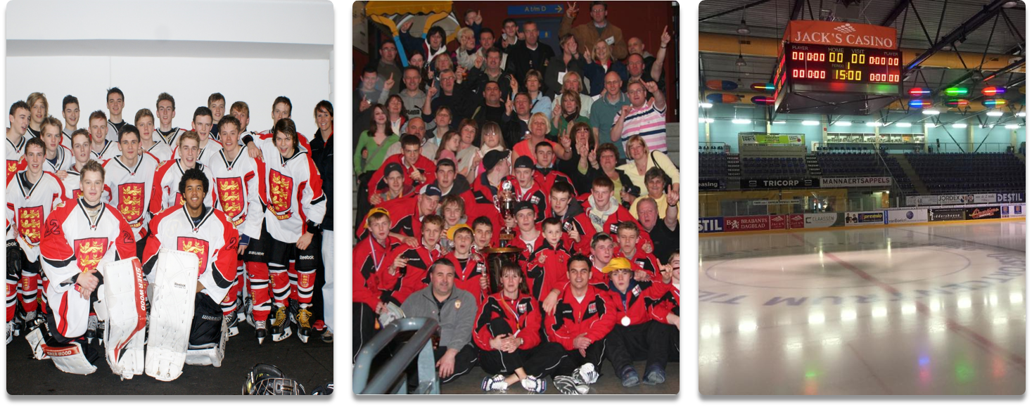
Ice hockey Swindon Wildcats (2000 to 2004) England and GB ice hockey

Slide 11
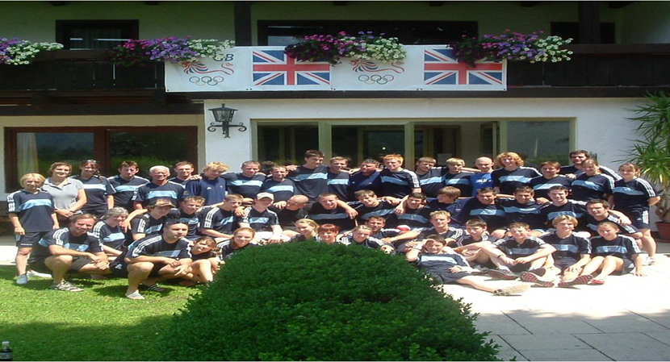
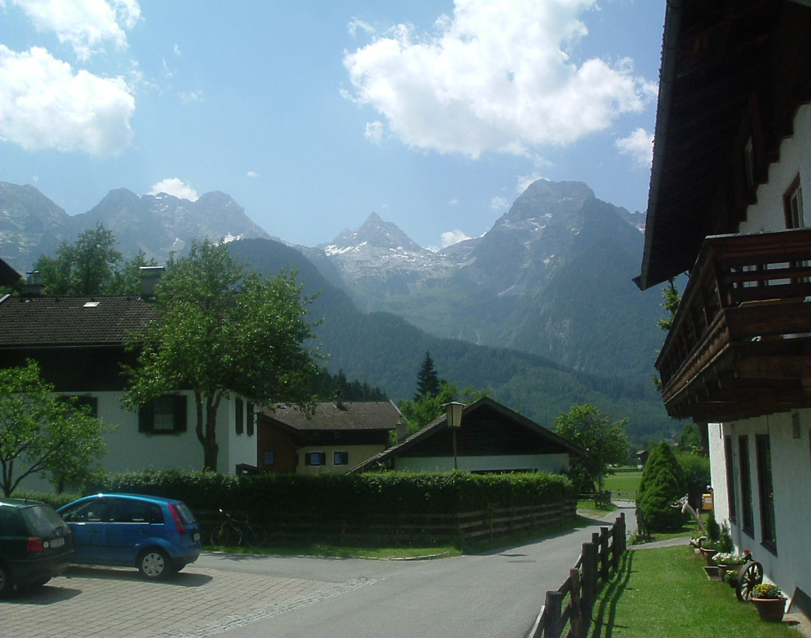
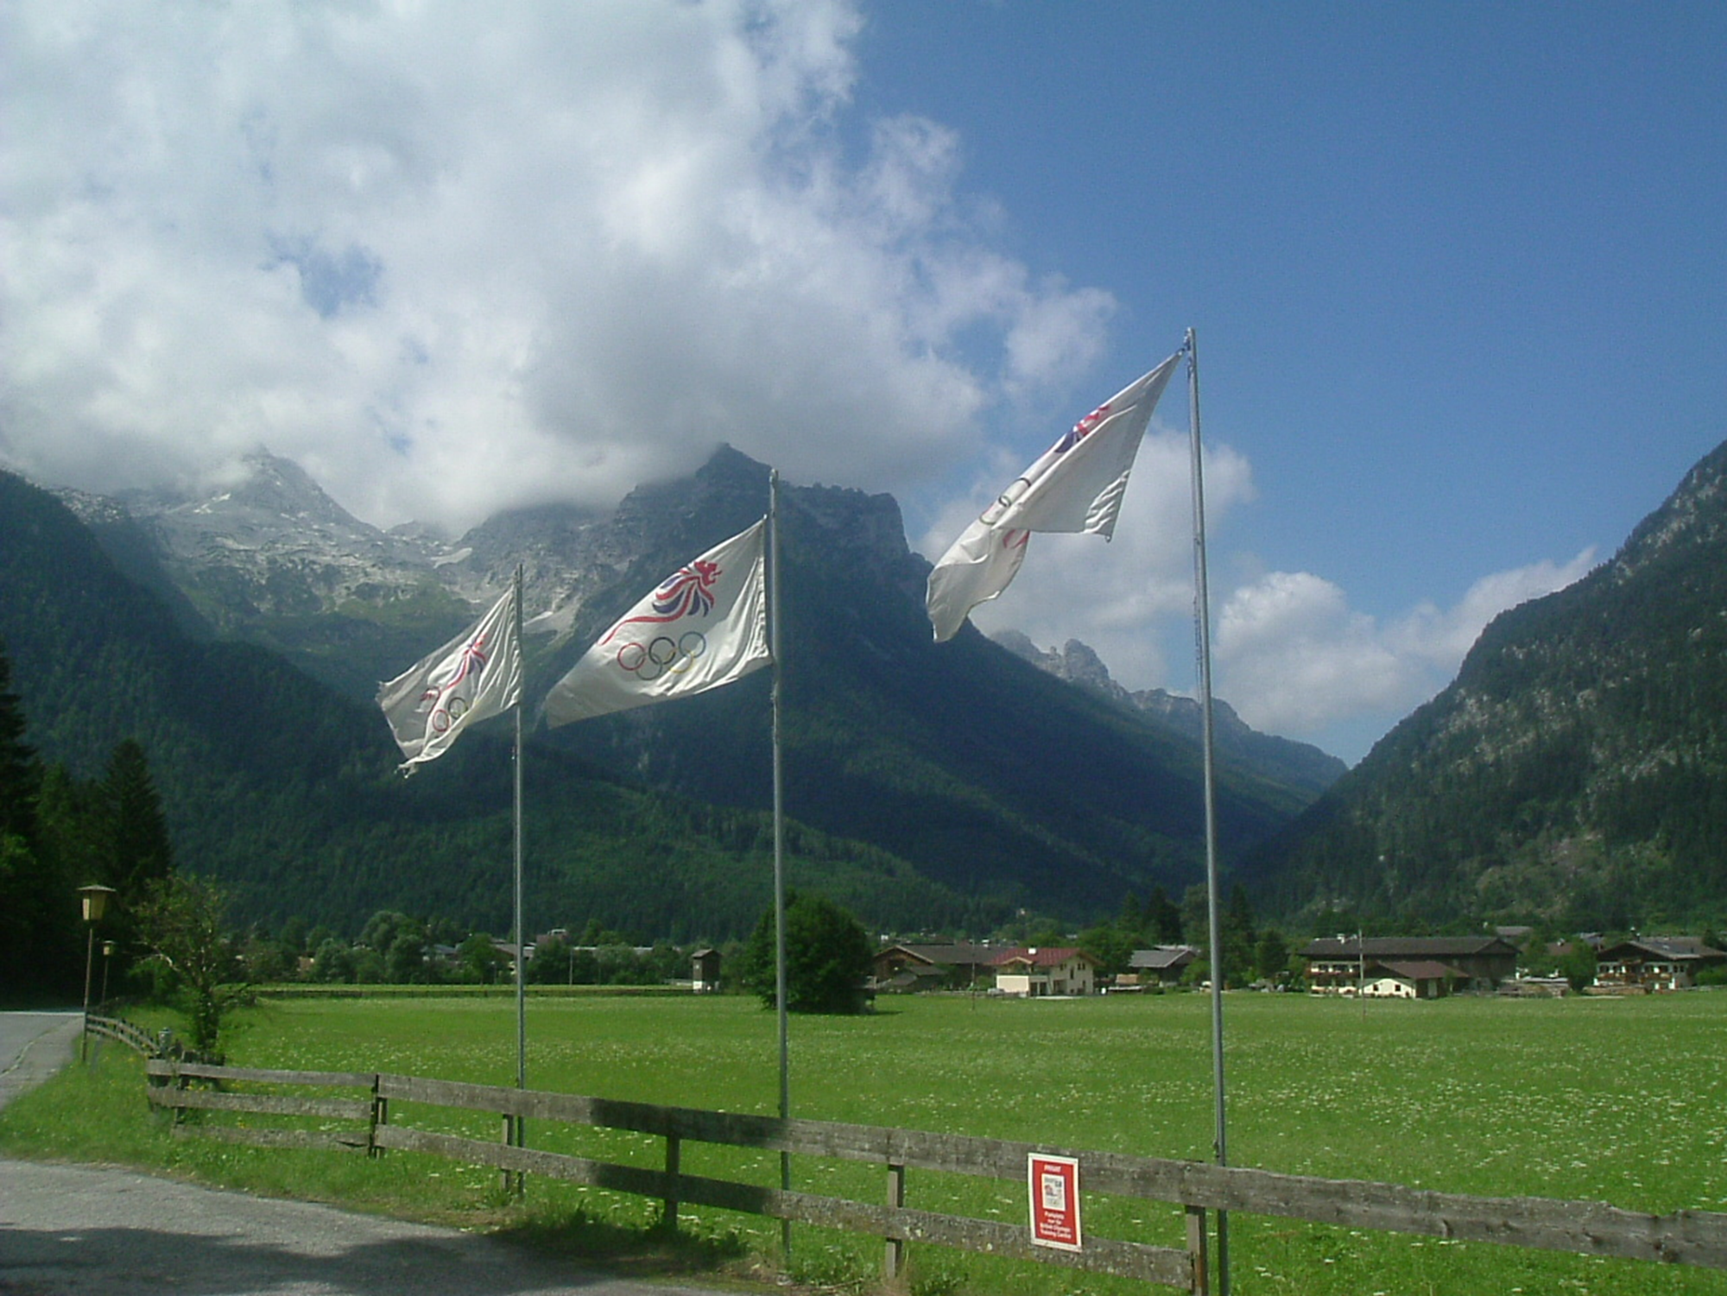
GB Winter Camp Lofer 2004

Slide 12
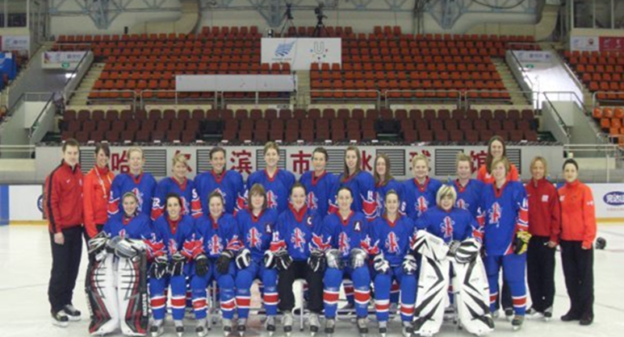
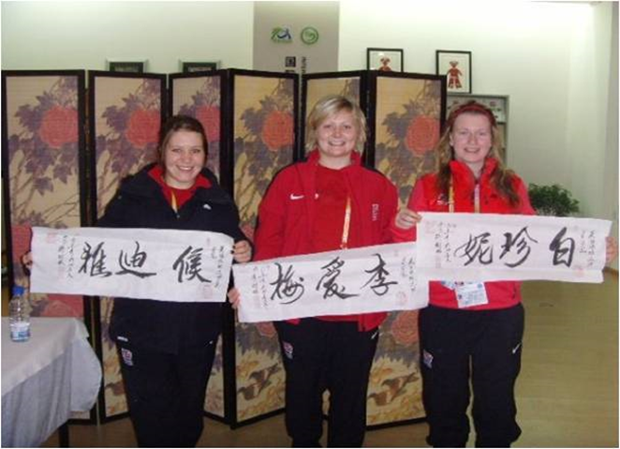
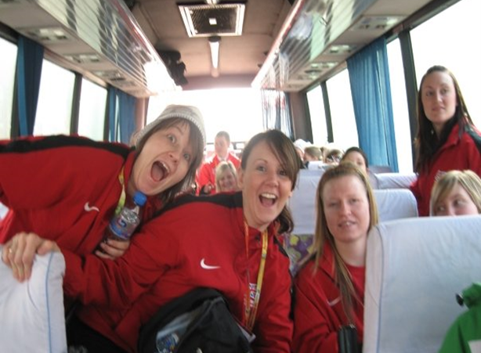
World Student Games Harbin 2009

Slide 13
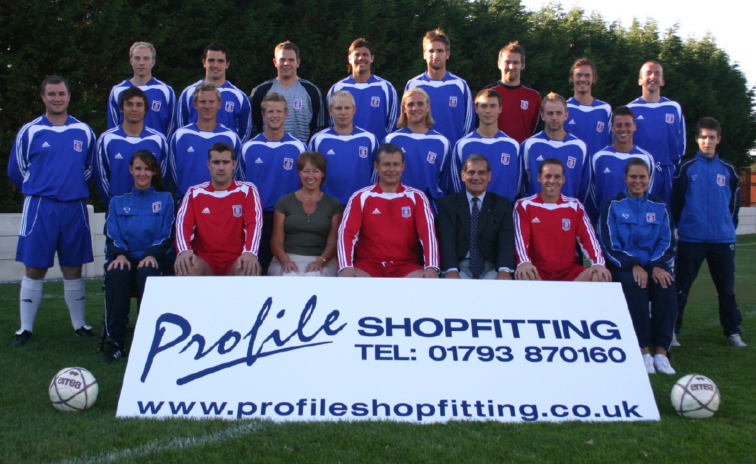
Starting in football

Slide 14
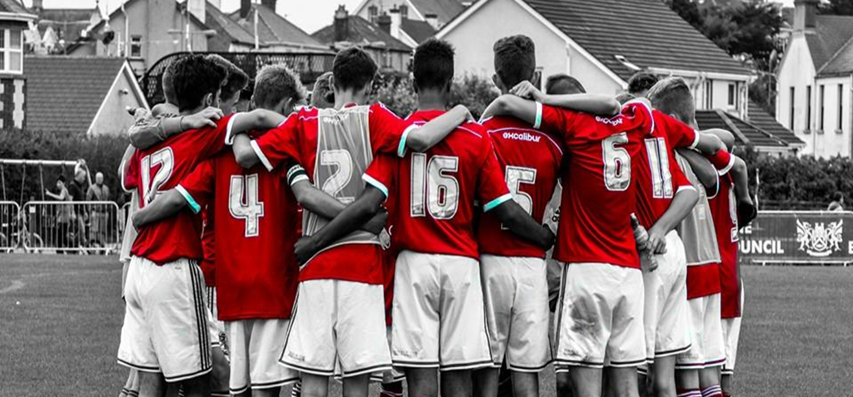
Academy Level football (2006-2016)

Slide 15
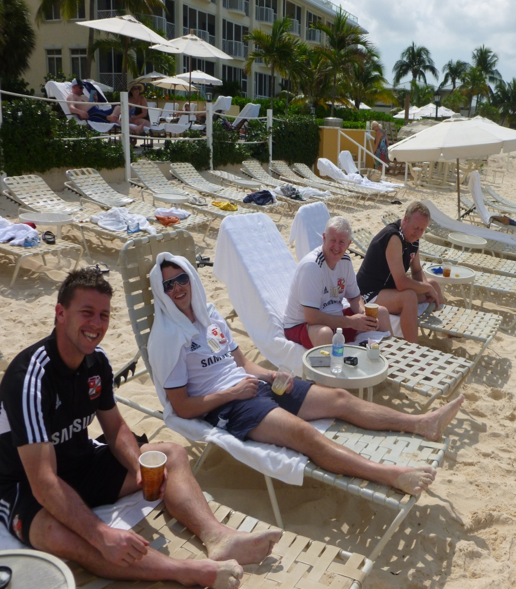
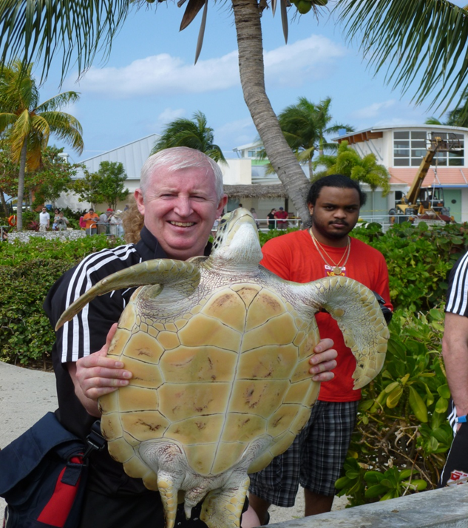
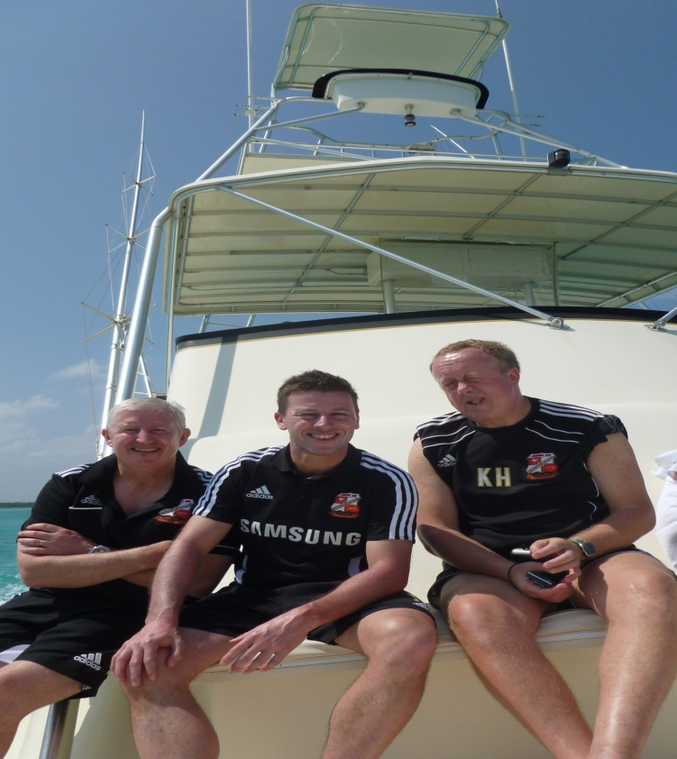
Tournaments abroad

Slide 16
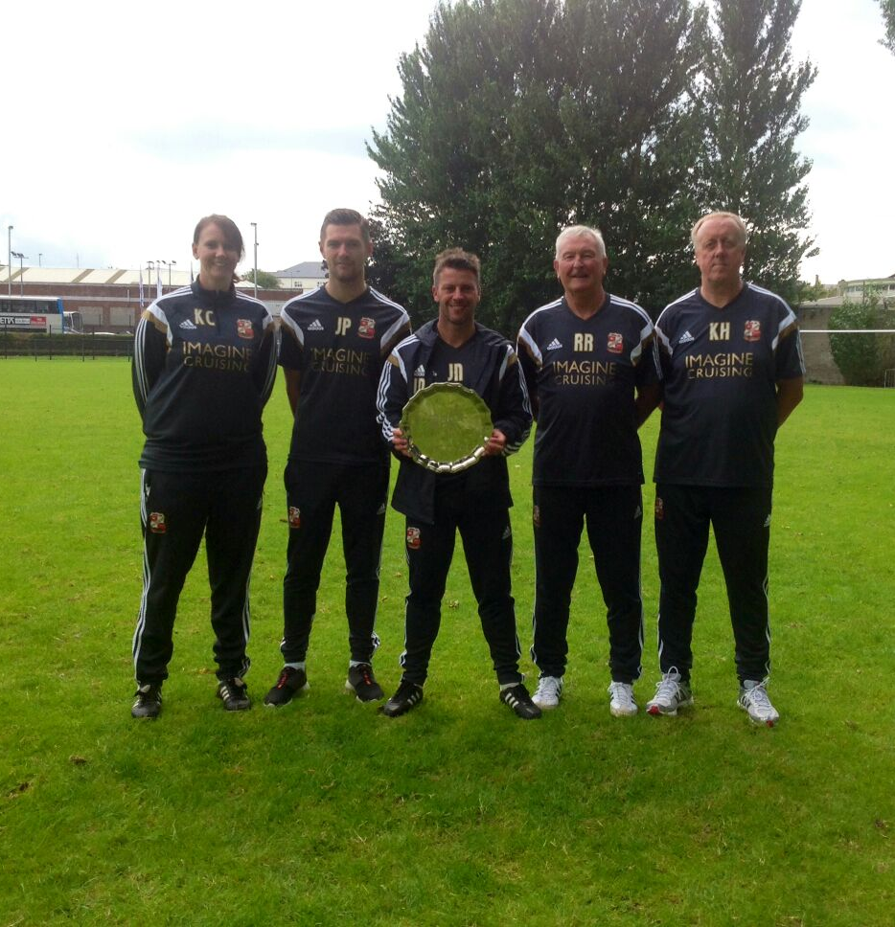
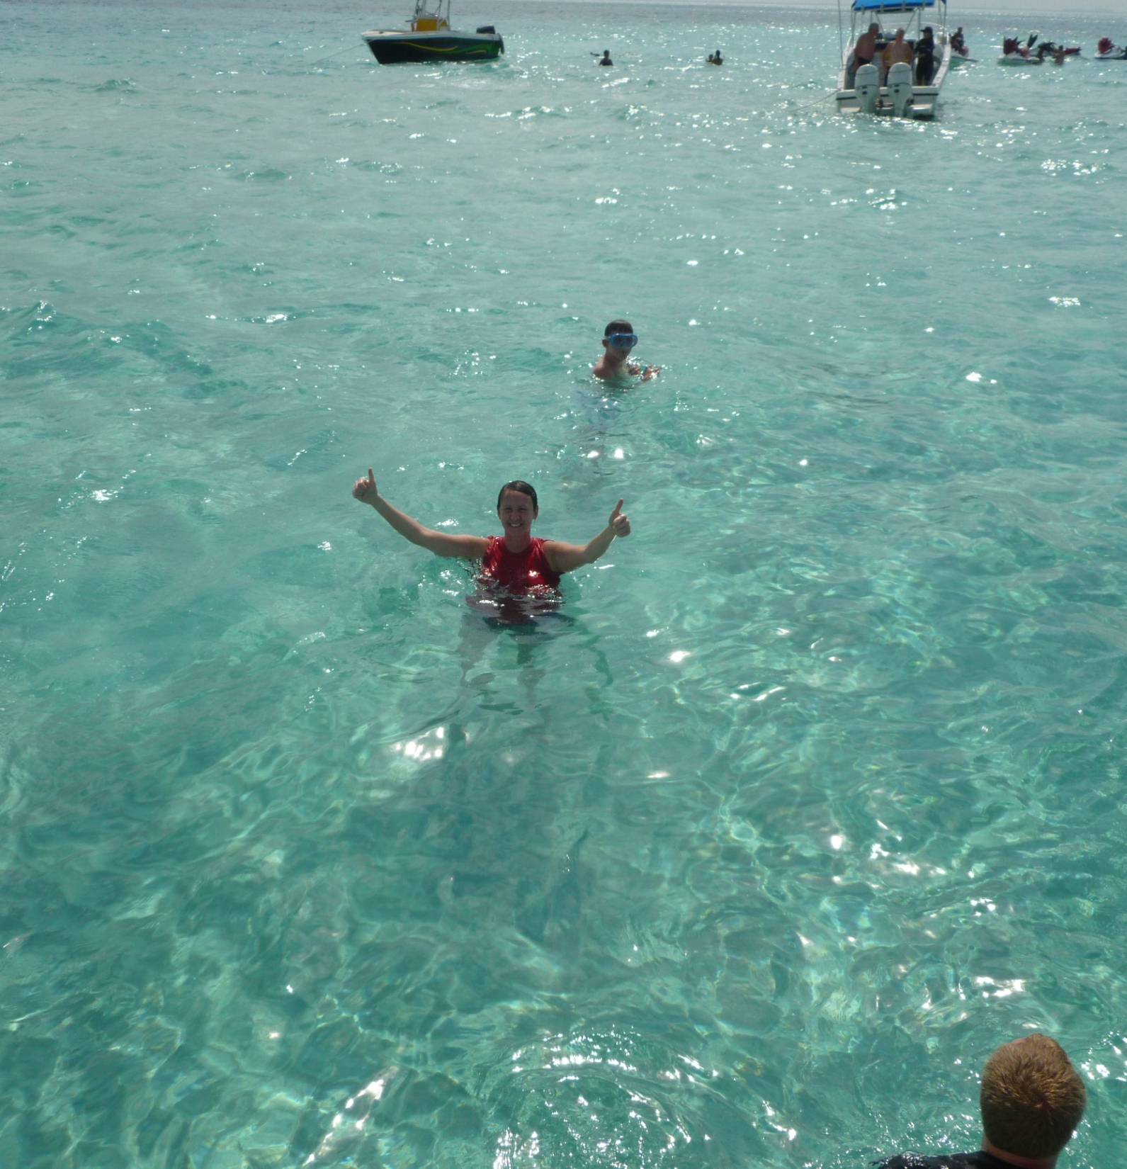

Slide 17
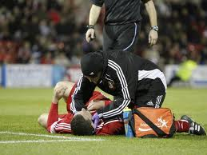
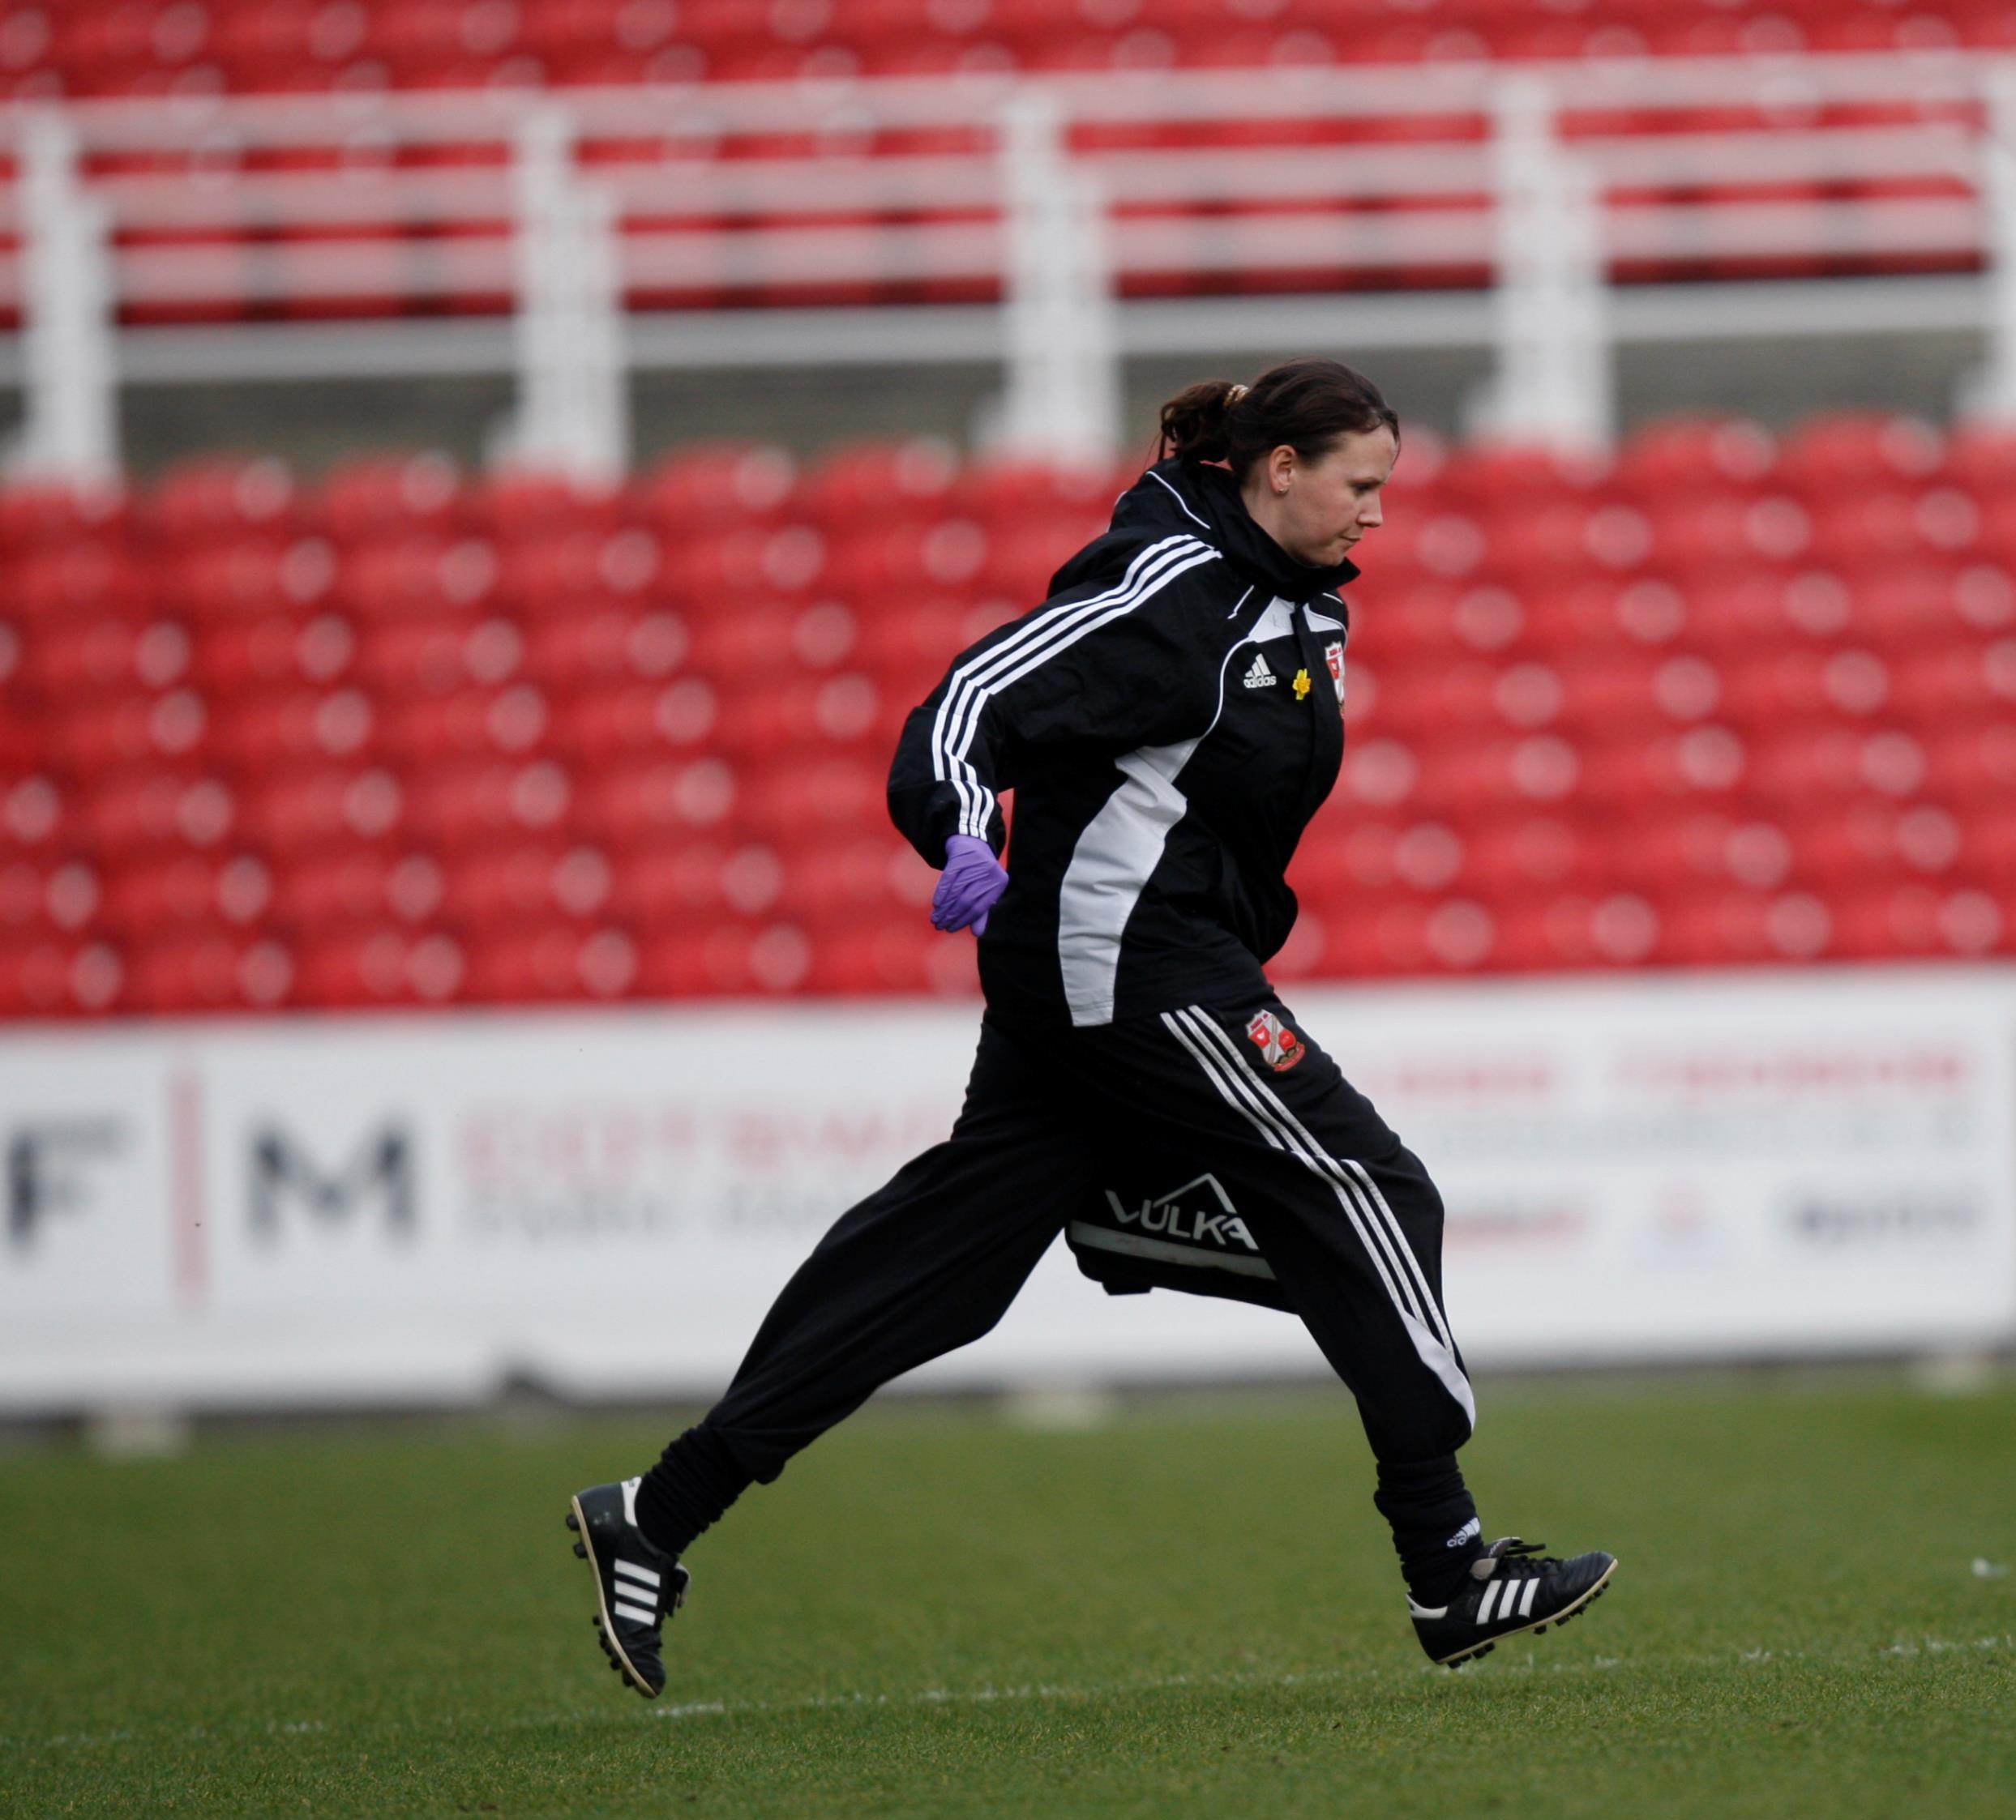
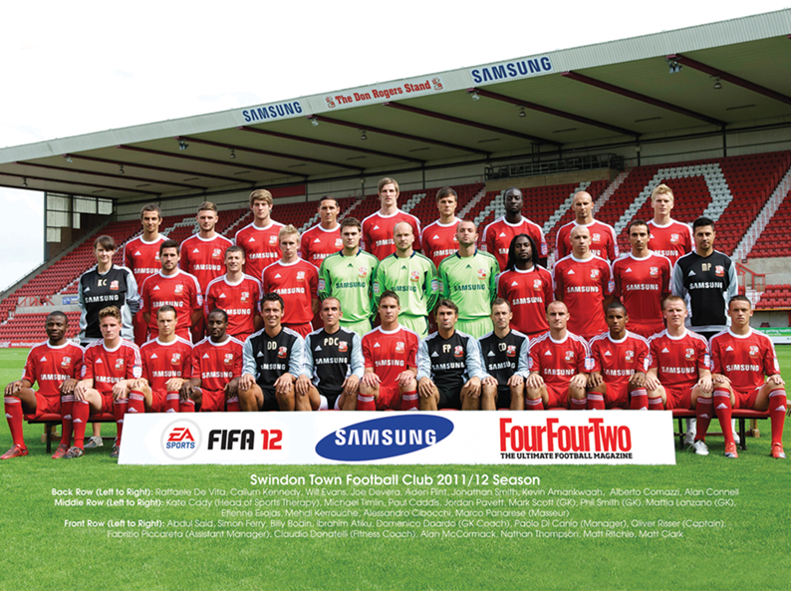
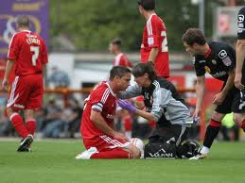
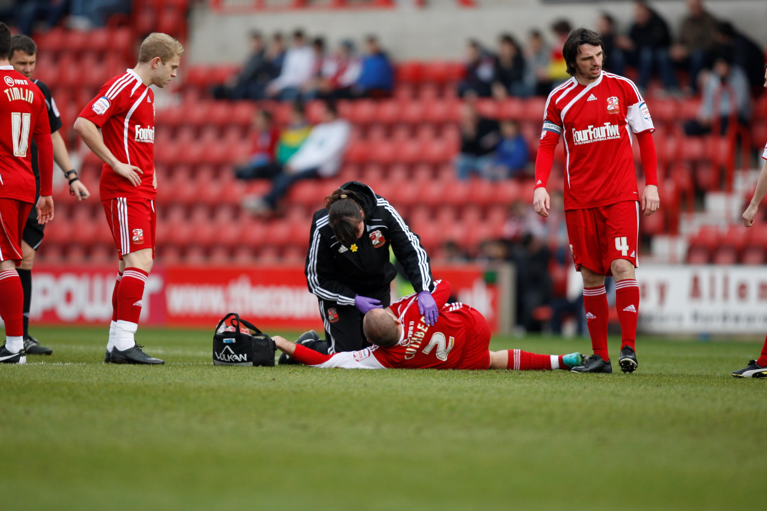
First team football

Slide 18
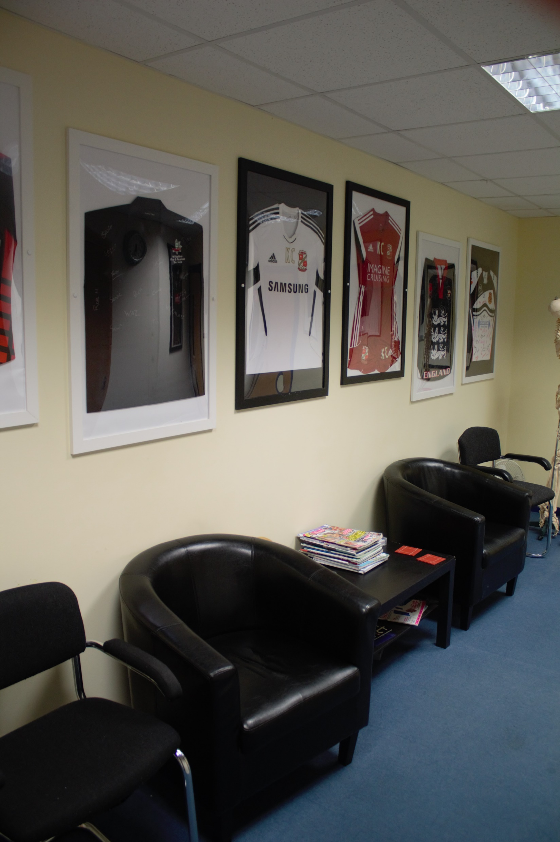
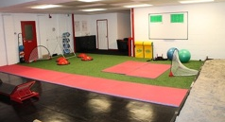
My business

Slide 19
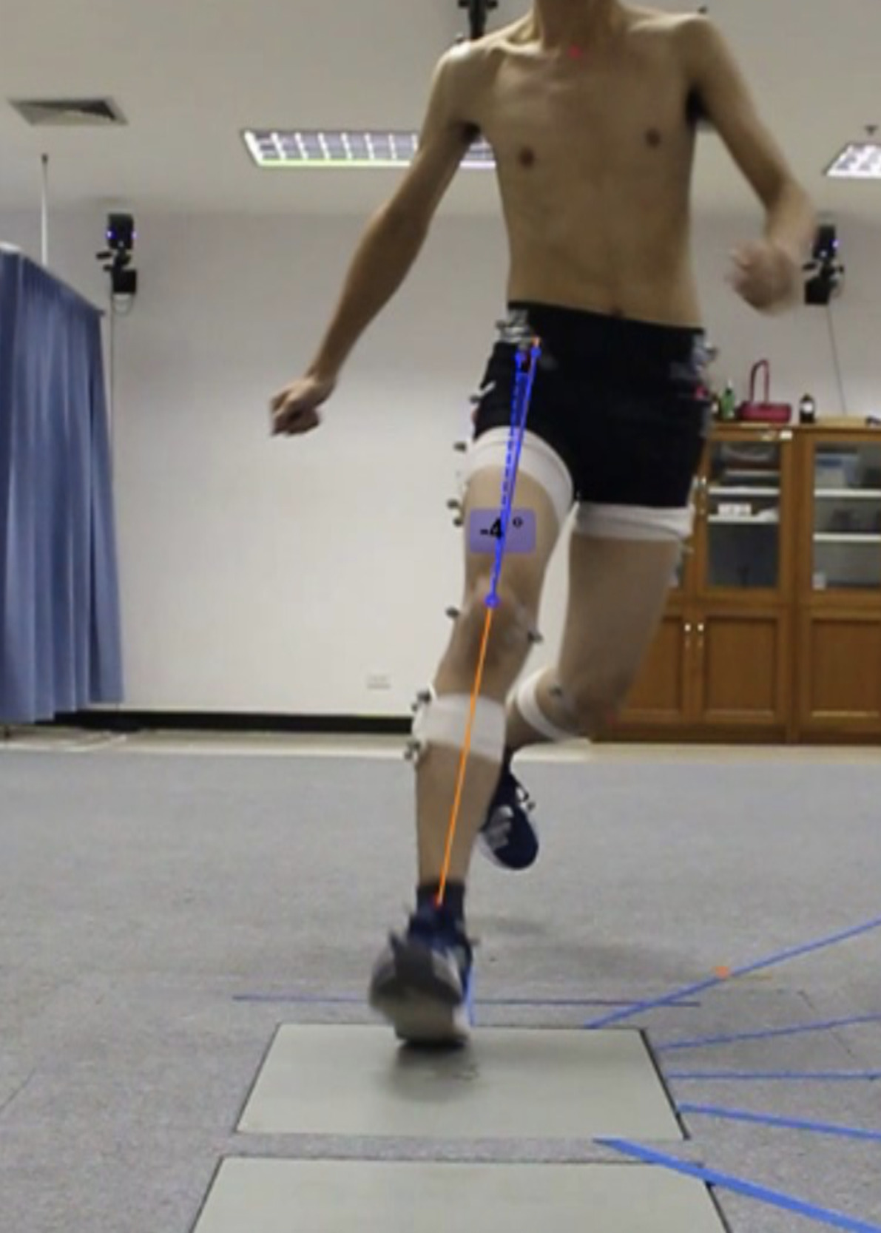
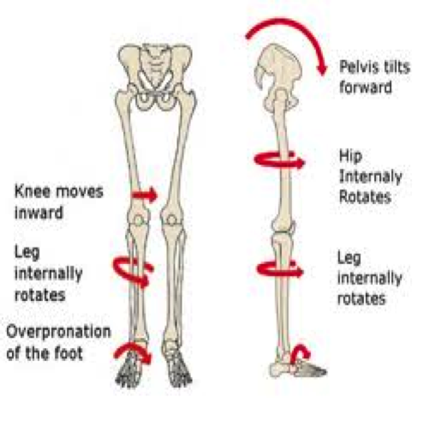
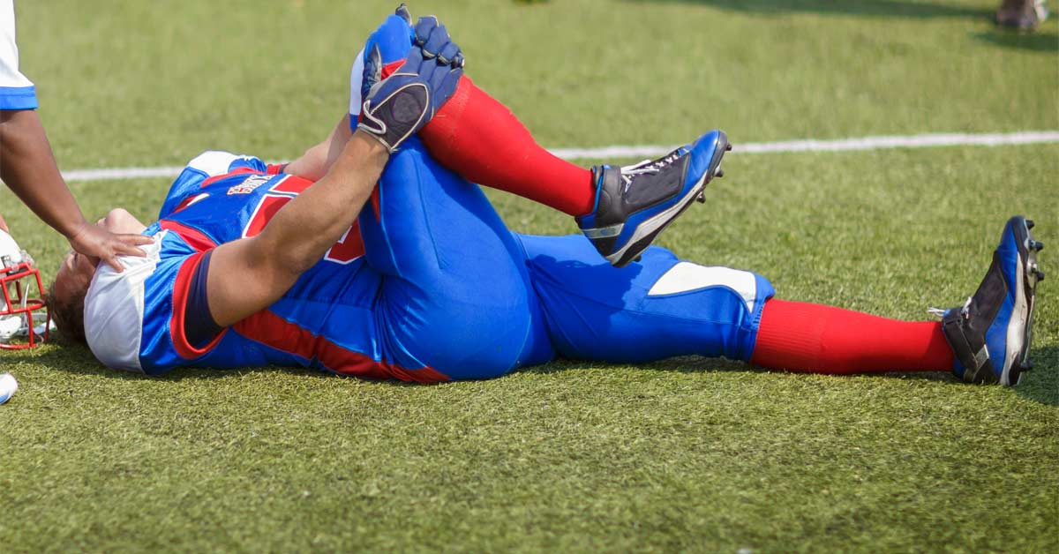
PhD Asymmetries in hip abduction strength and dorsiflexion range of motion of lower limb kinematics and kinetics during single leg landing and sidestep cutting
Irawan DS, Huoth C, Sinsurin K, Kiratisin P, Vachalathiti R, Richards J. Concurrent Validity and Reliability of Two-dimensional Frontal Plane Knee Measurements during Multi-directional Cutting Maneuvers. IJSPT. 2022;17(2):148-155

Slide 20
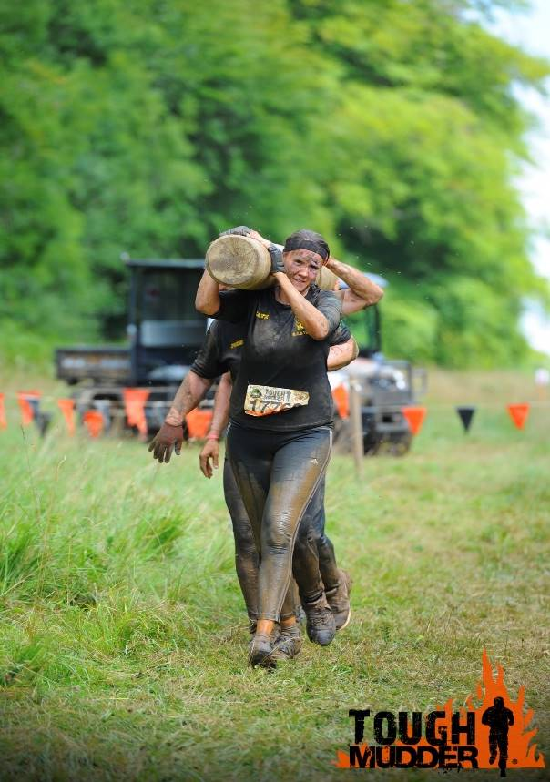
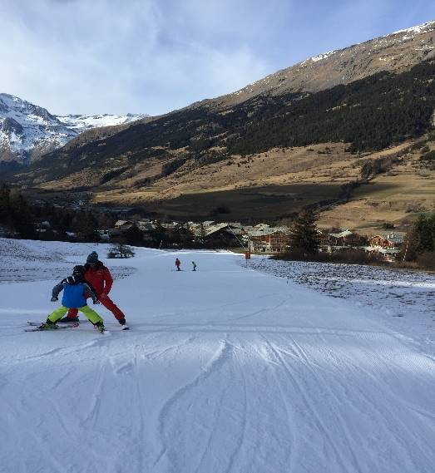
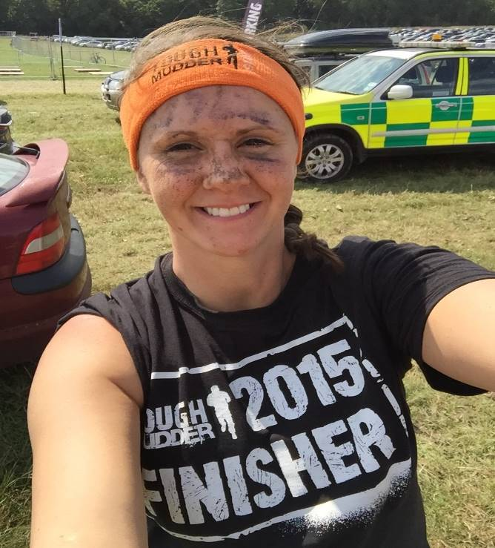
New Sports

Slide 21
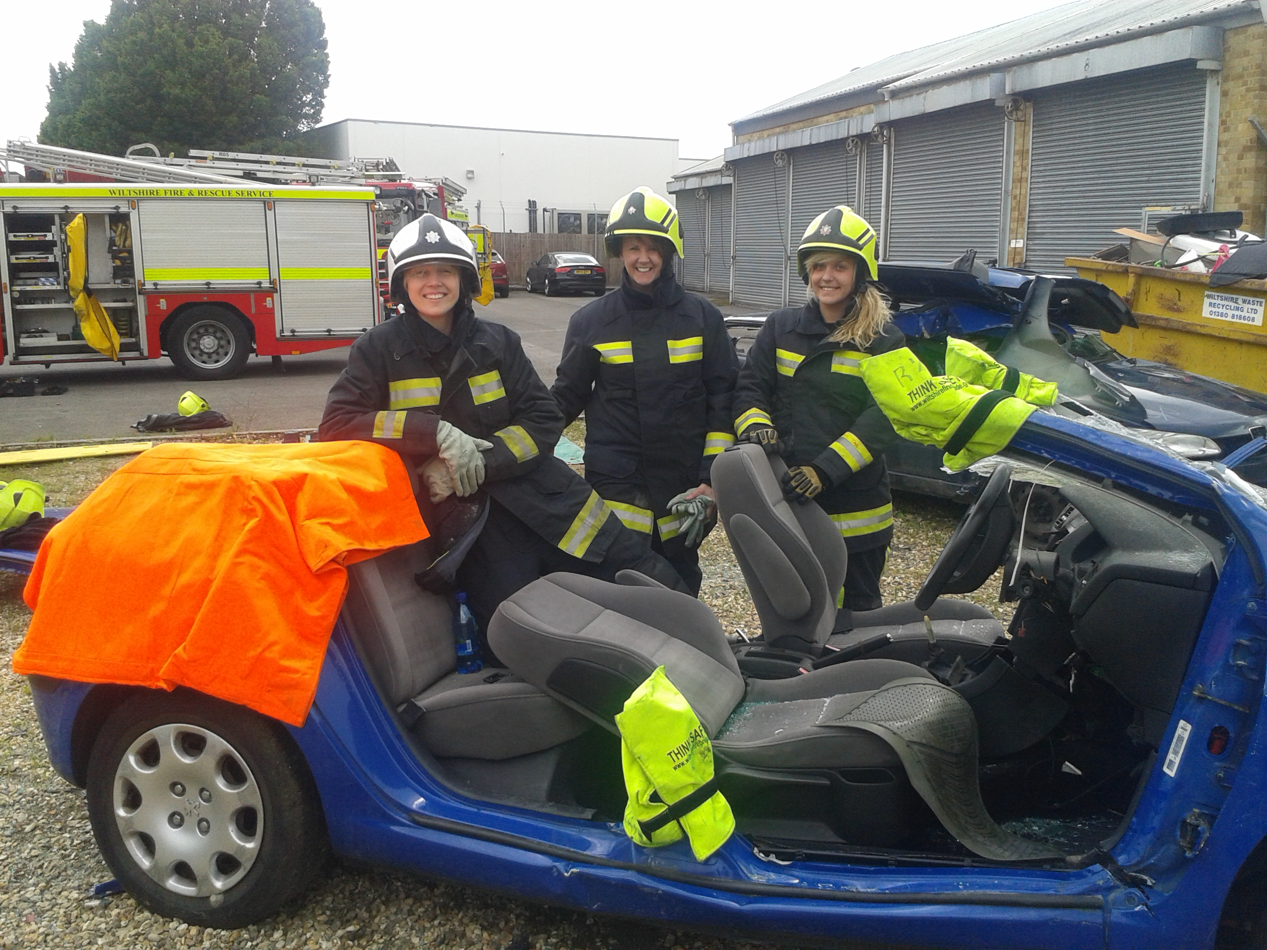
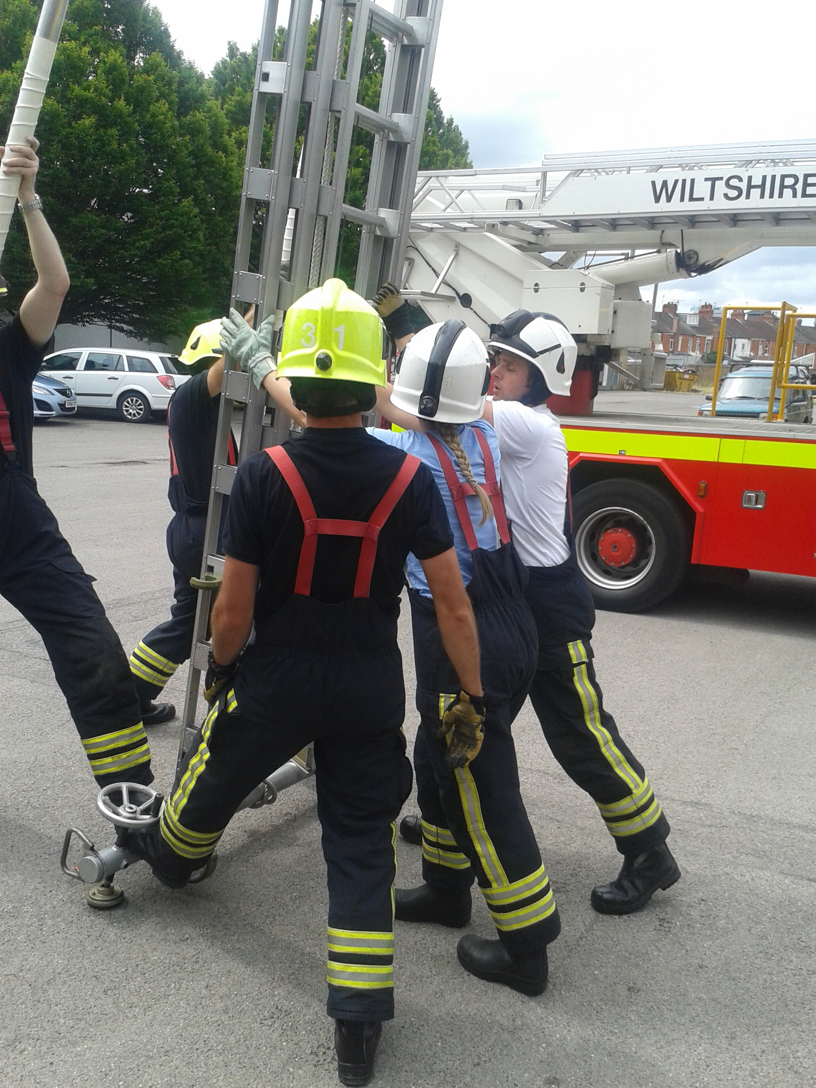
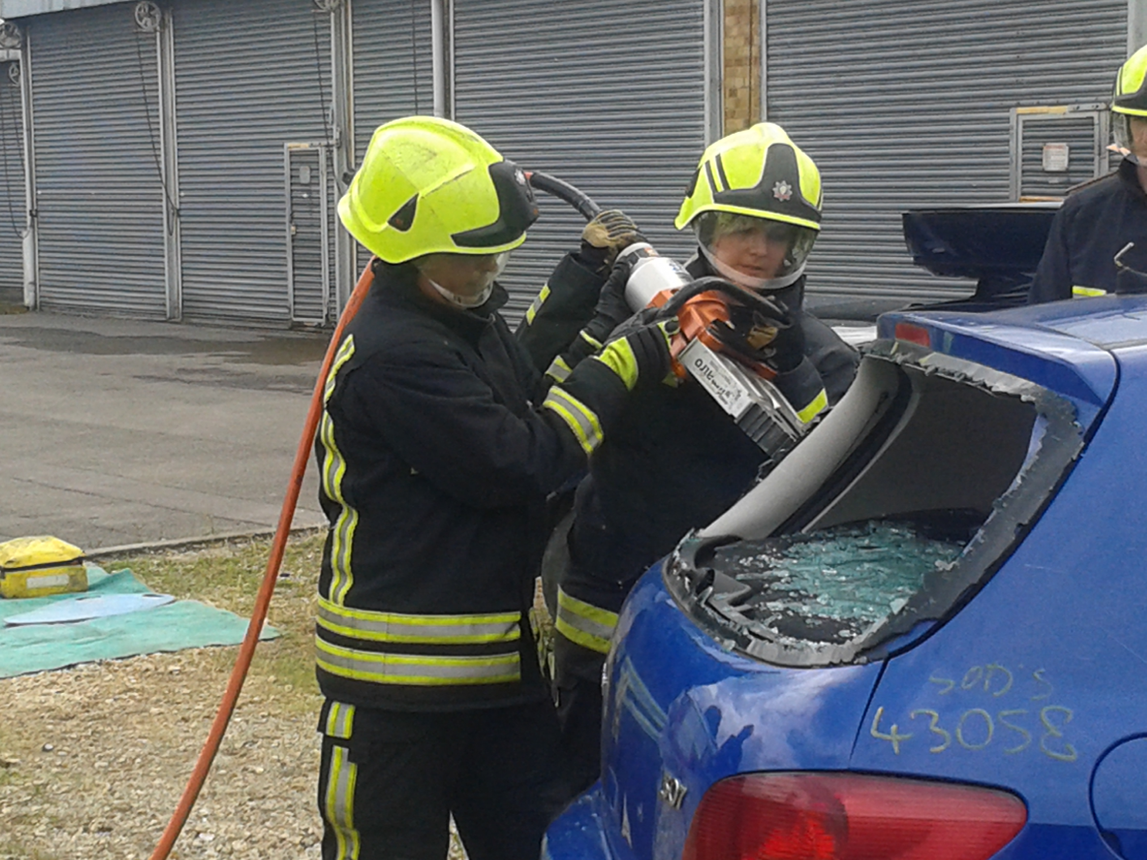
Understanding jobs….

Slide 22
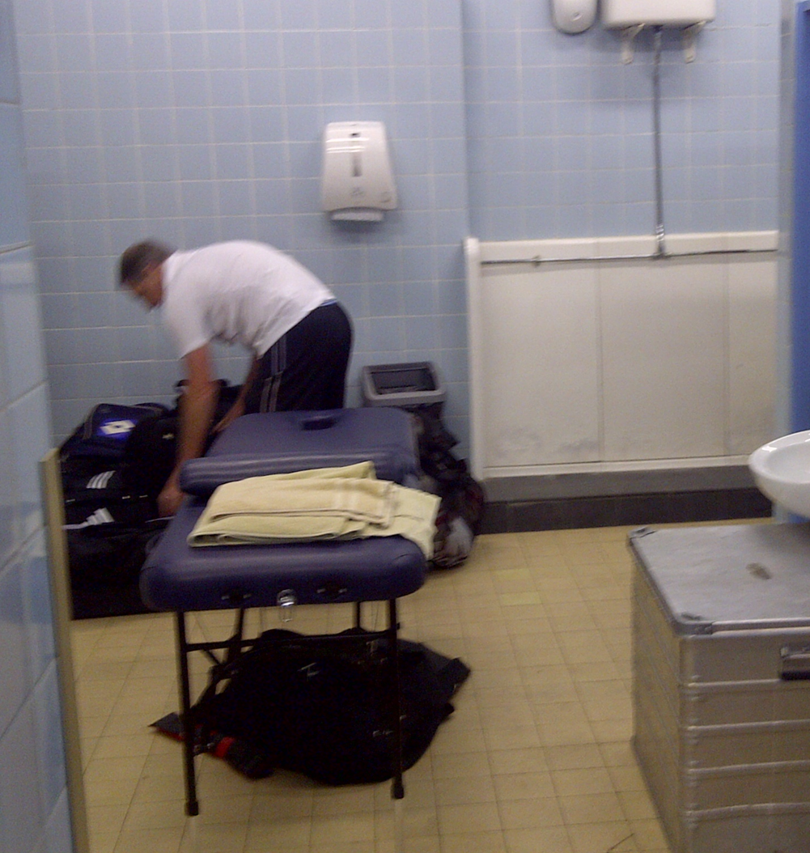
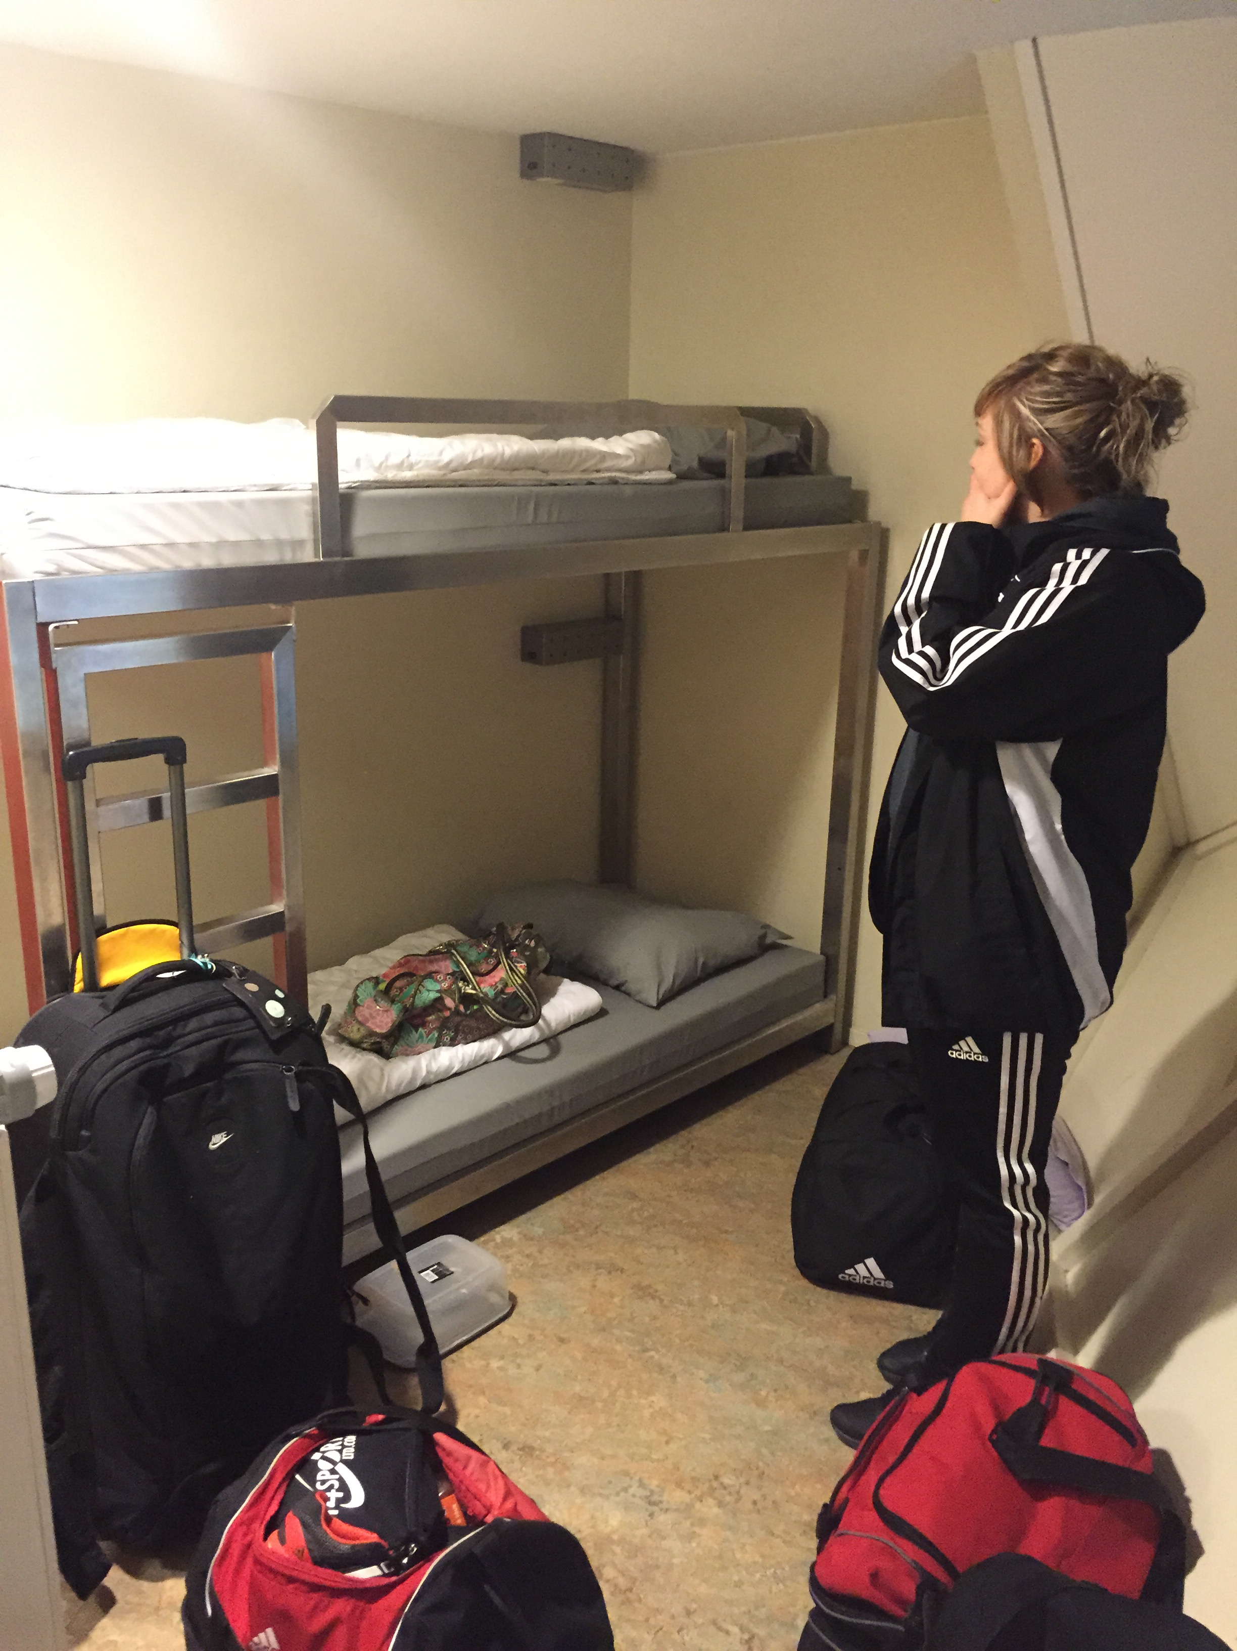
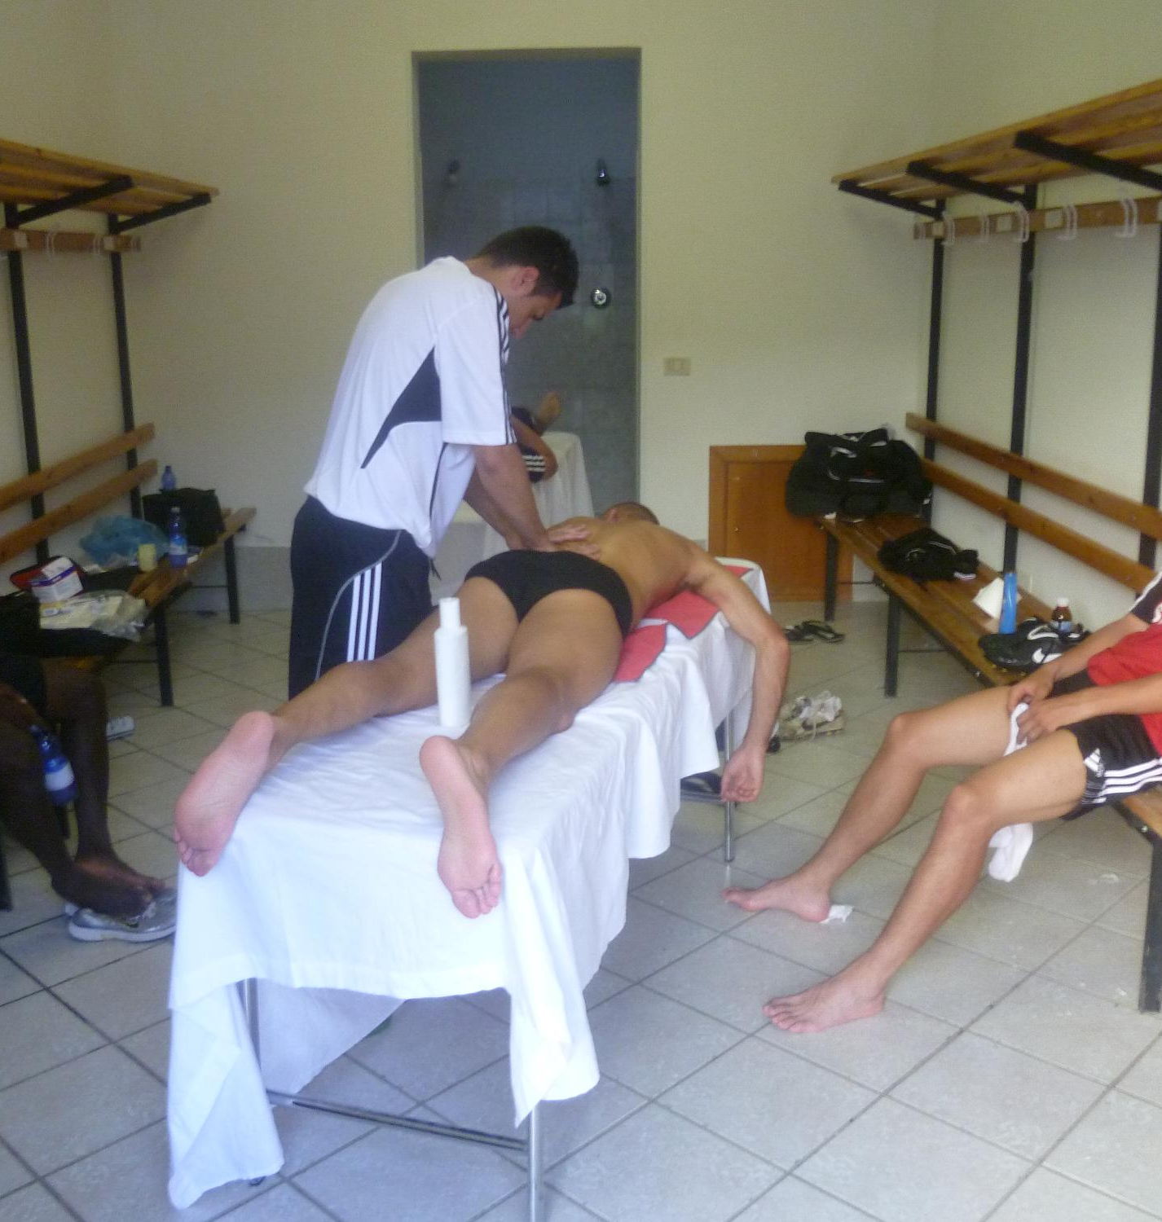
Reality of working in sport

Slide 23
But, sometimes, pretty amazing things happen

Slide 25
Graduate Sports Therapist
prevention
Recognition and evaluation
Management
Rehabilitation
Education

Slide 26
Summary
There will be mistakes – reflect and learn
Protect your income – what happens if you cannot work?
Say yes to different opportunities
Get lots of different experiences
Networking is key
Always be professional
It takes time to build a reputation and get contacts
Don’t worry if there are some set backs. Reflect and learn from them
Enjoy the journey

