Slide 1



‘Higher Education Tripartite Practitioners’ as an emerging role in UK Higher Education
Notes:
Poll to be added from slide 9, slide 13, slide 16 and slide 21

Slide 2




Dr Helen Charlton
Associate Professor – Work-aligned Learning
& Head of Executive Education
Dr Phil Power-Mason
Head of Strategic Management
& Academic Manager for Executive Programmes

Slide 3
Context
Background: UK Higher & Degree Apprenticeships (HDAs)
Who are Higher Education Tripartite Practitioners (HETPs)?
Study aims & methods
Key findings (3)
Implications & recommendations
Future research
Q&A

Slide 4
UK Higher & Degree Apprenticeships (HDAs)
Levels 6–7 (Bachelor & Master’s equivalent) blending work + study
Funded via the Apprenticeship Levy (tax on large employers)
12 occupational routes; Business, Administration & Law = 47% of starts (2022/23)
Tripartite relationship: apprentice • employer • higher education provider

Slide 5
Why do we have a ‘Tripartite Practitioner’ role?
Regulatory influence
ESFA leaves it to the provider to determine who undertakes statutory progress reviews; Ofsted extends delivery requirements from traditional ‘HE’ programmes
Cross-sector evidence
Growing cross-sector consensus that the success of the tripartite relationship is critical to apprenticeship success (Gov.uk; IfATE; UVAC; CMI; ILM; Minton & Lowe, 2019; Roberts et al, 2019 etc.)
'Sub-altern educator’
FE driven definition of the role taken by former competence assessors in the new apprenticeship frameworks (Esmond, 2019)
Workforce development in Apprenticeship
FE focussed

Slide 6
Study Aims
Map how HETP roles are configured in English business schools
Explore responsibilities, workload & professional identity
Surface tensions between compliance and learner development

Slide 7
Method
Mixed‑methods around a one‑day CPD event
Surveys: 76 registrants (25 HEIs) + 32 attendees (9 HEIs)
Focus groups: 12 hours across 4 apprenticeship stages (ISA, PRM, EPA, Enhancement)
Template analysis of transcripts

Slide 8
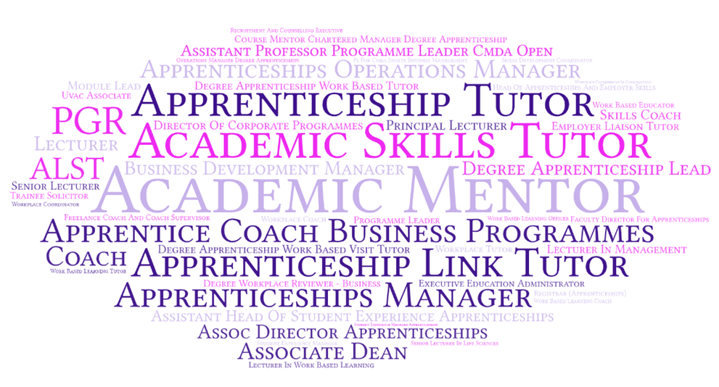
Finding 1 – Role Diversity
Wide variation in onboarding → offboarding responsibilities
54 distinct job titles across >30 HEIs
Common descriptors: coach, tutor, academic; workplace / employer focus

Slide 9
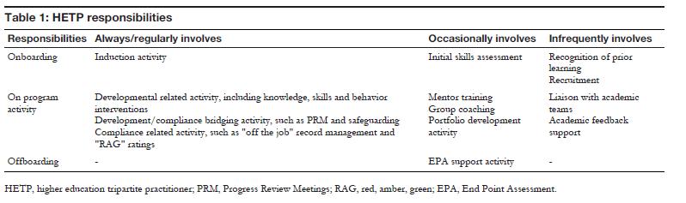

Slide 10
Finding 2 – Pedagogical Tension
Balancing developmental coaching vs. compliance responsibility
Early onboarding critical for relationships; late involvement leads to duplication and disconnect
Time‑pressured PRMs limit depth of discussion, and tracking tools (e.g. RAG ratings) can erode trust
Additional activity outside of compliance helpful, but time is limited
This has impacts at end point – which matters – finishing on time, or with the best possible result?

Slide 11
Finding 2 – Pre-enrolment engagement is key
…if that initial process of ISA is done centrally and the learners aren't really involved with a coach… that might lead to disconnect… they don't really understand that they're coming in on an apprenticeship
What we found is that when we’re part of onboarding, we start the relationship off really well. [It] makes a huge difference to engagement down the line.

Slide 12
Finding 2 – Compliance overtakes development
I get a bit overwhelmed with how much I've got to cover in an hour. I just feel like the list is getting longer and longer that we've got to be responsible for and to be compliant with and to check this and check that...
We have a particular system where if the off-the-job learning is below target, it just highlights in red, red, red. So, it looks really negative even though they might just be a few hours below… it makes them feel like they’re failing.
[We’re] spending so much time on compliance that we’re not focusing on meaningful engagement. We’d love to do more development activities, but it feels like we’re just ticking boxes rather than actually supporting learners to grow

Slide 13
Finding 3 – Boundary-spanning roles
Contracts: ~50% academic, ~50% professional services; 71% part‑time
Almost all employed by HEI; one freelance example
Highly qualified academically, but few hold pedagogy / coaching awards
Role crosses institutional boundaries yet lacks formal recognition

Slide 14
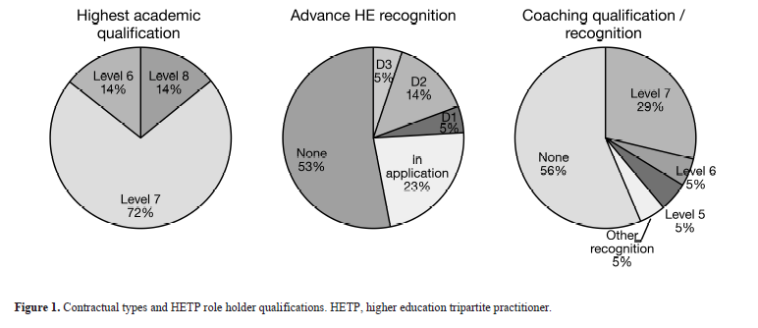

Slide 15
Summarizing English Business School Higher Education Tripartite Practitioners
Typically part-time, experienced, hold other academic/professional roles
Highly qualified, but not necessarily as coaches, or as HE practitioners
Support approx. 62 learner FTE, with clearly defined typical responsibilities
Complex role with dynamic tensions caused by structures within institutions and apprenticeships

Slide 16
Implications for Institutions & Sector
Need for consistent role descriptors & workload models
Professional recognition pathways required
Shift focus from compliance metrics to developmental impact
Resource allocation: time for group coaching / enhancement sessions

Slide 17
Future Research Directions
Existing activity
Theorising the tensions inherent in this role and context
Extending study across disciplines beyond business schools and English context – Society of Educational Studies funded research study
Further directions
Longitudinal impact of professionalizing HETP roles on apprentice outcomes
International comparisons of boundary‑spanning roles in work‑based learning

Slide 18
Proposing an HE-TP practice model
Development
Compliance
Process
Outcomes
Continuums
Forward looking
Backward looking
Holistic
Fragmented
Disciplinarity
Modality
Collective
Individualistic
Dualities
Mentor
Coaching
Long term
Short term
Notes:
Continuums – face contradictions and tensions to navigate; navigating the shift​
Dualities – co-exist; navigating the paradox
Development – compliance – includes Ofsted vs. ESFA frameworks; qualitative vs. quantitative assessment of impact; achievement vs. timeline​
​
Holistic – fragmented – includes points of information/data​
​
Disciplinarity – modality – driven by subject knowledge vs. driven by delivery expertise​
​

Slide 19
Questions
‘Higher Education Tripartite Practitioners’ as an emerging role in UK Higher Education
Notes:
Poll to be added from slide 9, slide 13, slide 16 and slide 21

